Slide 1
The Education University of Hong Kong
2022-2023 Quality Education Fund Thematic Network - Tertiary Institutes
STEM Project Team
SCHOOL: KSK 東華三院鄺錫坤伉儷中學
TOPIC: 3D printing (Fish Feeder)

Slide 2
Objective
To learn the design of fish feeder using 3D printing

Slide 3
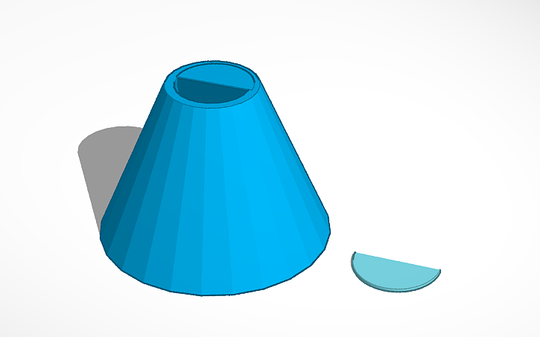
Model 1

Slide 4
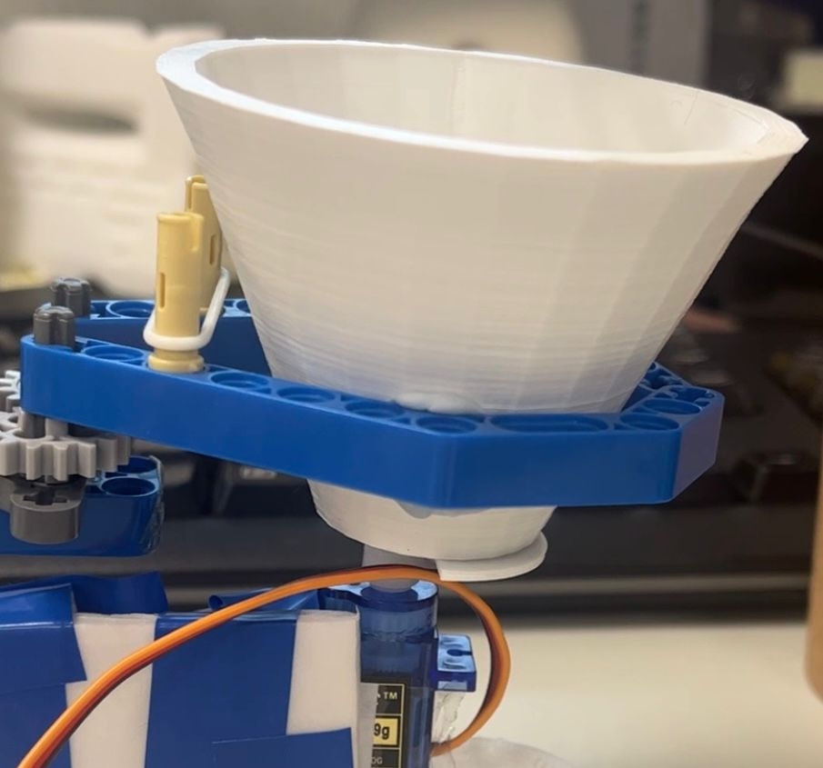
Result

Slide 6
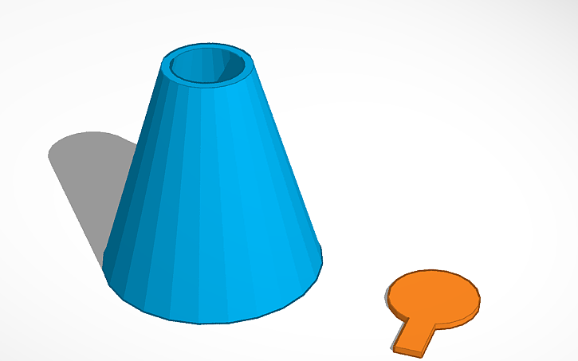
Model 2

Slide 7
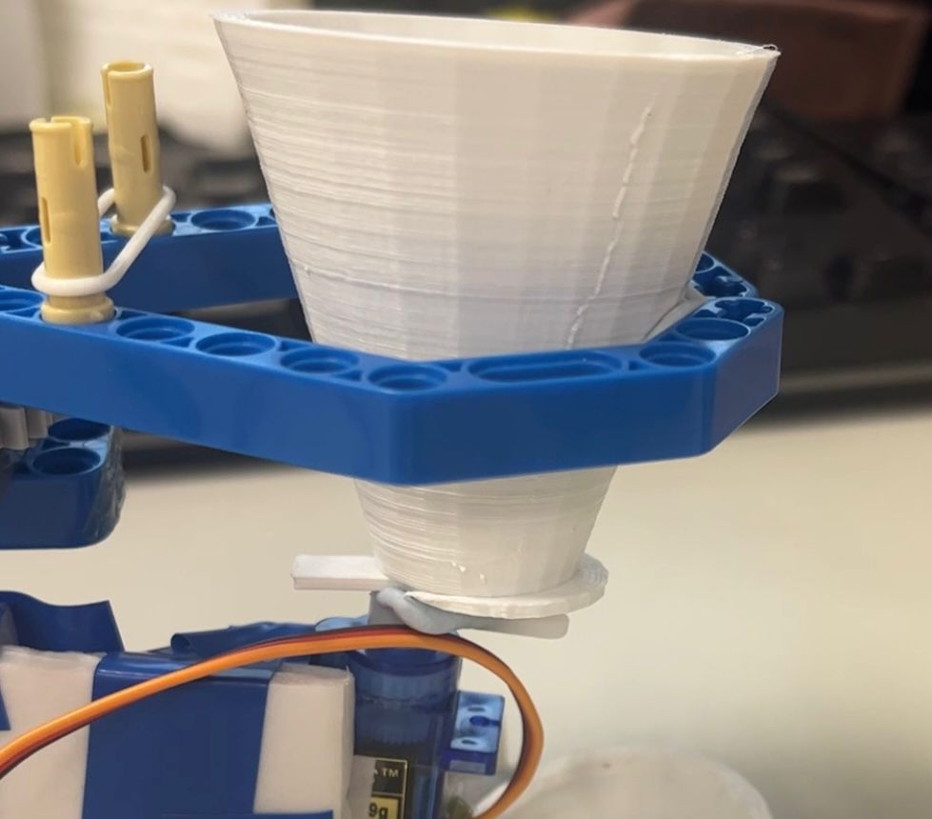
Result

Slide 9
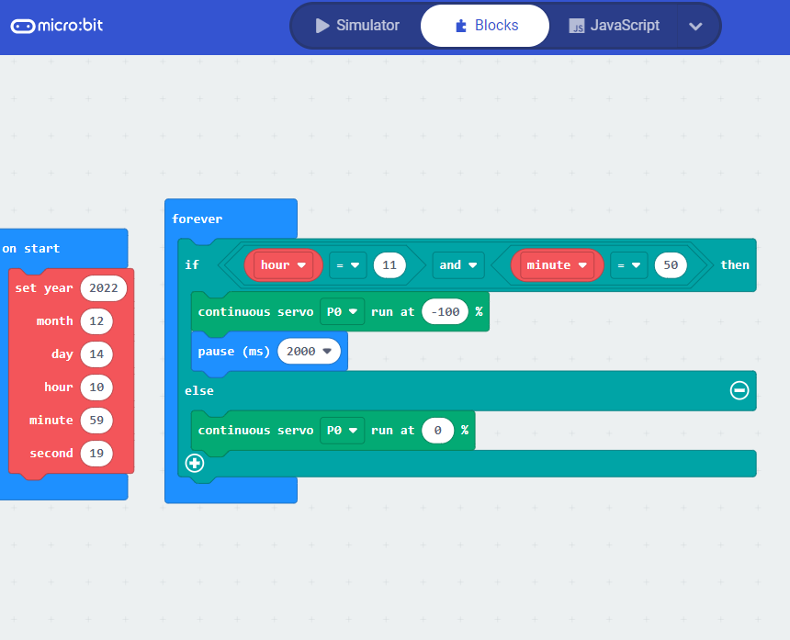
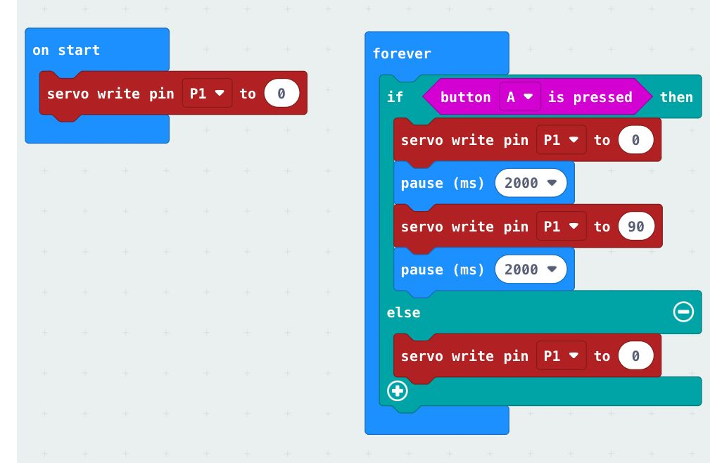
Micro:bit Code

