Slide 1
The Education University of Hong Kong
2022-2023 Quality Education Fund Thematic Network - Tertiary Institutes
STEM Project Team
SCHOOL:東華三院鄺錫坤伉儷中學TWGHs Mr & Mrs Kwong Sik Kwan College
TOPIC: Fish Tank Sensor

Slide 2
Topic
To monitor different condition of fish tank

Slide 3
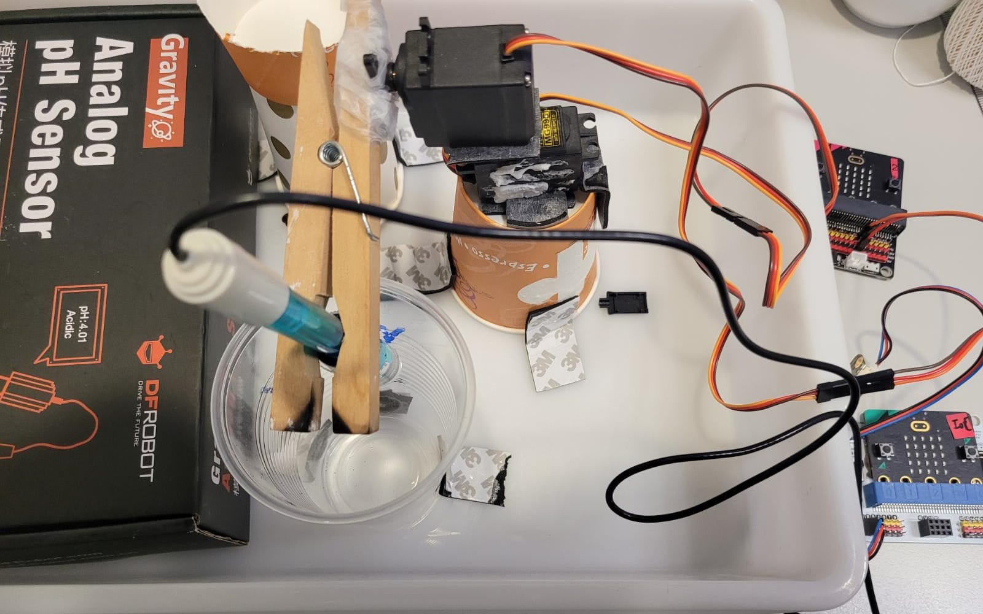
Experiment 1 material
2 mg996r
2 microbit
1 IoT bit
1 extension board (5V)
1 test tube holder
1 gravity: analog pH sensor

Slide 4
Objectives of Experiment 1
To washing the pH sensor after take the pH reading of the fisk tank water
Upload the pH value to ThingSpeak everyday

Slide 5
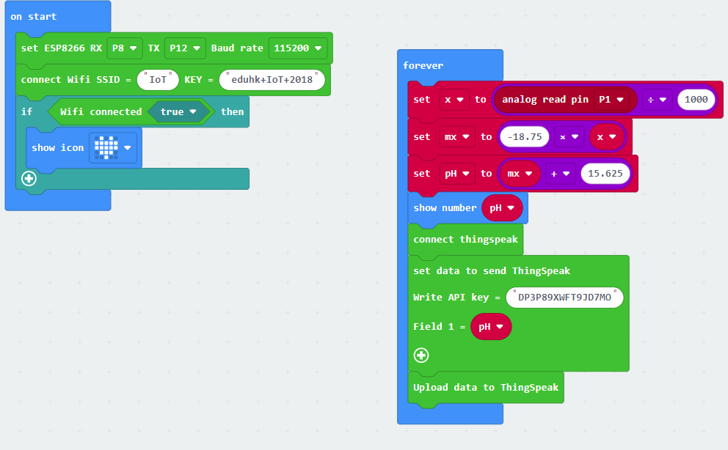
Coding for pH sensor

Slide 6
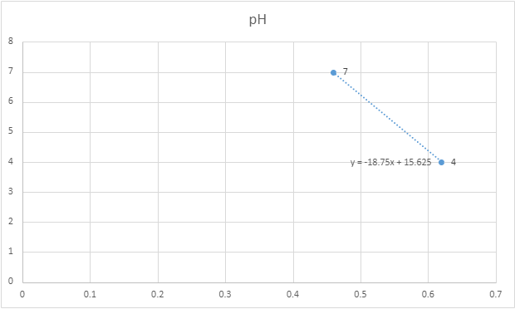
Calibration
reading | pH
0.46 | 7
0.62 | 4

Slide 7
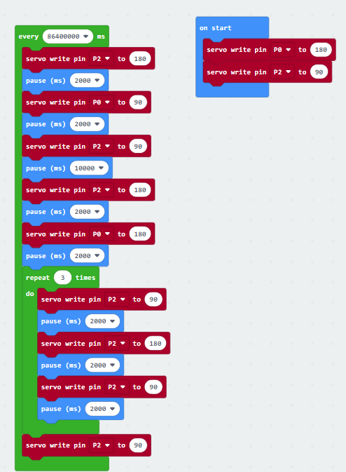
Coding for washing the pH sensor
https://makecode.microbit.org/_YF4ffUdgsab1

Slide 8
Demo

Slide 9
Objectives of Experiment 2
Upload the pH value, temperature and turbidity to ThingSpeak everyday

Slide 10
Experiment 2 material
1 microbit
1 IoT bit
1 gravity: analog pH sensor
1 Temperature Sensor DS18B20
1 SEN0189 (Turbidity)
https://thingspeak.com/channels/1898190

Slide 11
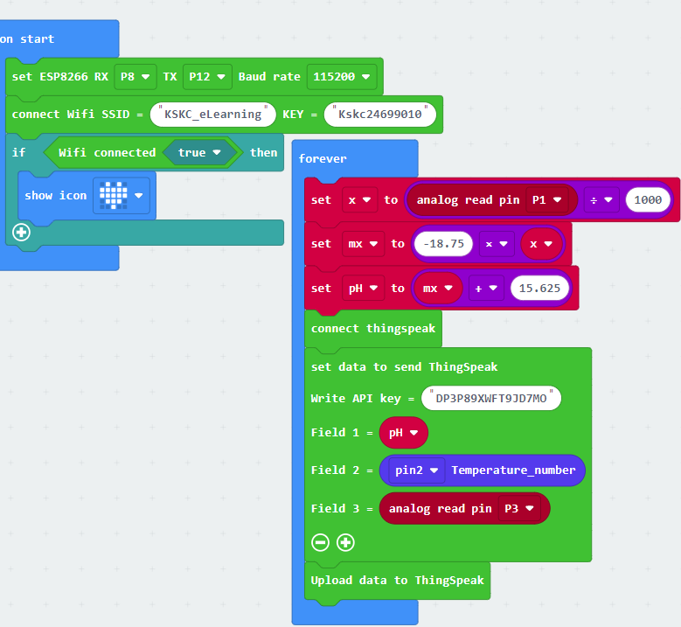
Coding for pH, temperature and turbidity
https://makecode.microbit.org/_FvHKqx5XsMzH

