Slide 1
The Education University of Hong Kong
2022-2023 Quality Education Fund Thematic Network - Tertiary Institutes
STEM Project Team
SCHOOL: 嘉諾撒聖方濟各學校 St. Francis' Canossian School
TOPIC: footstep counter (p.4)

Slide 2
Topic
打算在小冊子加入不同運動可消耗的卡路里、學生思考那種運動最有利健康、編程流程圖、學生進行測試時的注意事項及向同學推廣計步器！

Slide 3
Objectives of Experiment 1
Using the coding "Screen up" in Microbit to count footstep during walking
Using the coding "logo up" in Microbit to count footstep during walking
Using the coding "shake" in Microbit to count footstep during walking
Using the coding "3g" in Microbit to count footstep during walking

Slide 4
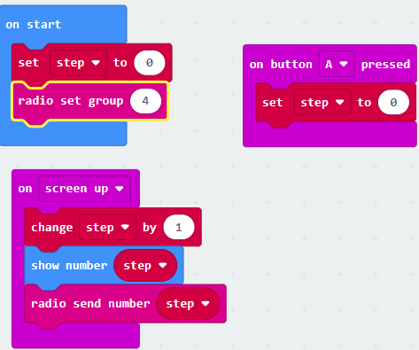
Setup 1 Screen up: Coding of sender

Slide 5
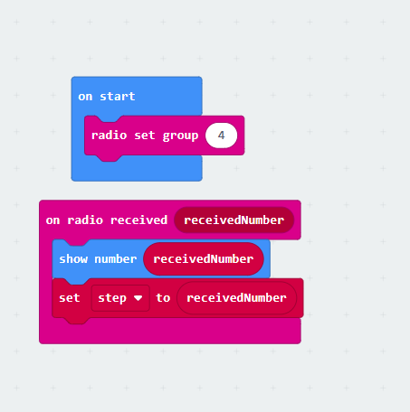
Setup 1Screen up Coding of receiver

Slide 6
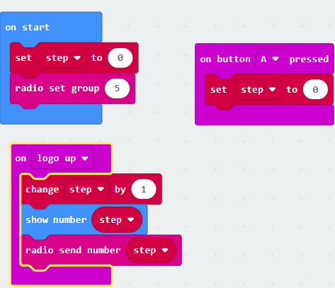
Setup 2 logo up Coding of sender

Slide 7
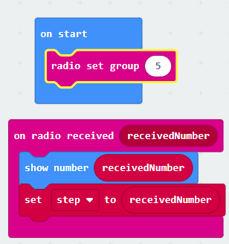
Setup 2 logo up Coding of receiver

Slide 8
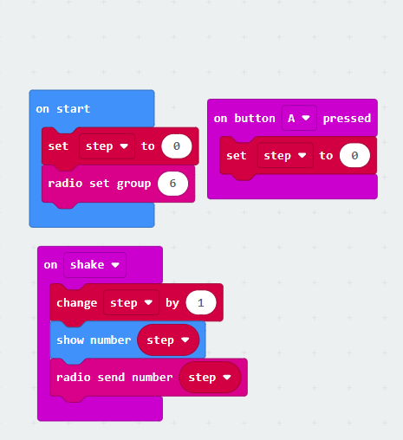
Setup 3 shake Coding of sender

Slide 9
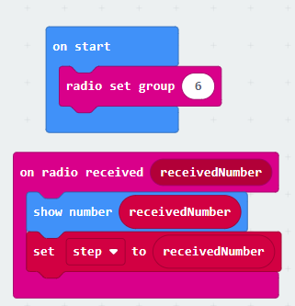
Setup 3 shake Coding of receiver

Slide 10
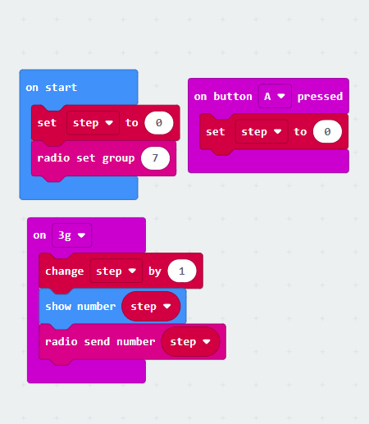
Setup 4 3g Coding of receiver

Slide 11
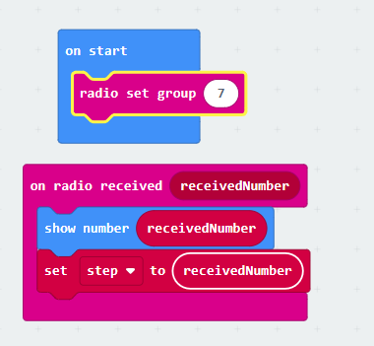
Setup 4 3g Coding of receiver

Slide 12
Result
no. of step | screen up | logo up | shake | 3g | actual move of left foot
instep | 12/17/11 | 16/18/17 | 0/4/0 | 2/2/1 | 10/10/10
ankle | 0/0/0 | 0/0/0 | 2/3/1 | 0/0/0 | 10/10/10

Slide 13
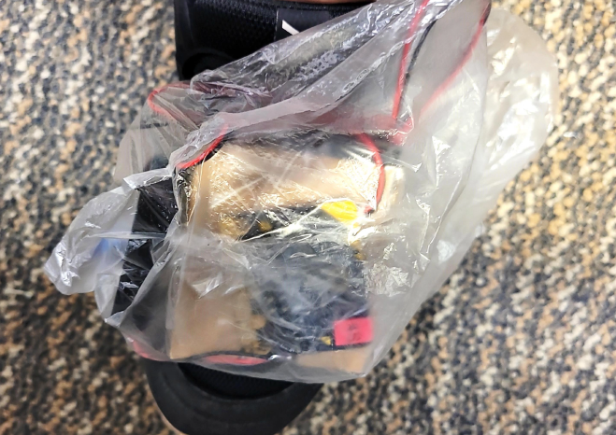
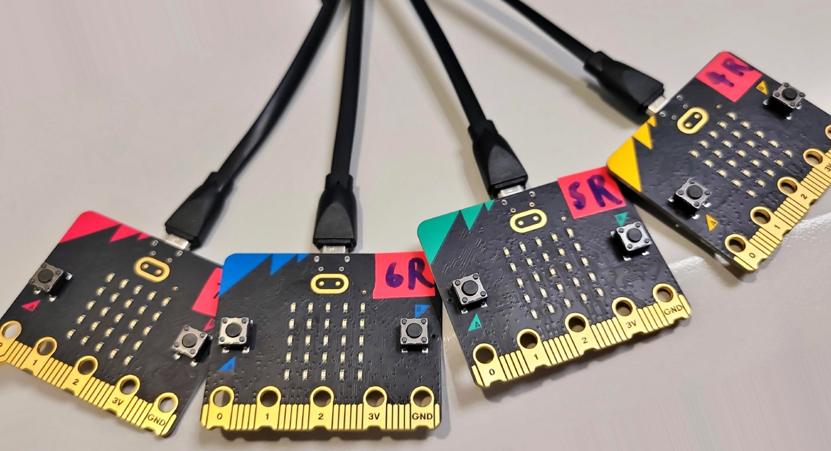
Photo

Slide 14
Objectives of Experiment 2
Using accelerometer in different axis to count step

Slide 15
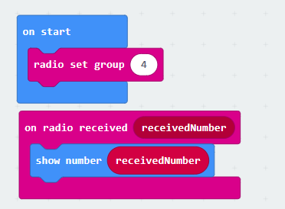
Coding of receiver

Slide 16
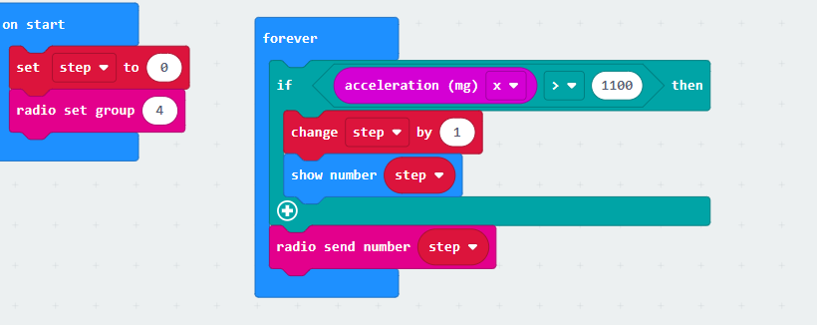
Coding of sender v2

Slide 17
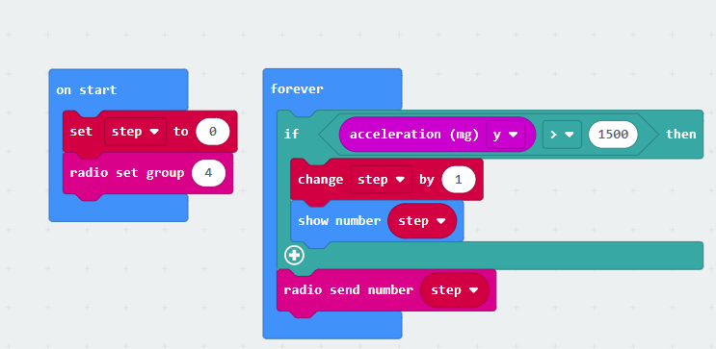
Setup 4 3g Coding of receiver

Slide 18
Result
axis | x axis | y axis | actual move on left wrist
no. of step | 1/1/1 | 10/10/10 | 10/10/10

Slide 19
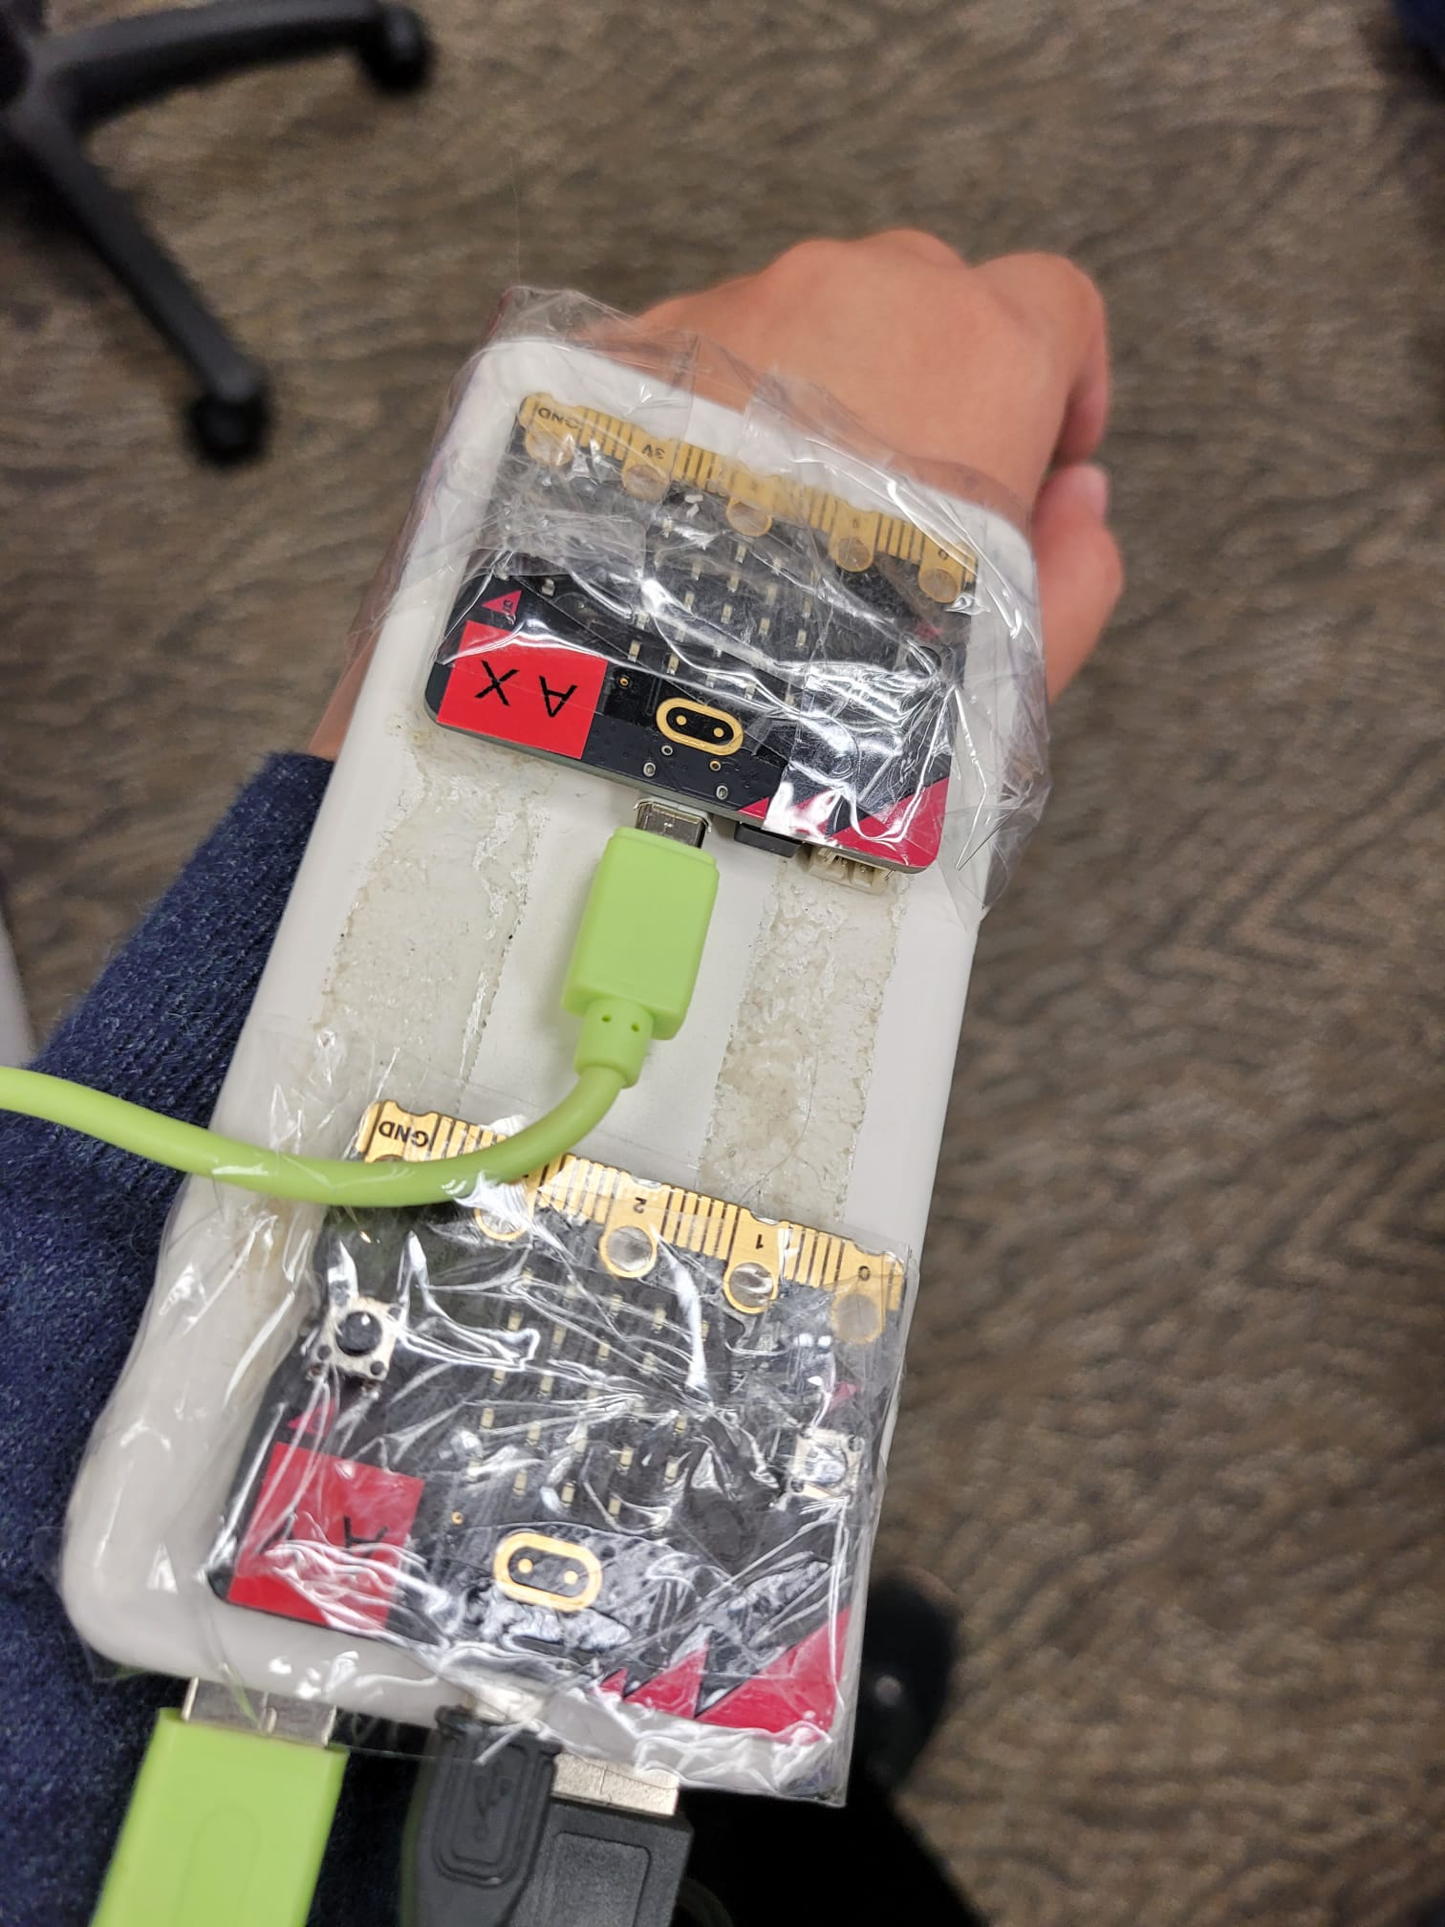
photo

Slide 20
Objectives of Experiment 3
To compare the difference between Microbit v1 and v2

Slide 21
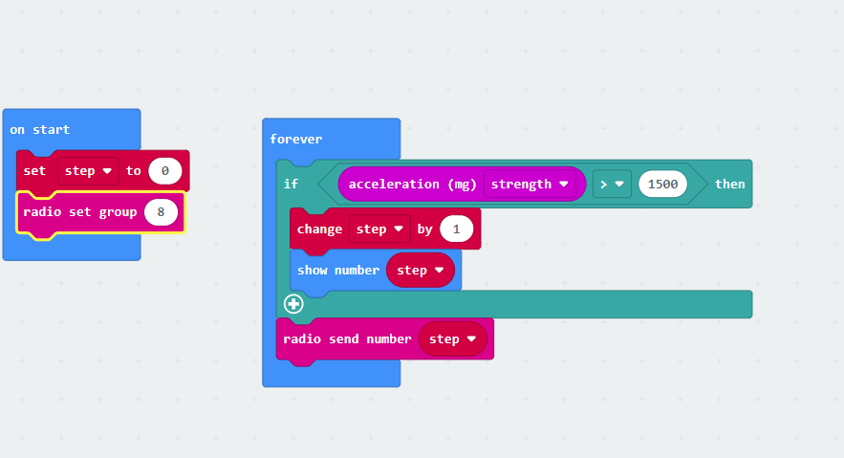
Coding of sender v2

Slide 22
Result
version | v1 | v2 | actual move on left foot
no. of step | 10/10/10 | 10/10/10 | 10/10/10

Slide 23
Objectives of Experiment 3
Using the coding "shake" in Microbit v1 to count footstep during walking​

Slide 24
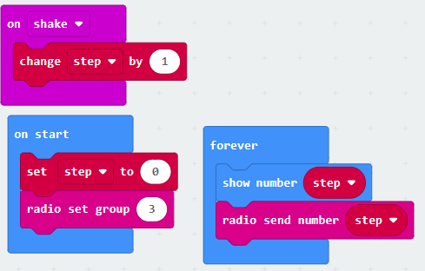
Coding of sender

Slide 25
Coding of receiver

Slide 26
Result
 | v1 reading | actual move on left foot
no. of step | 10/10/11 | 10/10/10

Slide 27
.

