Slide 1
The Education University of Hong Kong
2022-2023 Quality Education Fund Thematic Network - Tertiary Institutes
STEM Project Team
SCHOOL:SF嘉諾撒聖方濟各學校St. Francis' Canossian School
TOPIC: p.3 parachute

Slide 2
Topic
Using parachute to transport supplies

Slide 3
Experiment 1 material
Plastic sheeting (20 cm *2, 25cm *2)
Cotton rope (30cm *24)
Biscuit *4

Slide 4
Objectives of Experiment 1
To compare the following prototypes:
20*20 cm Plastic sheeting with 4 ropes
20*20 cm Plastic sheeting with 8 ropes
25*25 cm Plastic sheeting with 4 ropes
25*25 cm Plastic sheeting with 8 ropes

Slide 5
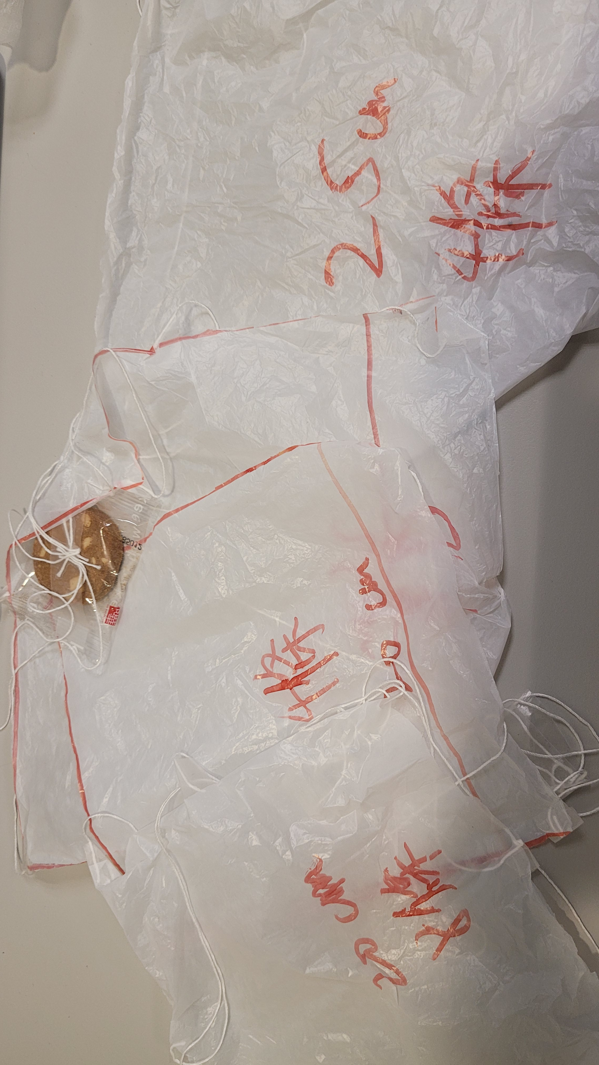
Photo

Slide 6
Result
Type | Time (s) | Biscuit broken?
20*20 cm Plastic sheeting with 4 ropes​ | 1.86 | yes
20*20 cm Plastic sheeting with 8 ropes​ | 2.66 | no
25*25 cm Plastic sheeting with 4 ropes​ | 2.28 | no
25*25 cm Plastic sheeting with 8 ropes​ | 2.53 | no

Slide 7
Objectives of Experiment 2
To compare the following prototypes:
20*20 cm Plastic sheeting, plastic film, pop paper
30*30 cm Plastic sheeting, plastic film, pop paper

Slide 8
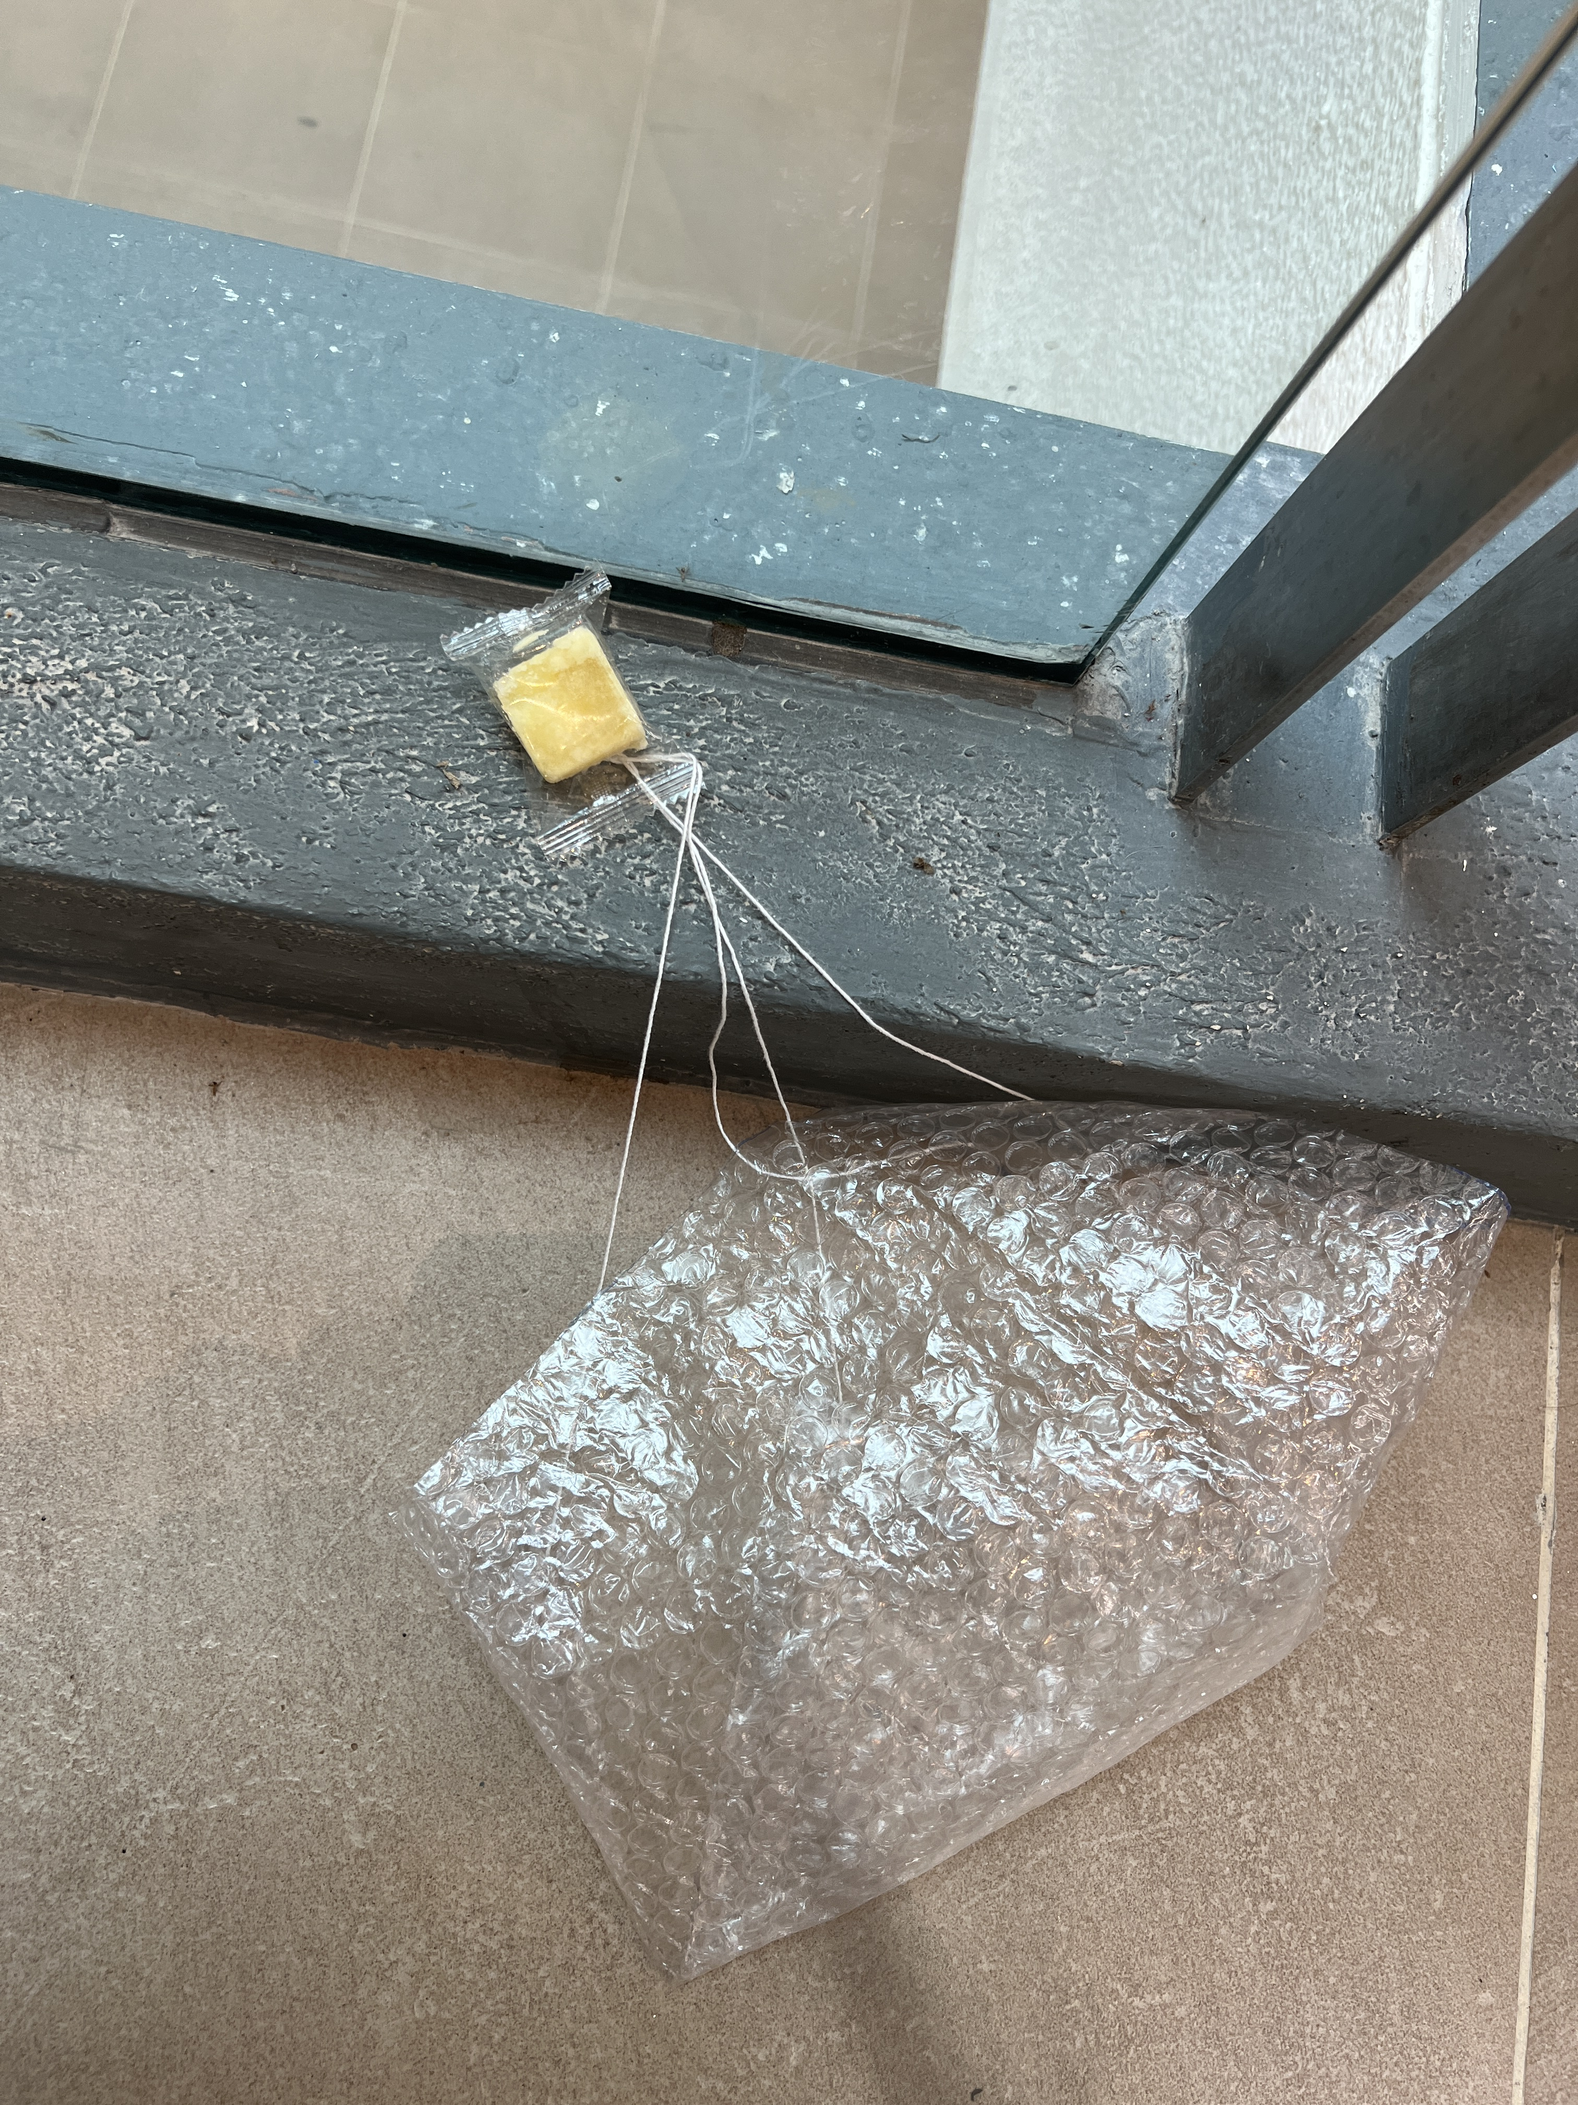
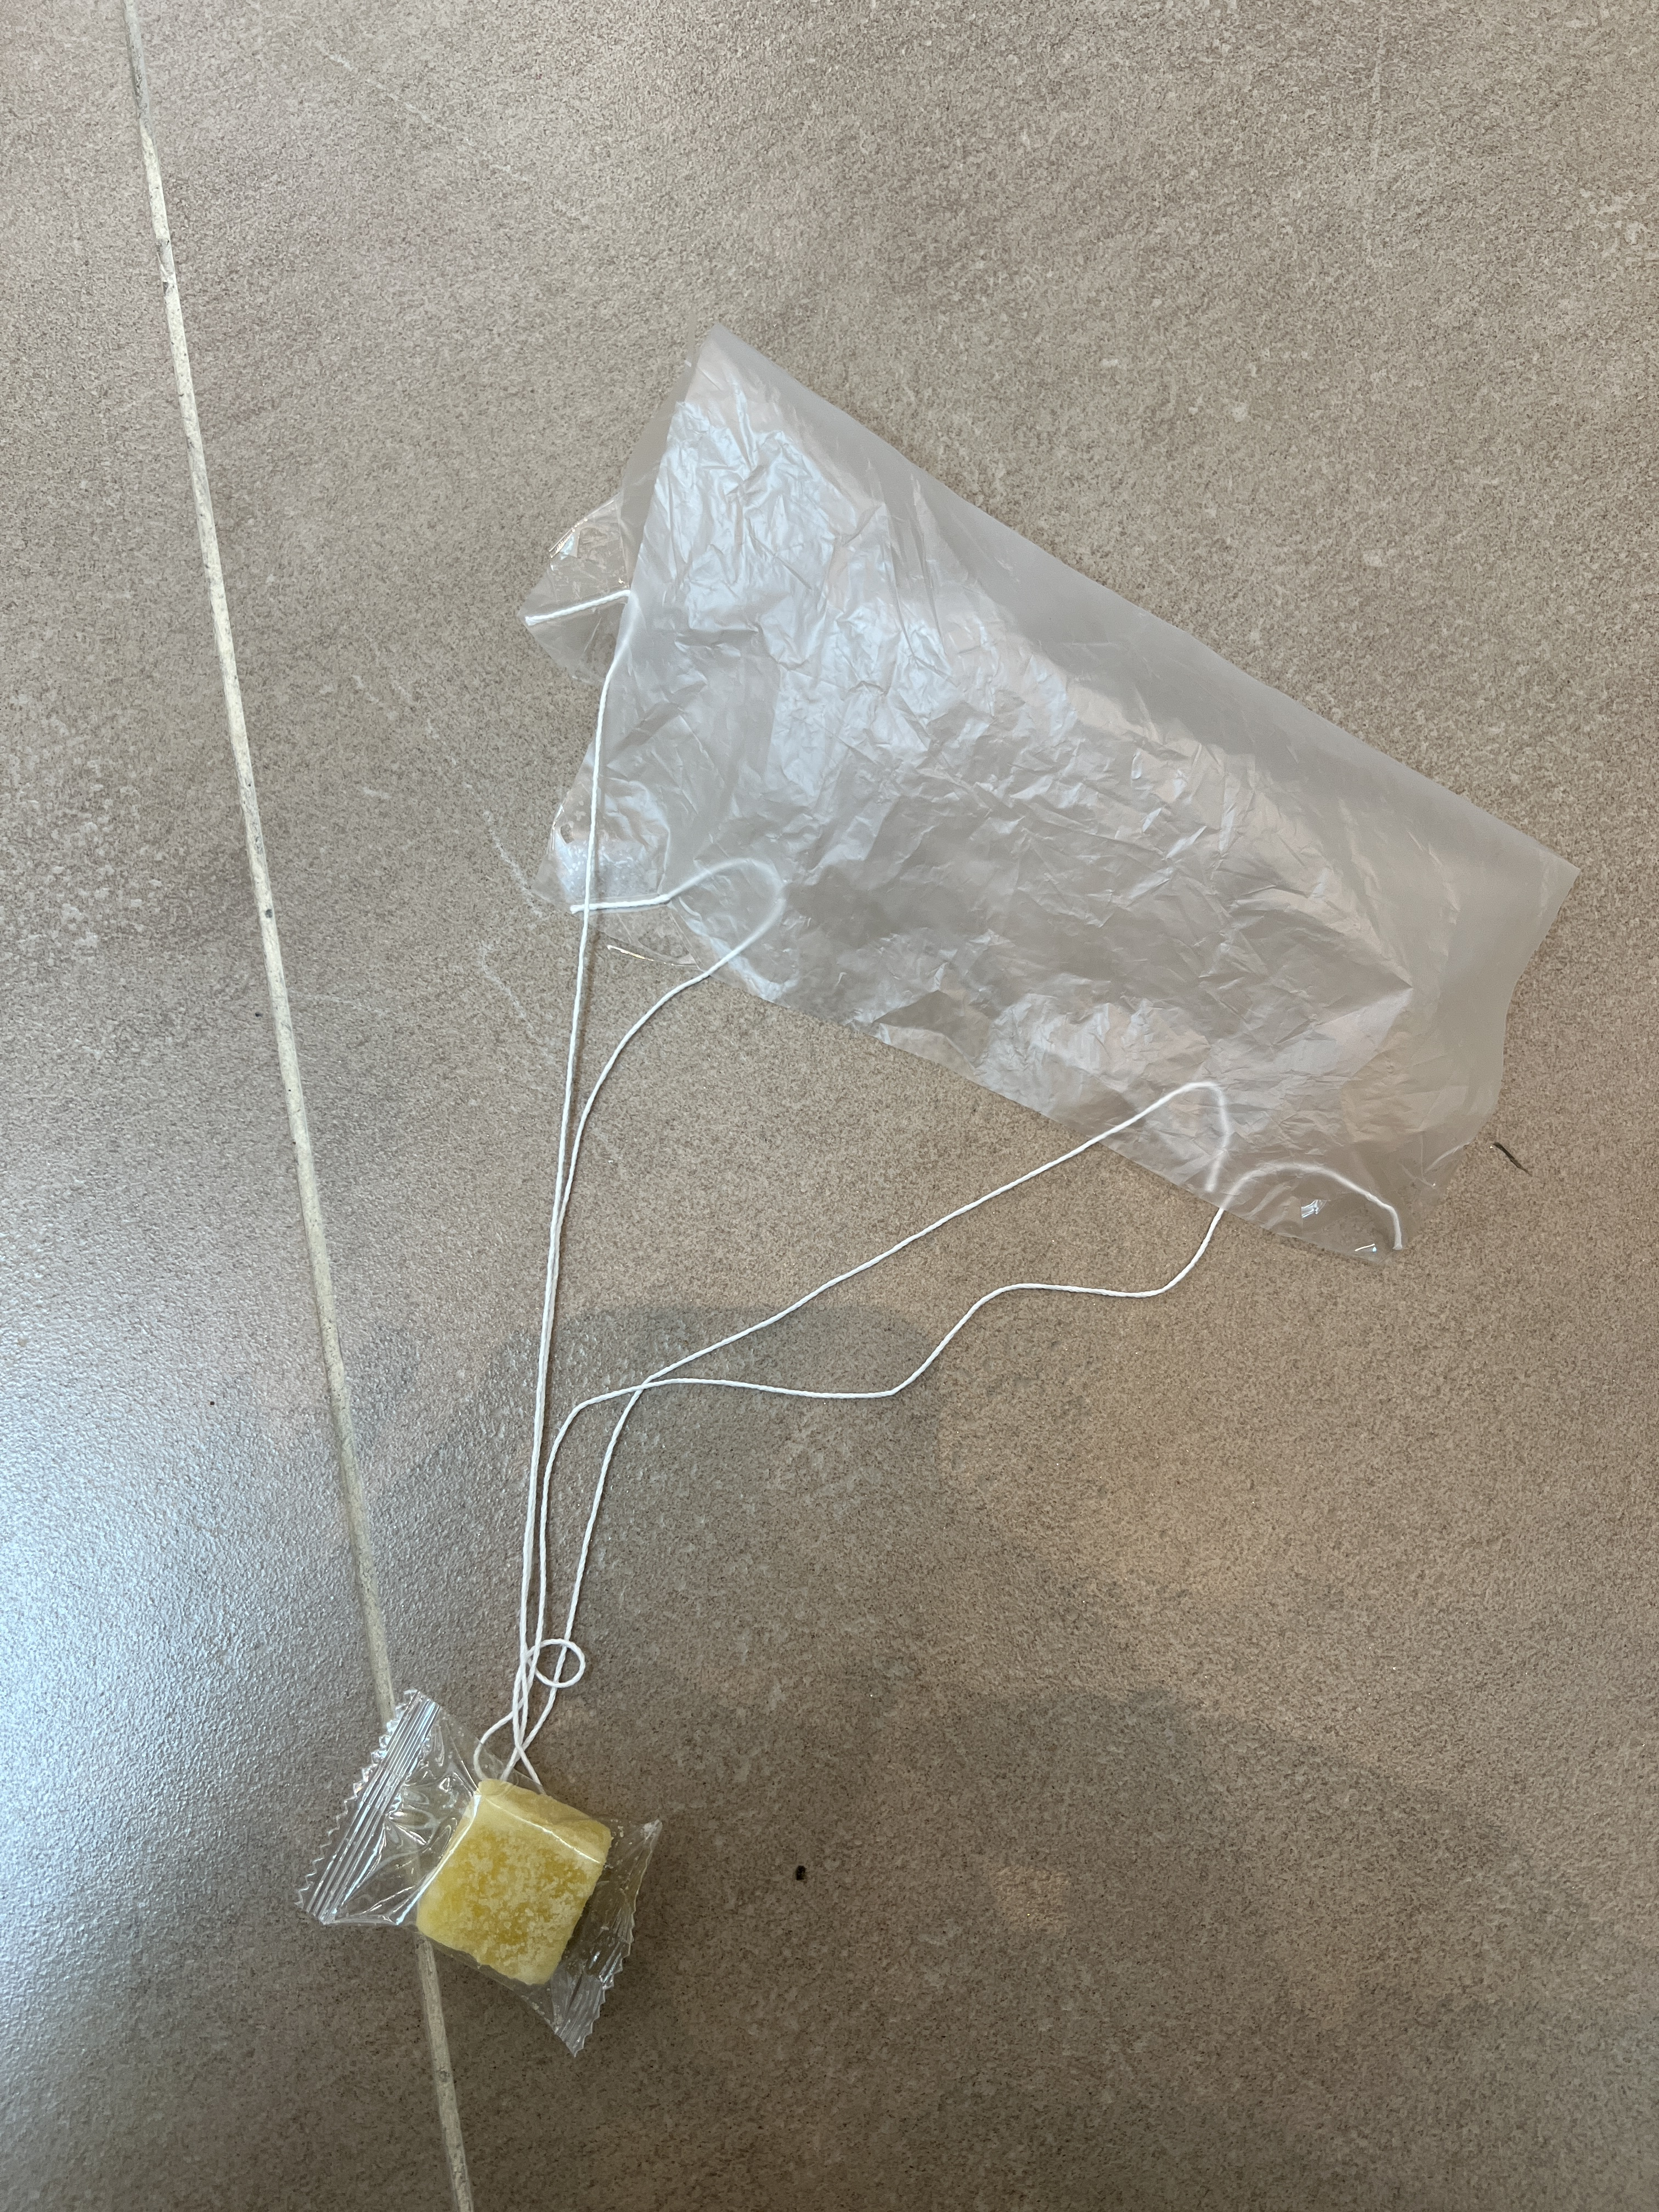
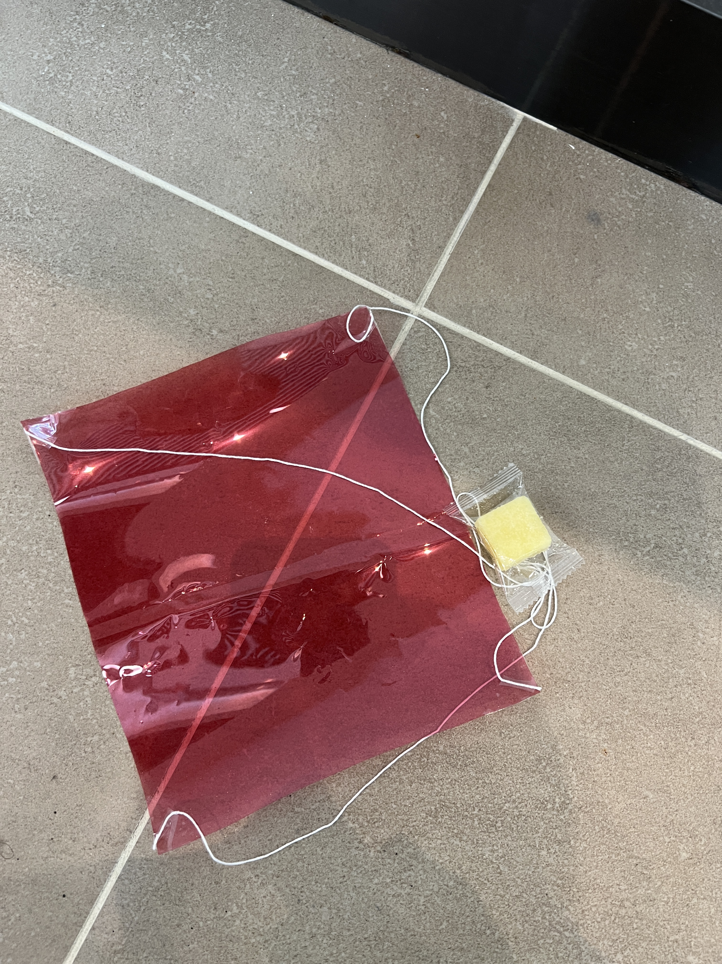
Photo

Slide 9
Result 2
length | pop paper | plastic sheet | plastic film
20cm | 1.98 | 1.72 | 1.72
 | 1.53 | 1.53 | 1.63
 | 1.64 | 1.52 | 1.91
 | 1.66 | 1.53 | 1.92
average of 20cm | 1.7 | 1.575 | 1.795
30cm | 1.99 | 2.07 | 2.35
 | 2.38 | 2.29 | 2.64
 | 2.55 | 2.89 | 2.47
average of 30cm | 2.3067 | 2.4167 | 2.4867

Slide 10
Objectives of Experiment 3
To compare the following prototypes:
10*10 cm Plastic sheeting
20*20 cm Plastic sheeting
30*30 cm Plastic sheeting
50*50 cm Plastic sheeting

Slide 11
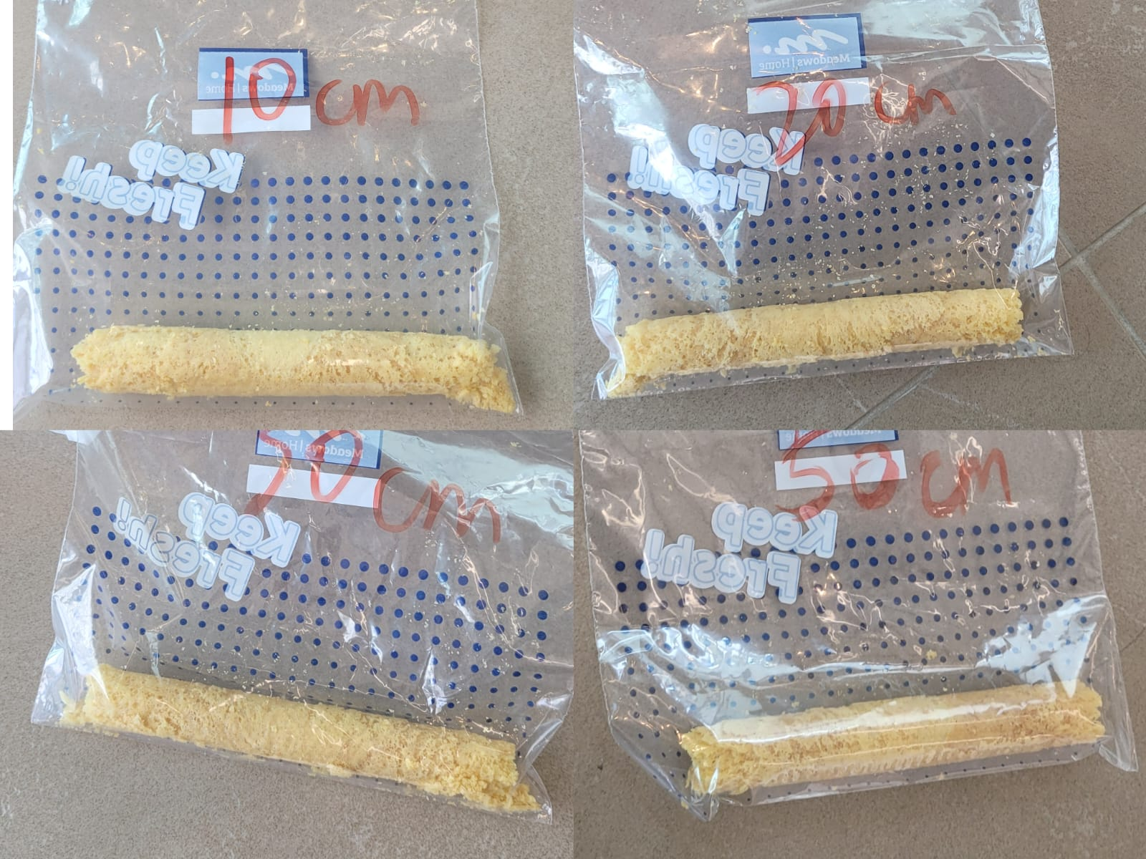
Before VS After

Slide 12
Result
Type | Time (s) | eggroll broken lv.
10*10 cm Plastic sheeting | 0.82 | 4
20*20 cm Plastic sheeting | 1.46 | 3
30*30 cm Plastic sheeting | 1.80 | 2
50*50 cm Plastic sheeting | 2.91 | 1

