Slide 1
The Education University of Hong Kong
2022-2023 Quality Education Fund Thematic Network - Tertiary Institutes
STEM Project Team
SCHOOL: 育賢學校 Yuk Yin School
TOPIC: 太陽能風扇帽 Solar fan hat

Slide 2
Solar fan hat (voltage test)

Slide 3
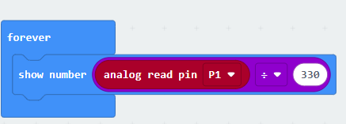
Coding of voltmeter

Slide 4
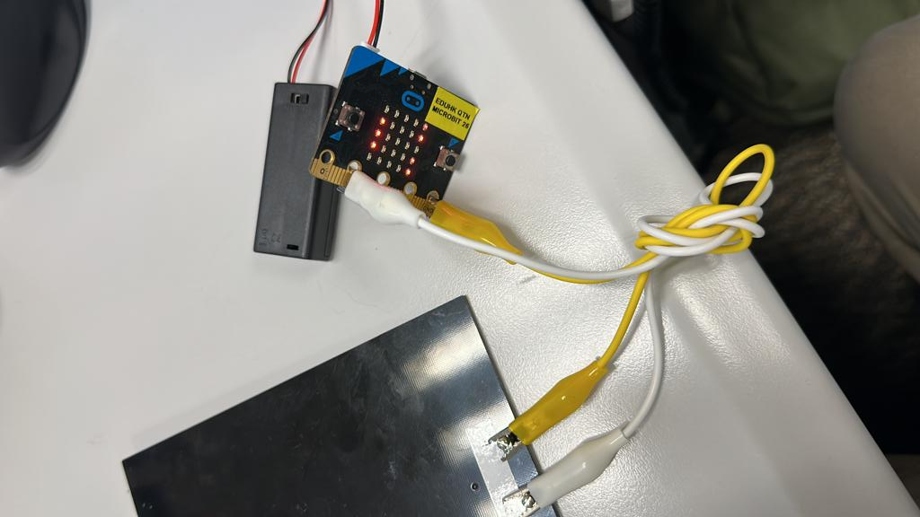
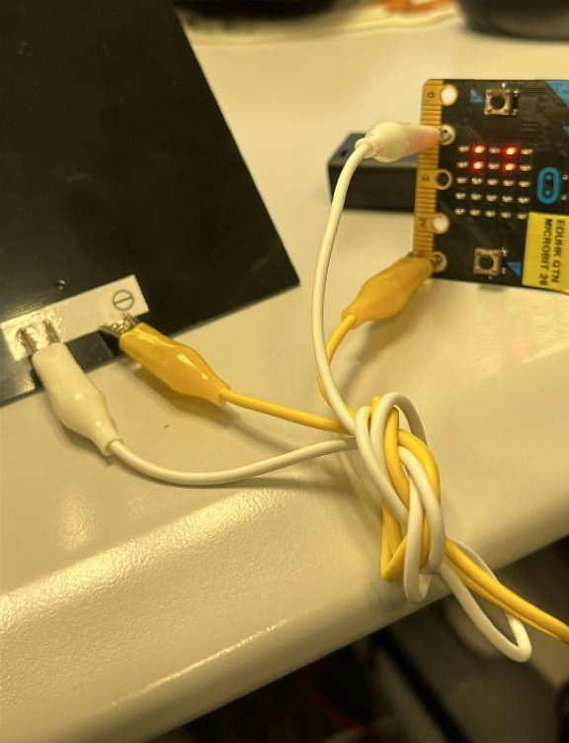

Slide 5
Multimeter VS Microbit voltmeter

