Slide 1
The Education University of Hong Kong
2022-2023 Quality Education Fund Thematic Network - Tertiary Institutes
STEM Project Team
SCHOOL: Tak Sun Secondary School
TOPIC: Concentration Test

Slide 2
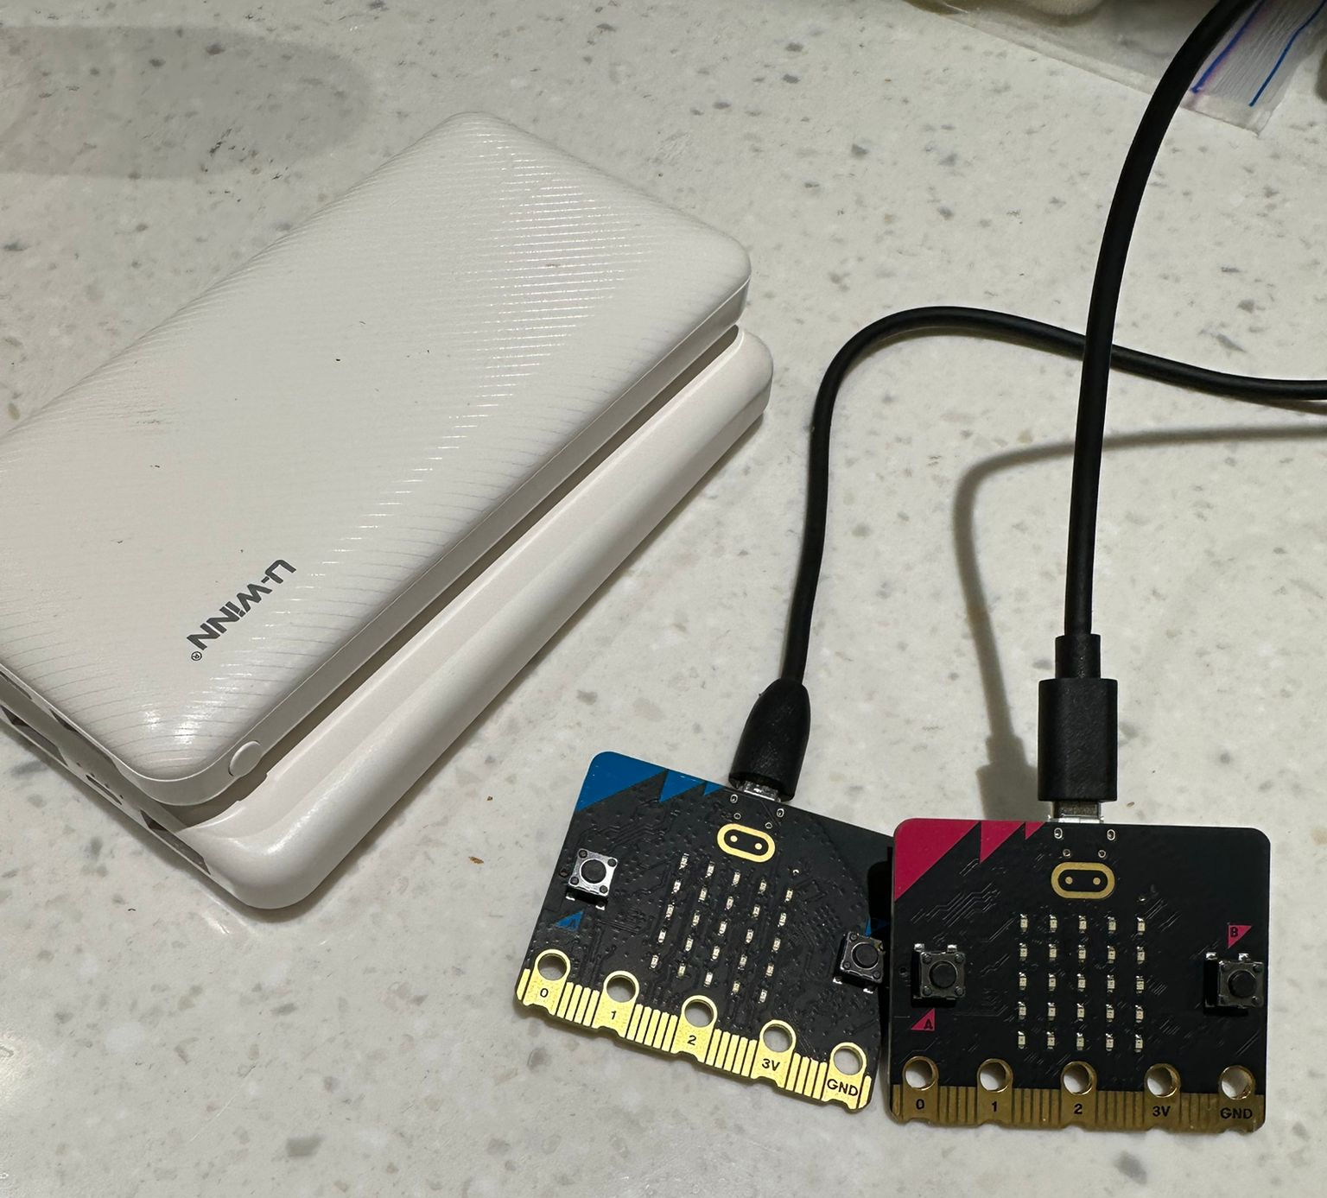
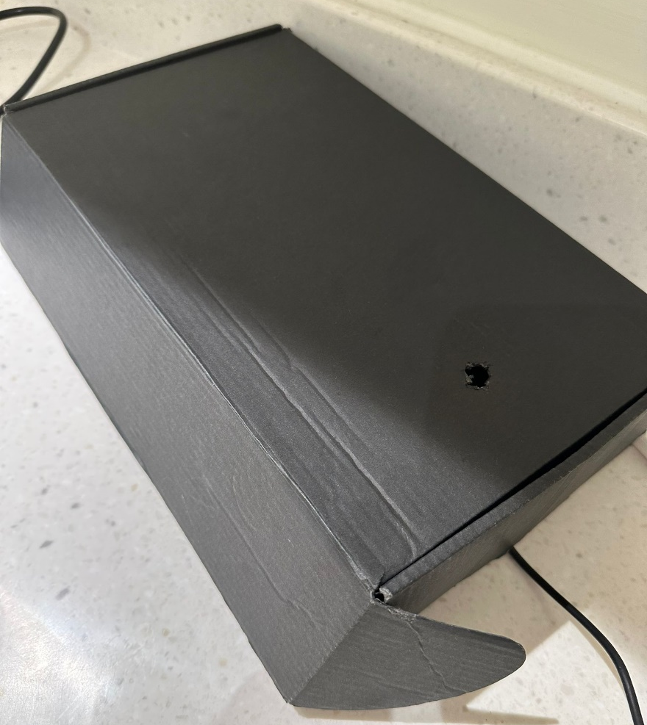
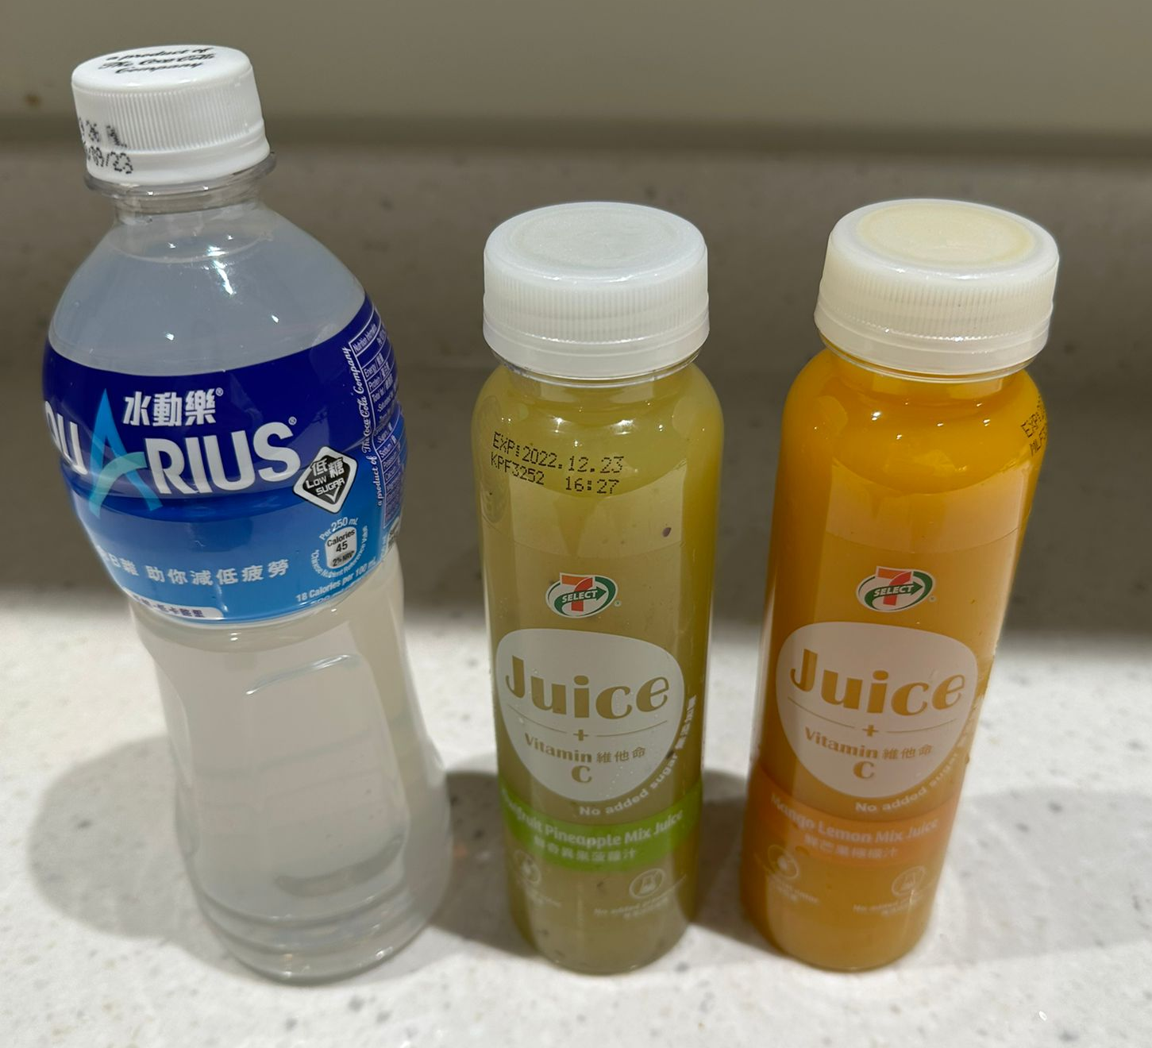
Experiment material
Notes:
turbidimeter

Slide 3
Objectives of Experiment
To find out the light level of different liquids with micro:bit.
To predict the turbidity of the liquids.

Slide 4
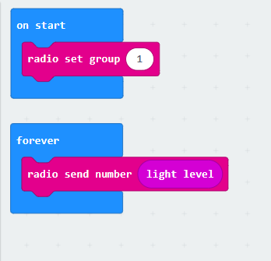
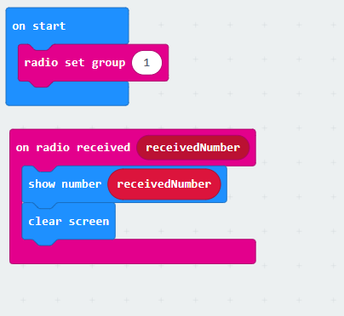
Coding
For testing the light level of the liquids: | for radio (receive data):

Slide 5
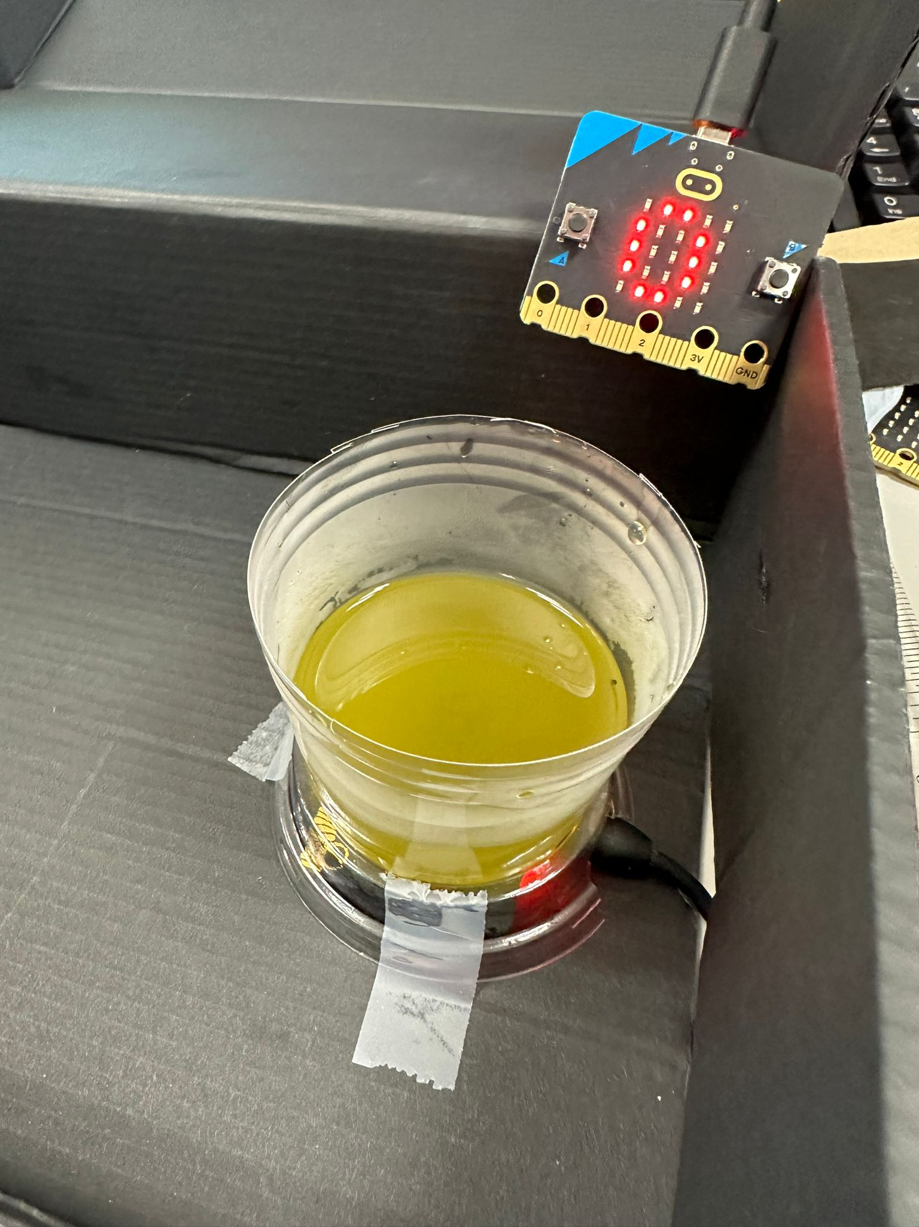
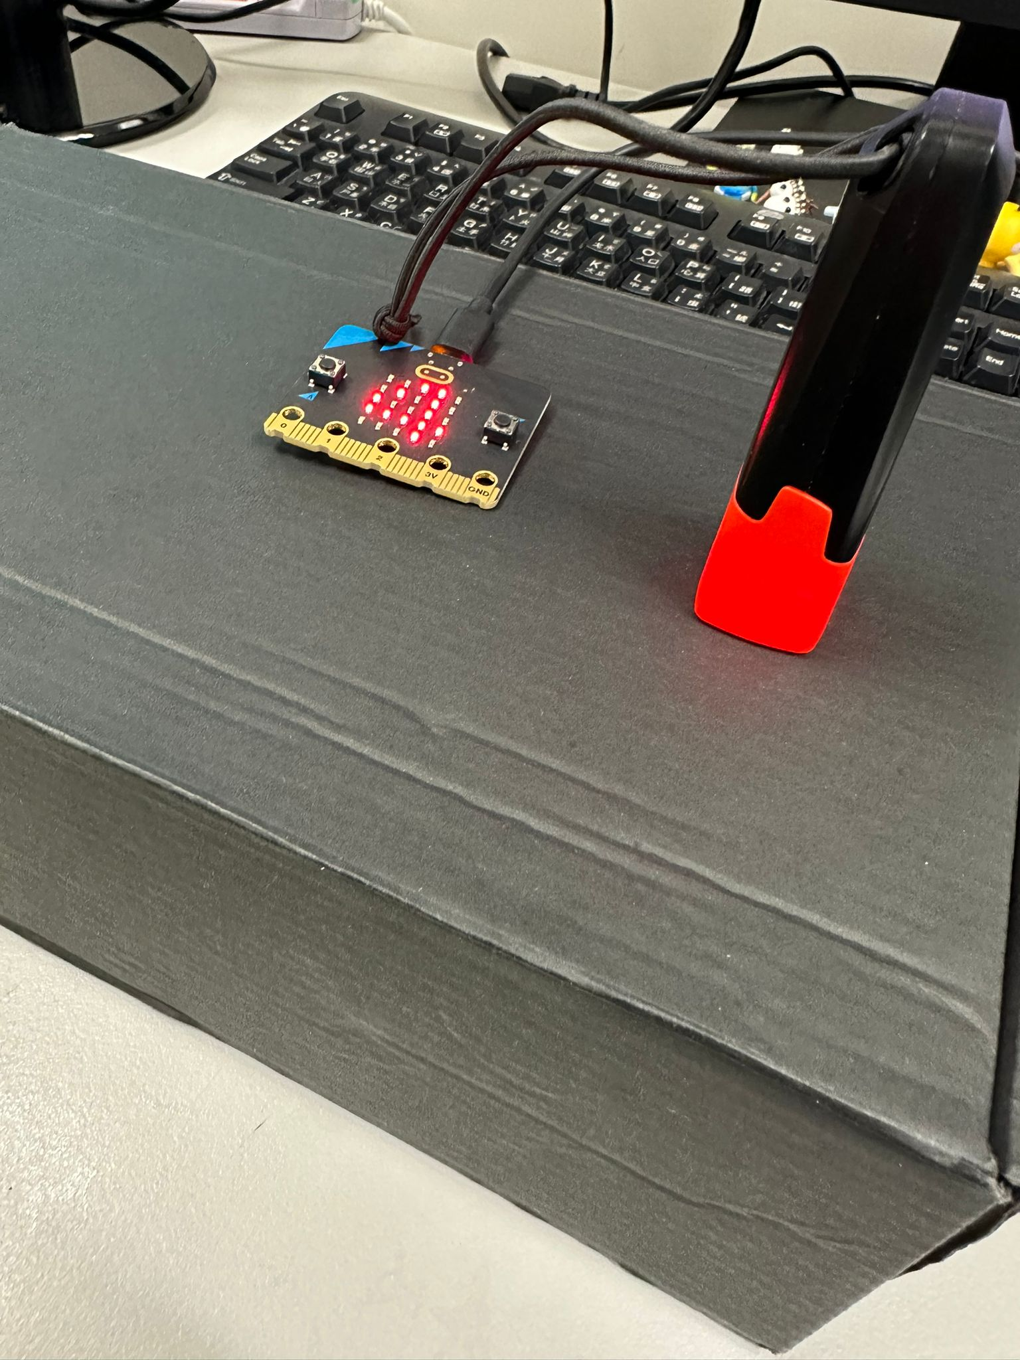
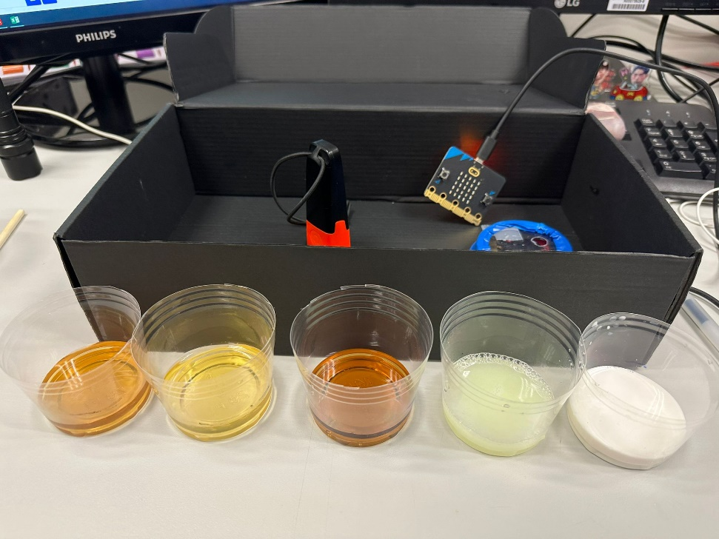
Experiment

Slide 6
Result
Concentration 100% | Micro:bit light level
Water | 249
Pocari Sweat | 245
Green Tea | 245
Dishwasher Detergent | 240
Red Tea | 237
Cola (with no sugar) | 236
Kiwi Juice | 215
Cola | 192
Milk, Milk Tea, Soy sauce | 0 (cannot show the number)

Slide 7
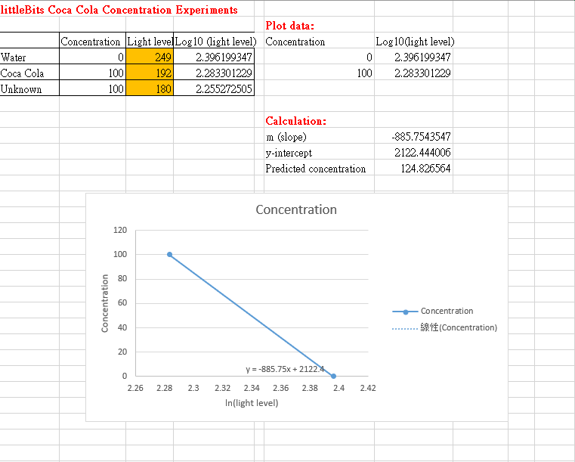
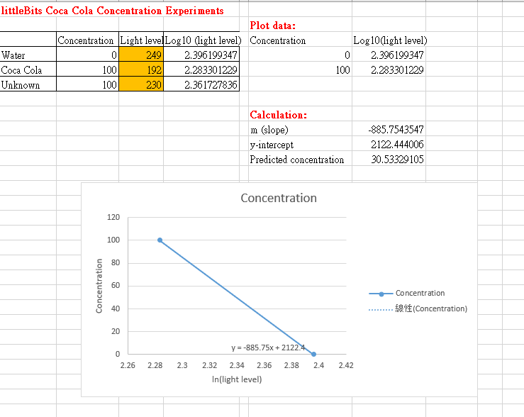
Concentration Experiments
Sample A:
Sample B:
Sample A (with 180 micro:bit light level) is more similar to the Coca Cola, and the predicted concentration is higher than Sample B.
Notes:
可樂濃度= 𝑚× log(光感讀數)+𝑐

