Slide 1
The Education University of Hong Kong
2022-2023 Quality Education Fund Thematic Network - Tertiary Institutes
STEM Project Team
SCHOOL: Sha Tin Methodist Primary School (P.5)
TOPIC: Sound insulation
Notes:
objectives
Sound source
Calibration
Microbit measure
distance

Slide 2
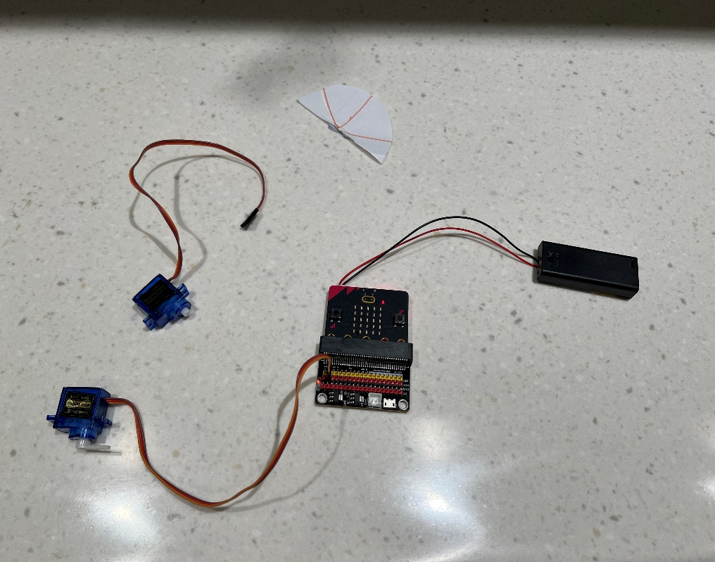
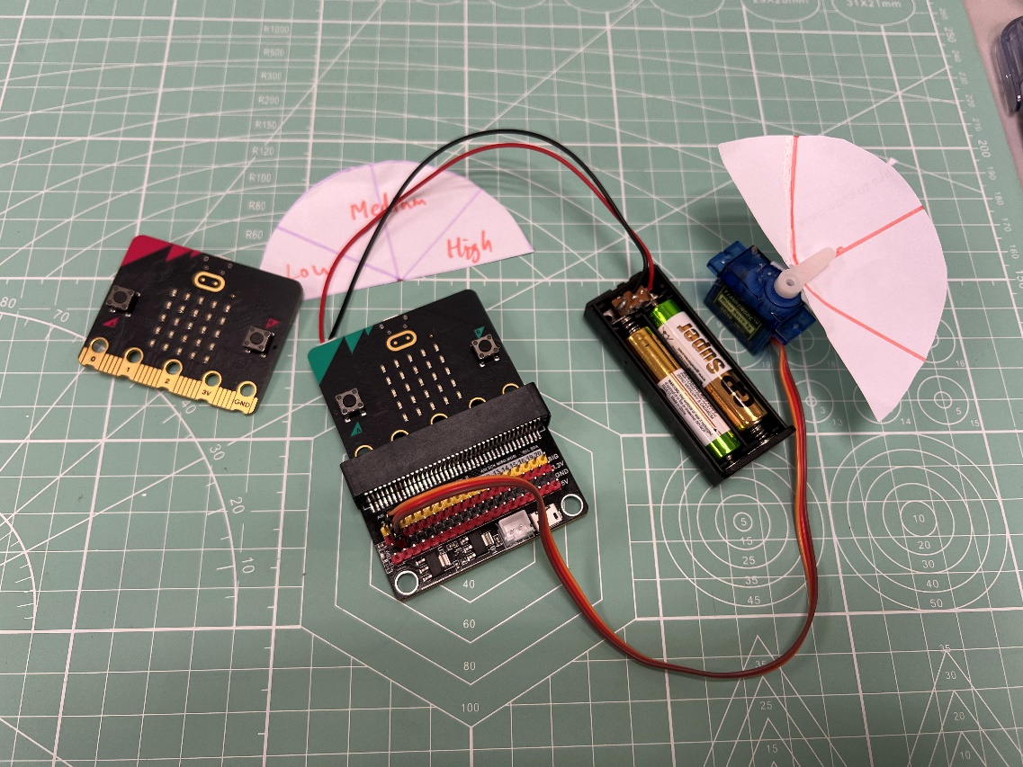
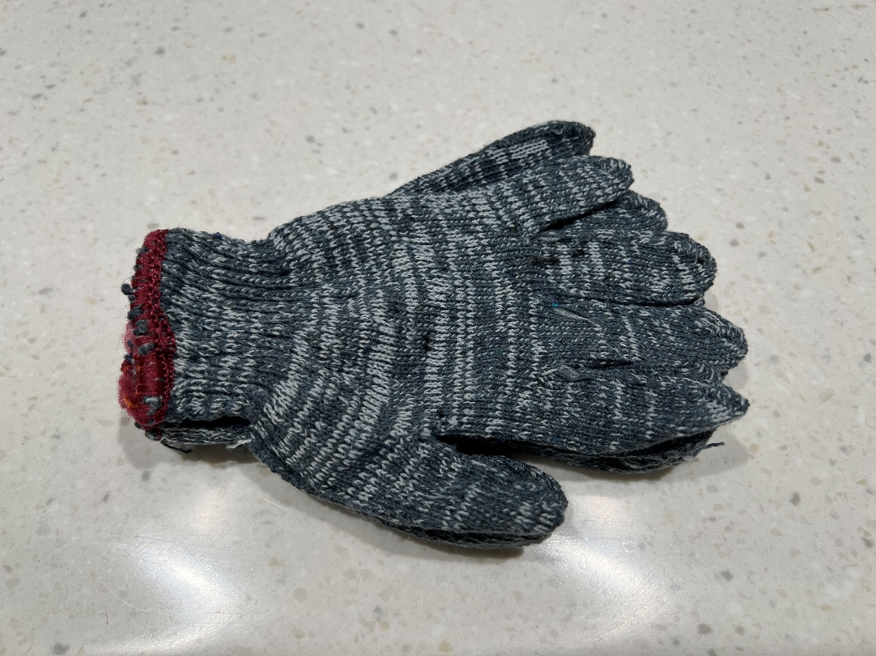
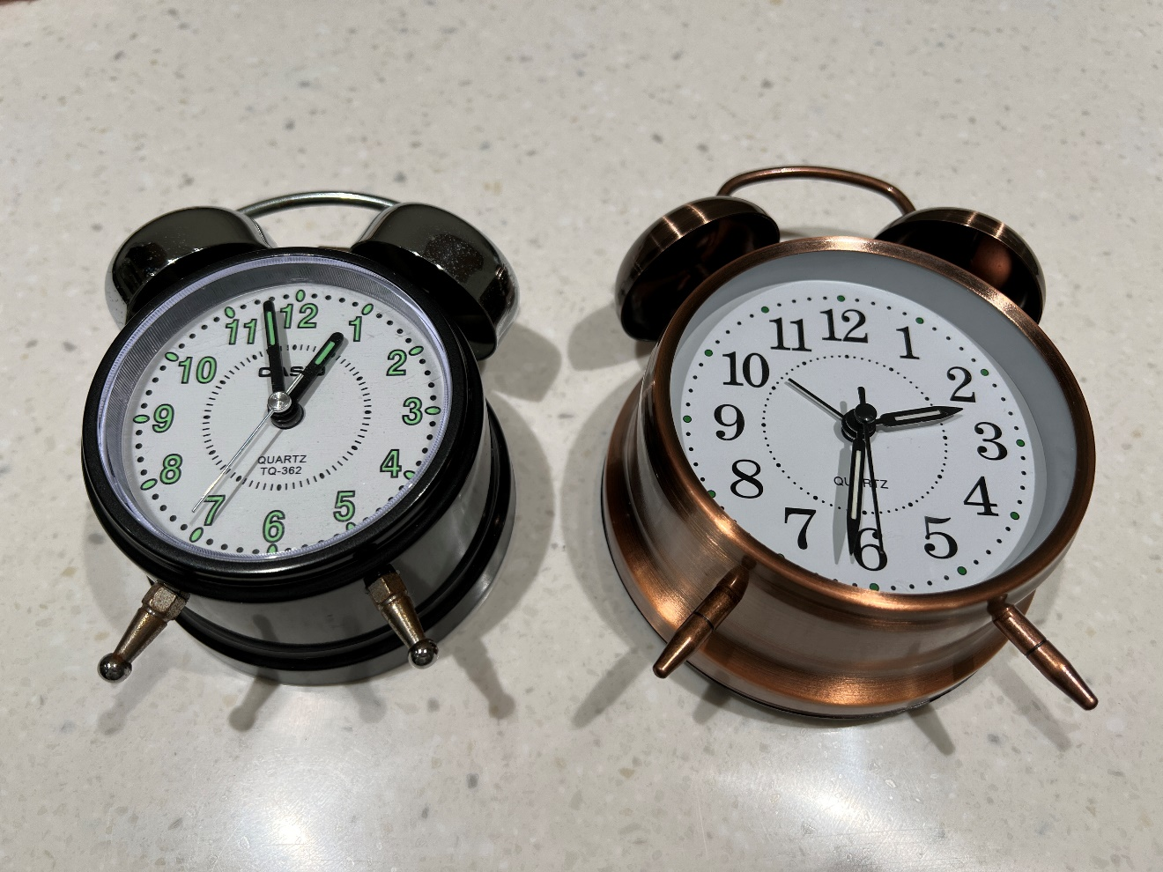
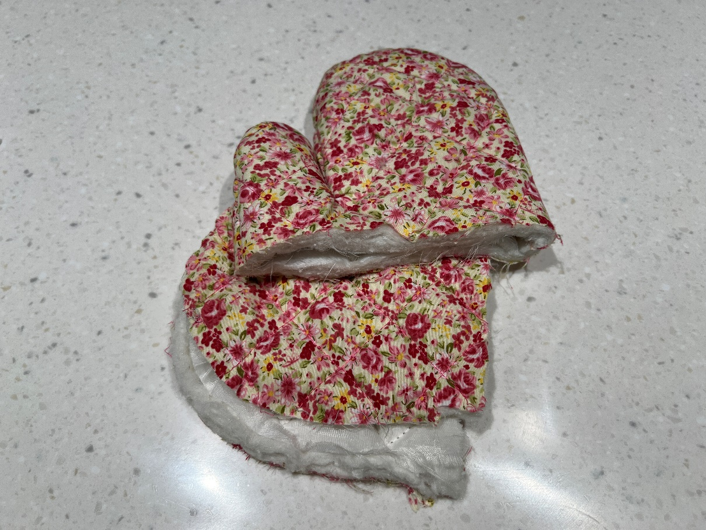
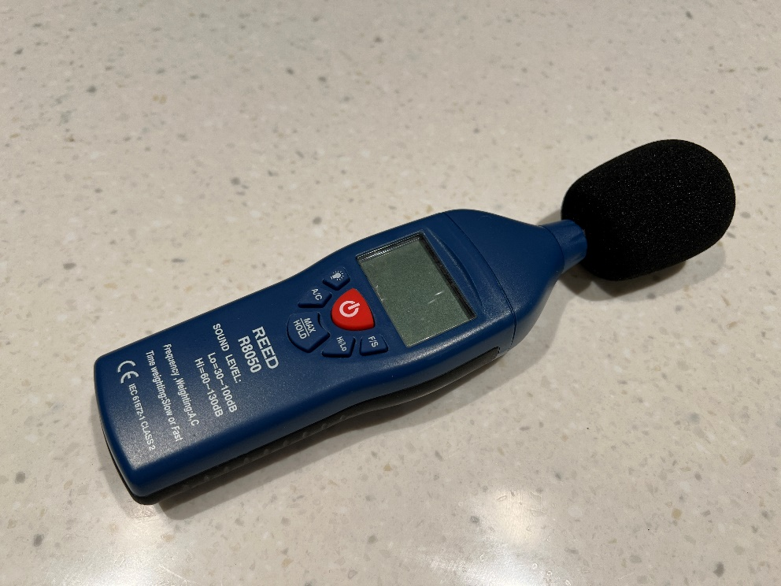
Experiment material

Slide 3
Objectives of Experiment 1
A) To compare sound meter apps on different device with Professional device R8050 in different distance
B) To compare the sound meter level difference with the sound source place on the table and on the sponge by using different devices

Slide 4
Sound Source Coding

Slide 5
distance (on table) | R8050 | iphone | calibration | ipad | calibration | samsung | calibration
0 | 73 | 74 | -1 | 62 | 11 | 78 | -5
0.5 | 51 | 56 | -5 | 41 | 10 | 58 | -7
1 | 51 | 55 | -4 | 39 | 12 | 57 | -6
1.5 | 50 | 55 | -5 | 39 | 11 | 54 | -4
2 | 48 | 52 | -4 | 36 | 12 | 56 | -8
2.5 | 50 | 53 | -3 | 35 | 15 | 53 | -3
/ | / | / | Average -3.67 | / | Average 11.8 | / | Average -5.5

Slide 7
distance (on sponge) | R8050 | iphone | calibration | ipad | calibration | samsung | calibration
0 | 59 | 57 | +2 | 49 | +10 | 58 | +1
0.5 | 54 | 50 | +4 | 39 | +15 | 51 | +3
1 | 48 | 49 | -1 | 36 | +12 | 48 | 0
1.5 | 45 | 47 | -2 | 34 | +11 | 47 | +2
2 | 45 | 49 | -4 | 41 | +4 | 48 | +3
2.5 | 43 | 48 | -5 | 33 | +10 | 46 | +3
/ | / | / | Average -1 | / | Average 10.3 | / | Average 2

Slide 9
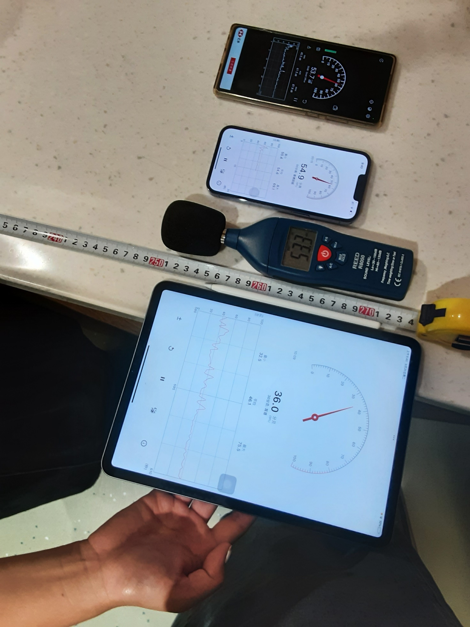

Slide 10
Objectives of experiment 2
To compare different sound source by using R8050 and Microbit

Slide 11
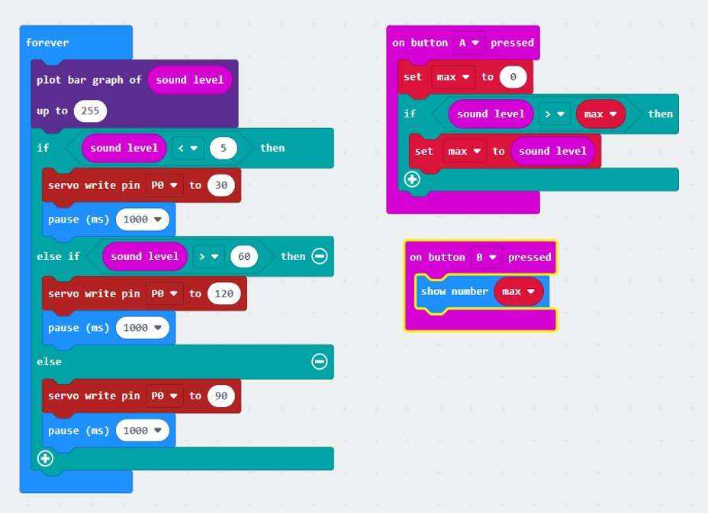
Sound meter of micro:bit coding

Slide 12
Experiment 2
Distance (m) | clock | white noise
0 | 127/87 | 106/88
0.5 | 121/80 | 67/73
1 | 108/79 | 63/74
2 | 97/73 | 56/72
*R8050/Microbit

Slide 13
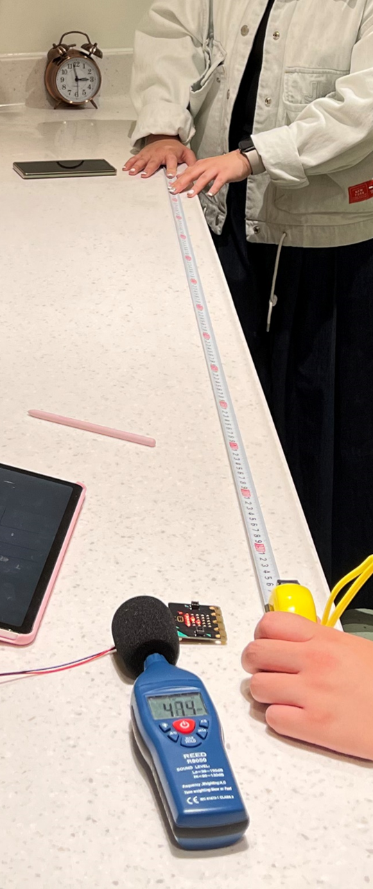
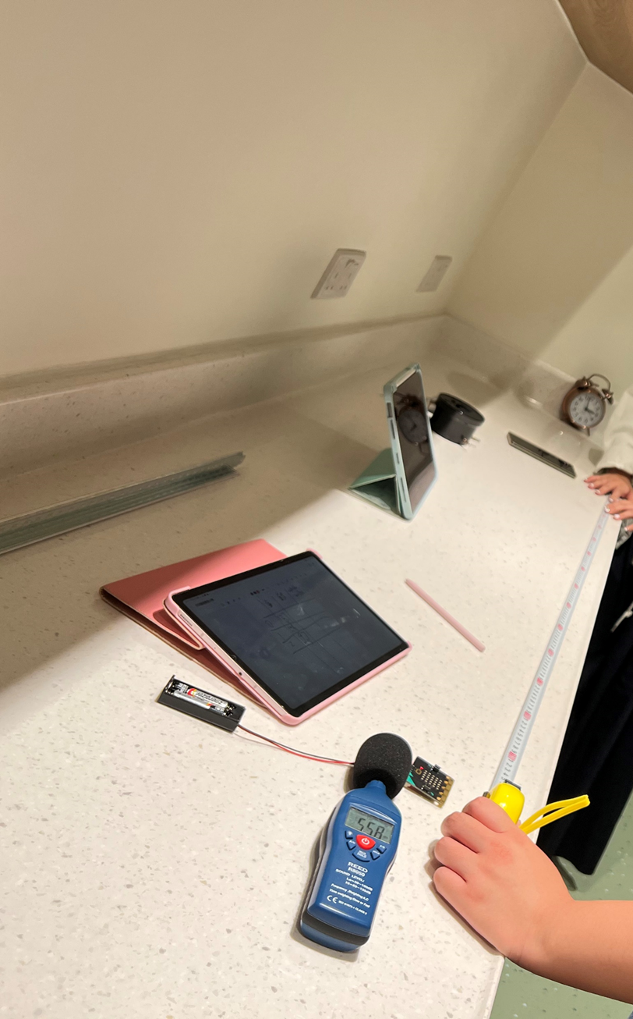
Clock
Microbit
R8050

Slide 14
Objectives of experiment 3
To compare the effect of soundproofing of different sound insulation materials

Slide 15
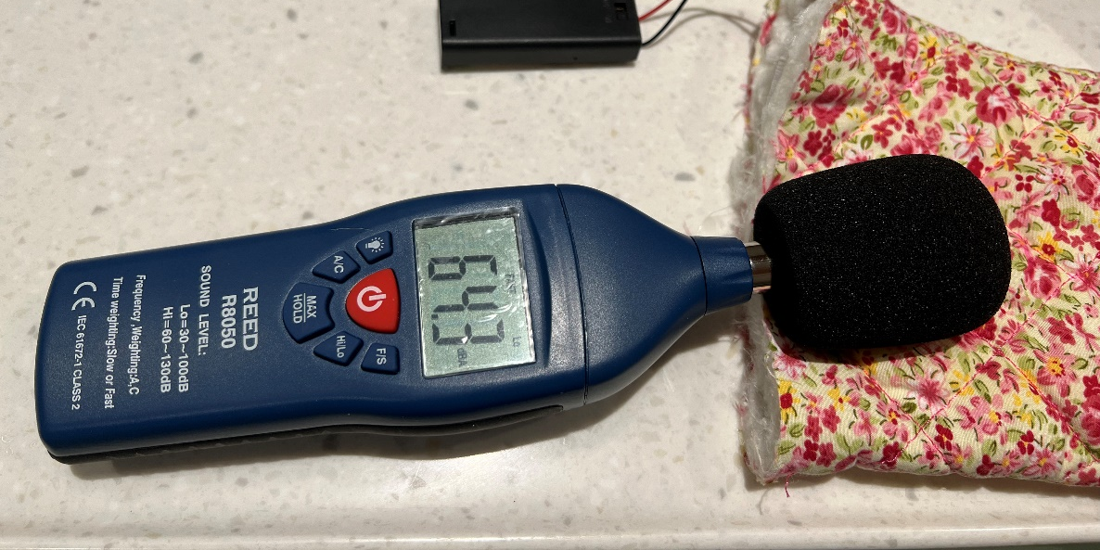
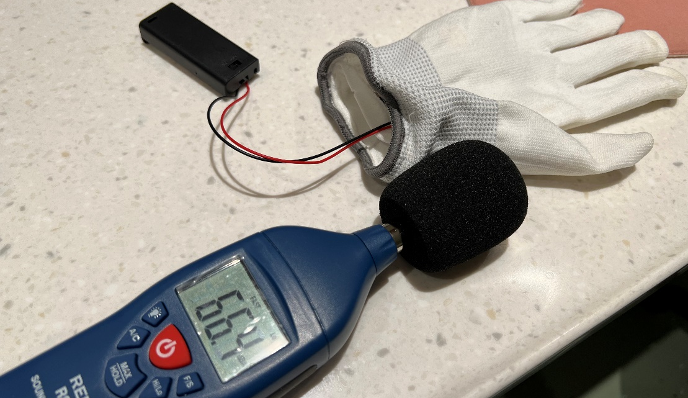
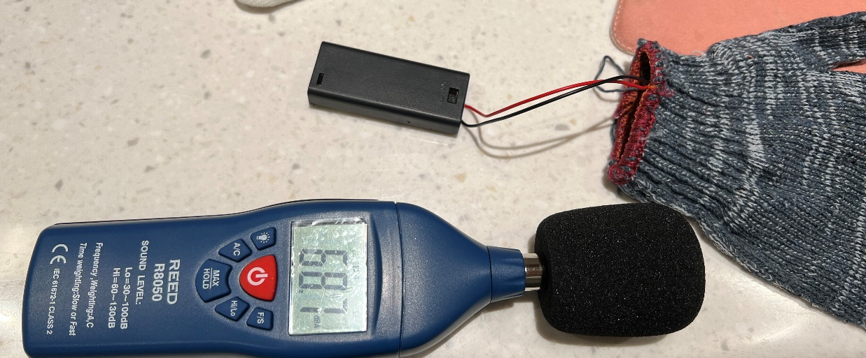
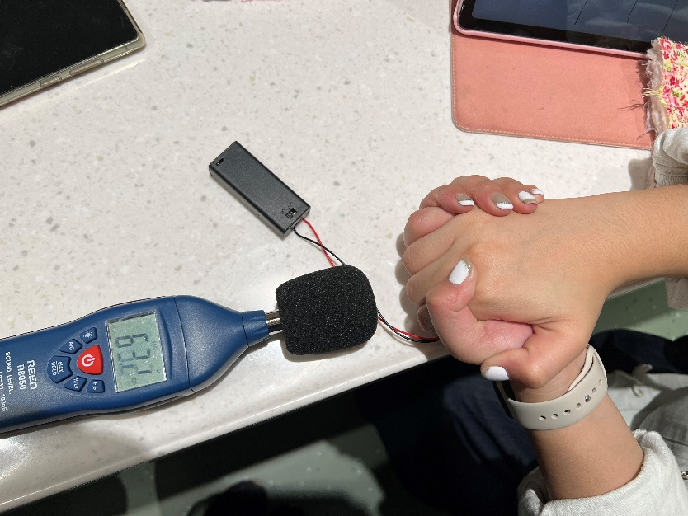
Experiment 3
wrapping material | Decibel (dB)
none | 71
pink gloves | 62
white gloves | 67
gray gloves | 68
hand | 50
all | 45

Slide 16
Objectives of experiment 4
Using Microbit as sound source, and measure sound level by using Microbit as sound meter

Slide 17
Sound Source Coding

Slide 18
Coding of sound meter in experiment 4

Slide 19
Experiment 4
distance between 2 microbit (m) | Sound level of Microbit (receiver on table) | Average | Sound level of Microbit ( receiver on sponge) | Average | Sound level of Microbit (both on sponge) | Average
0 | 60 | 60 | 52/56/60 | 56 | 33/37/48 | 39.3
0.5 | 22/30 | 26 | 22/30 | 26 | 15/22/33 | 23.3
1 | 15/22/30 | 22.3 | 22/30 | 26 | 15/22/30 | 22.3
1.5 | 22/30 | 26 | 15/22/30 | 22.3 | 15/22/30 | 22.3
2 | 15/22/30 | 22.3 | 15/22/30 | 22.3 | 22/30 | 26
* Result of holding and rotating the receiving micro:bit board do not have clear difference.

Slide 20
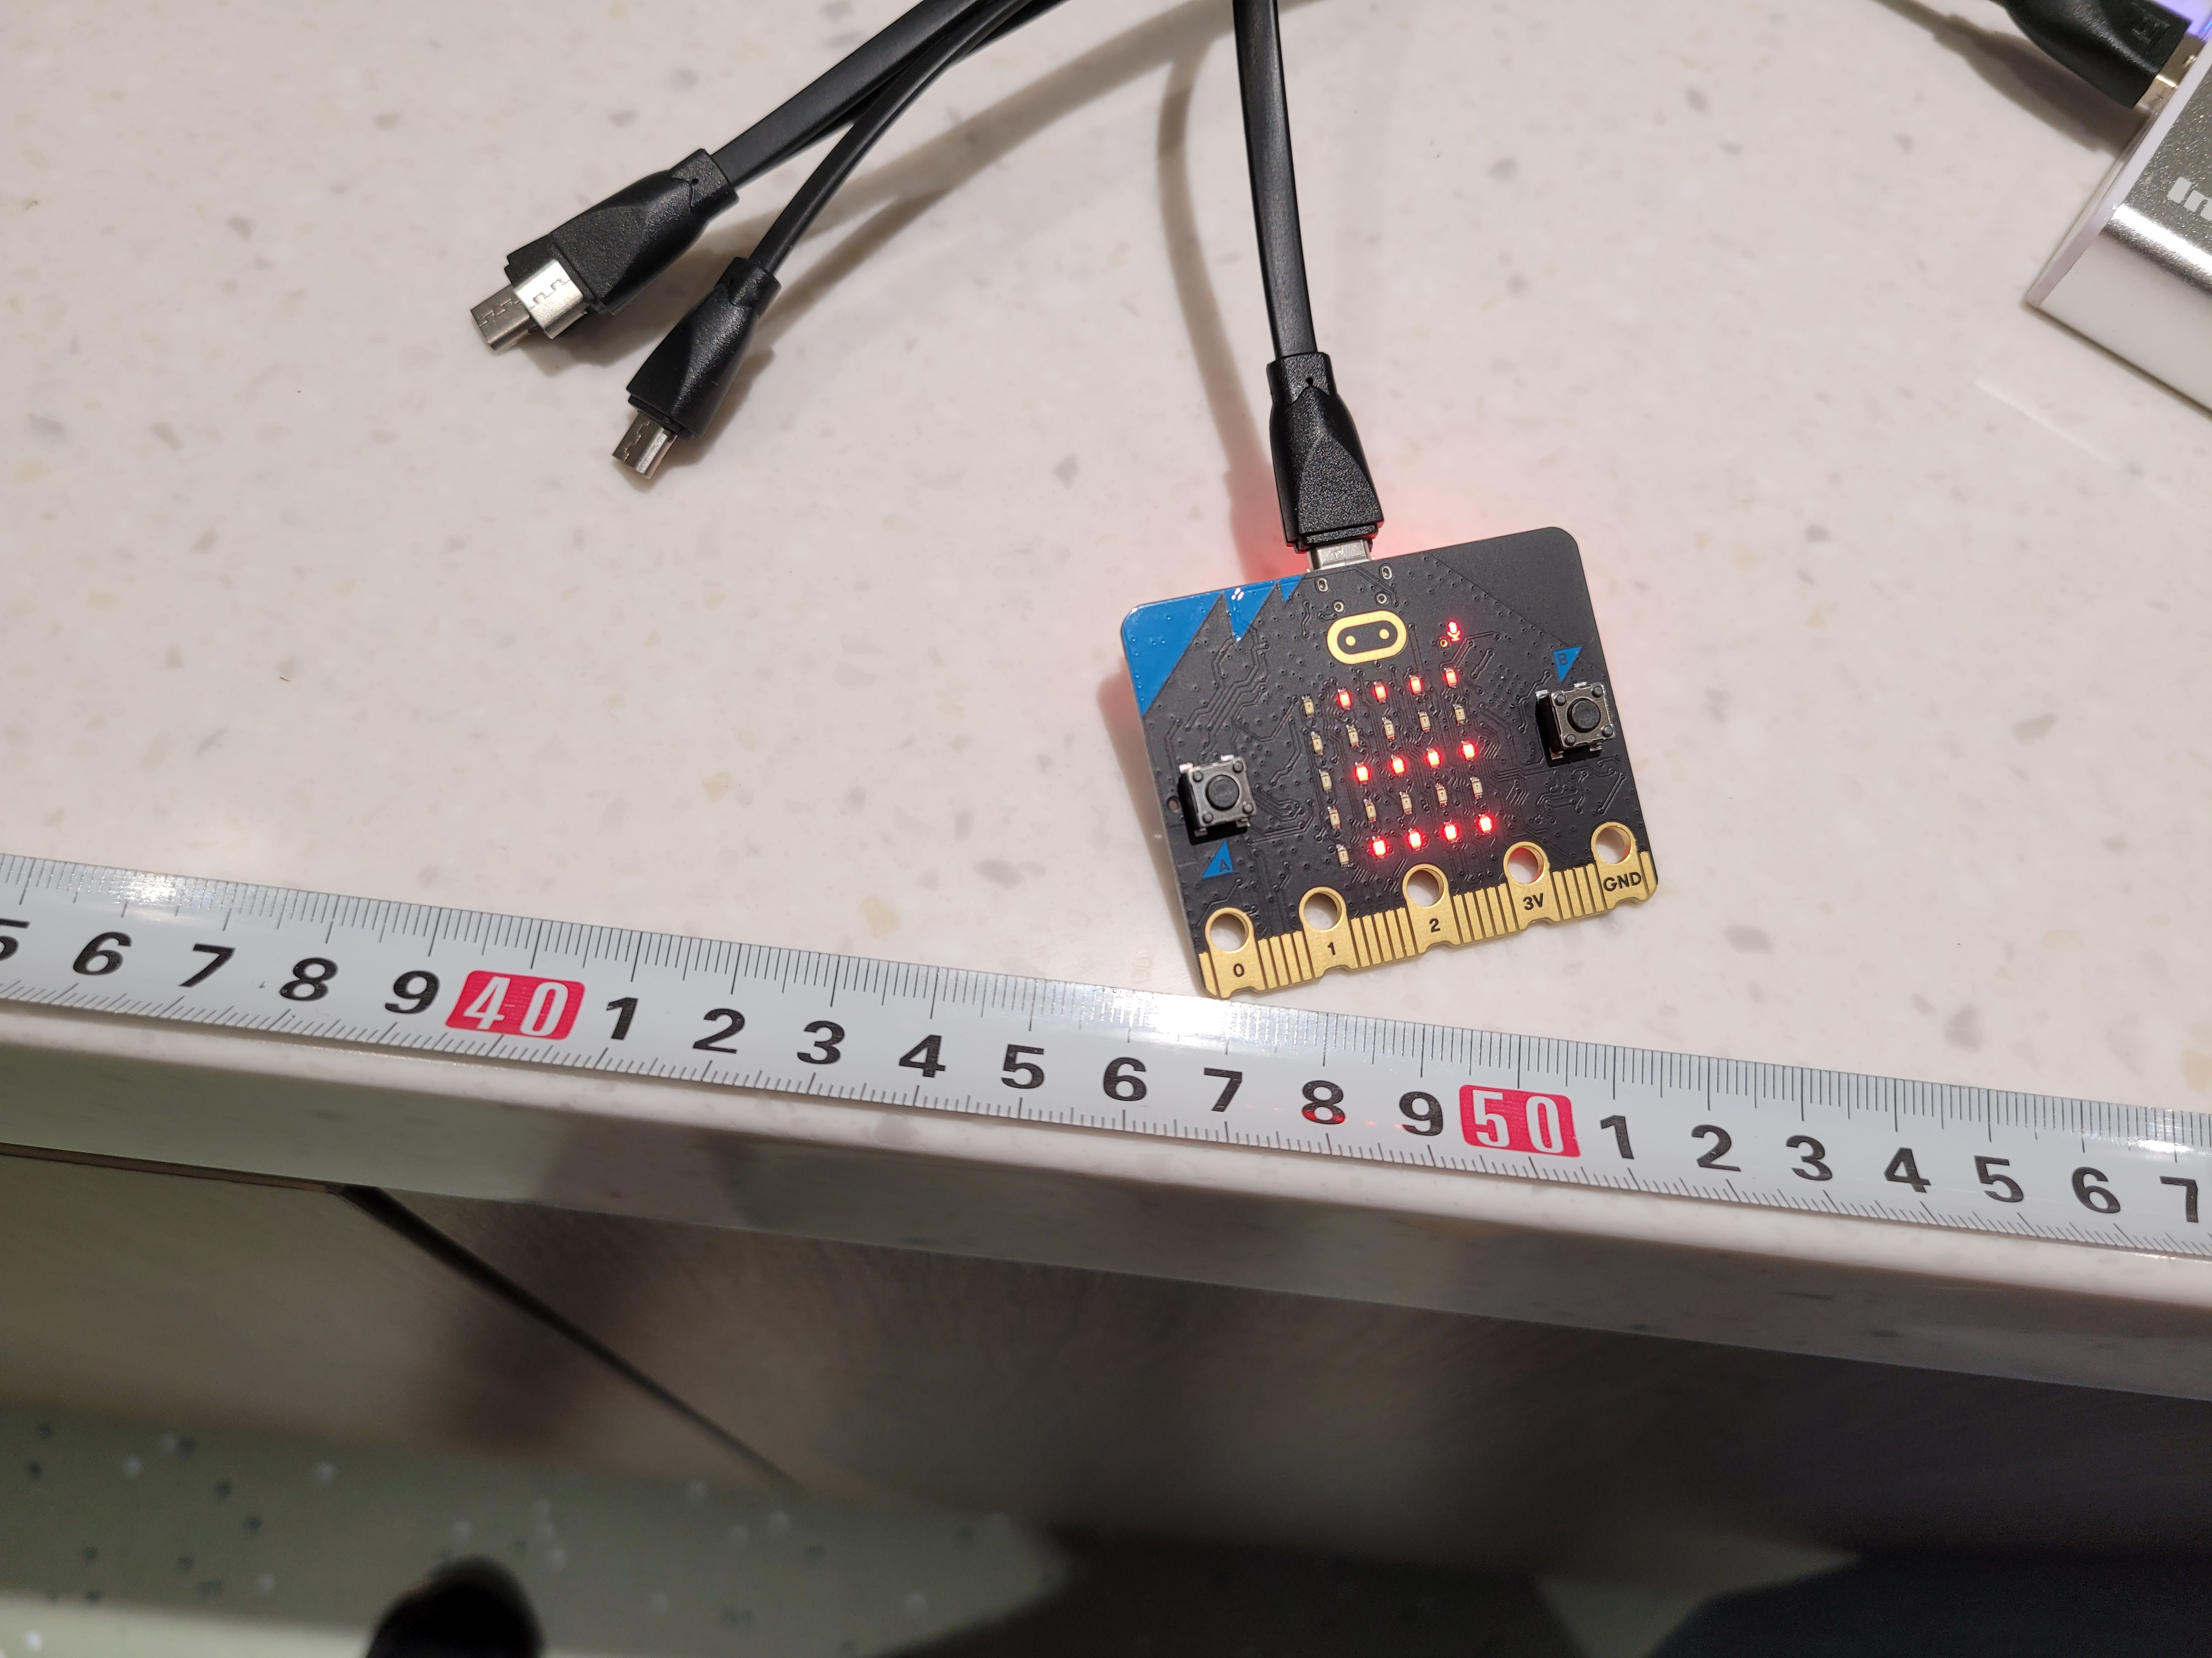
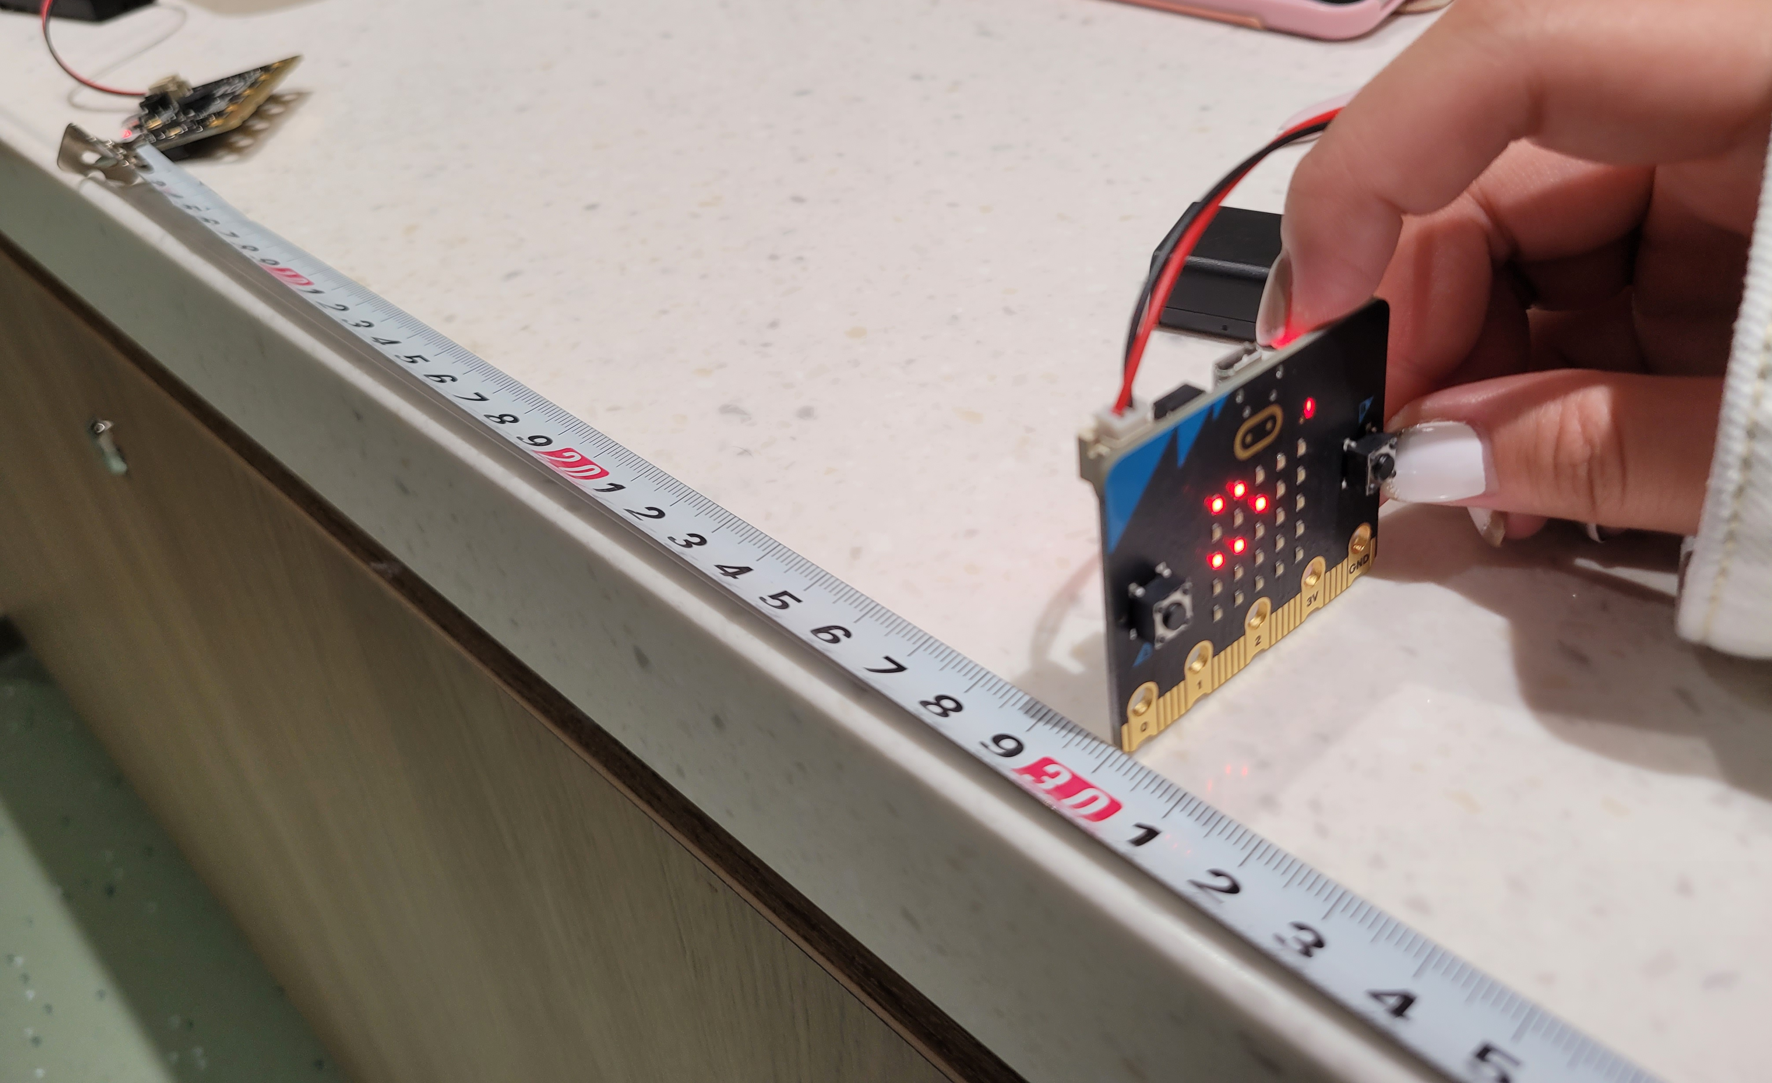
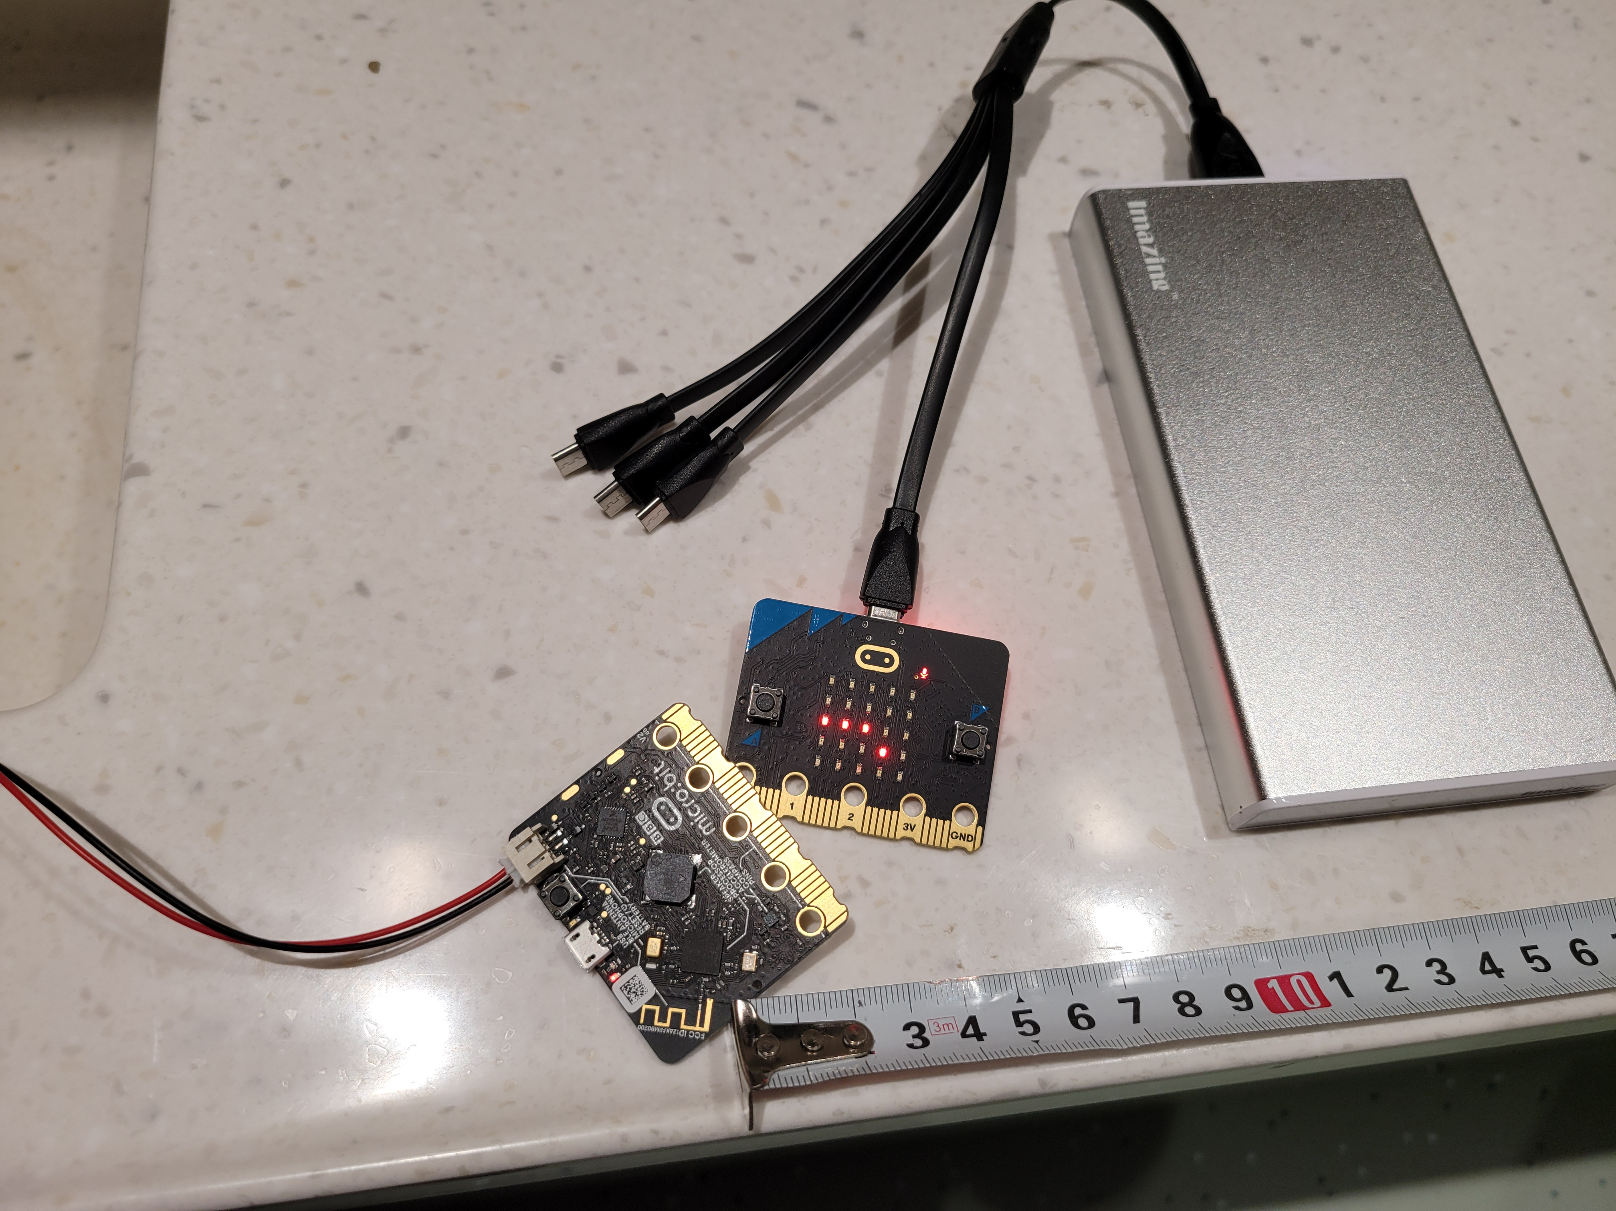
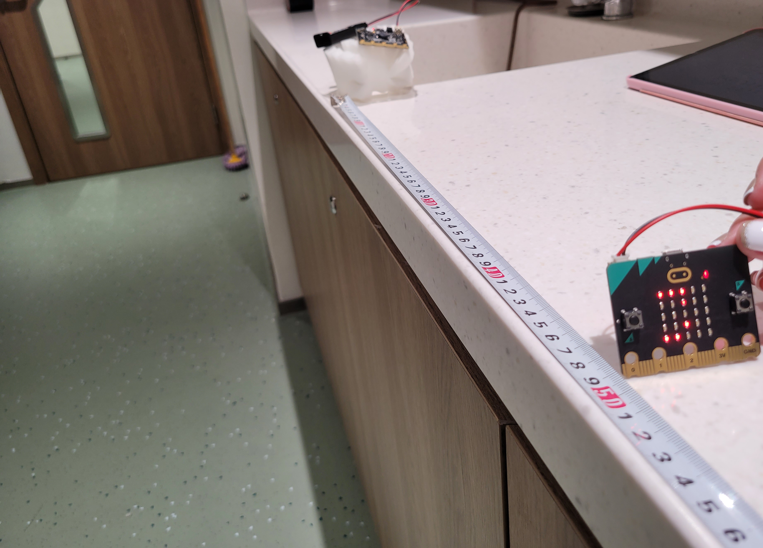
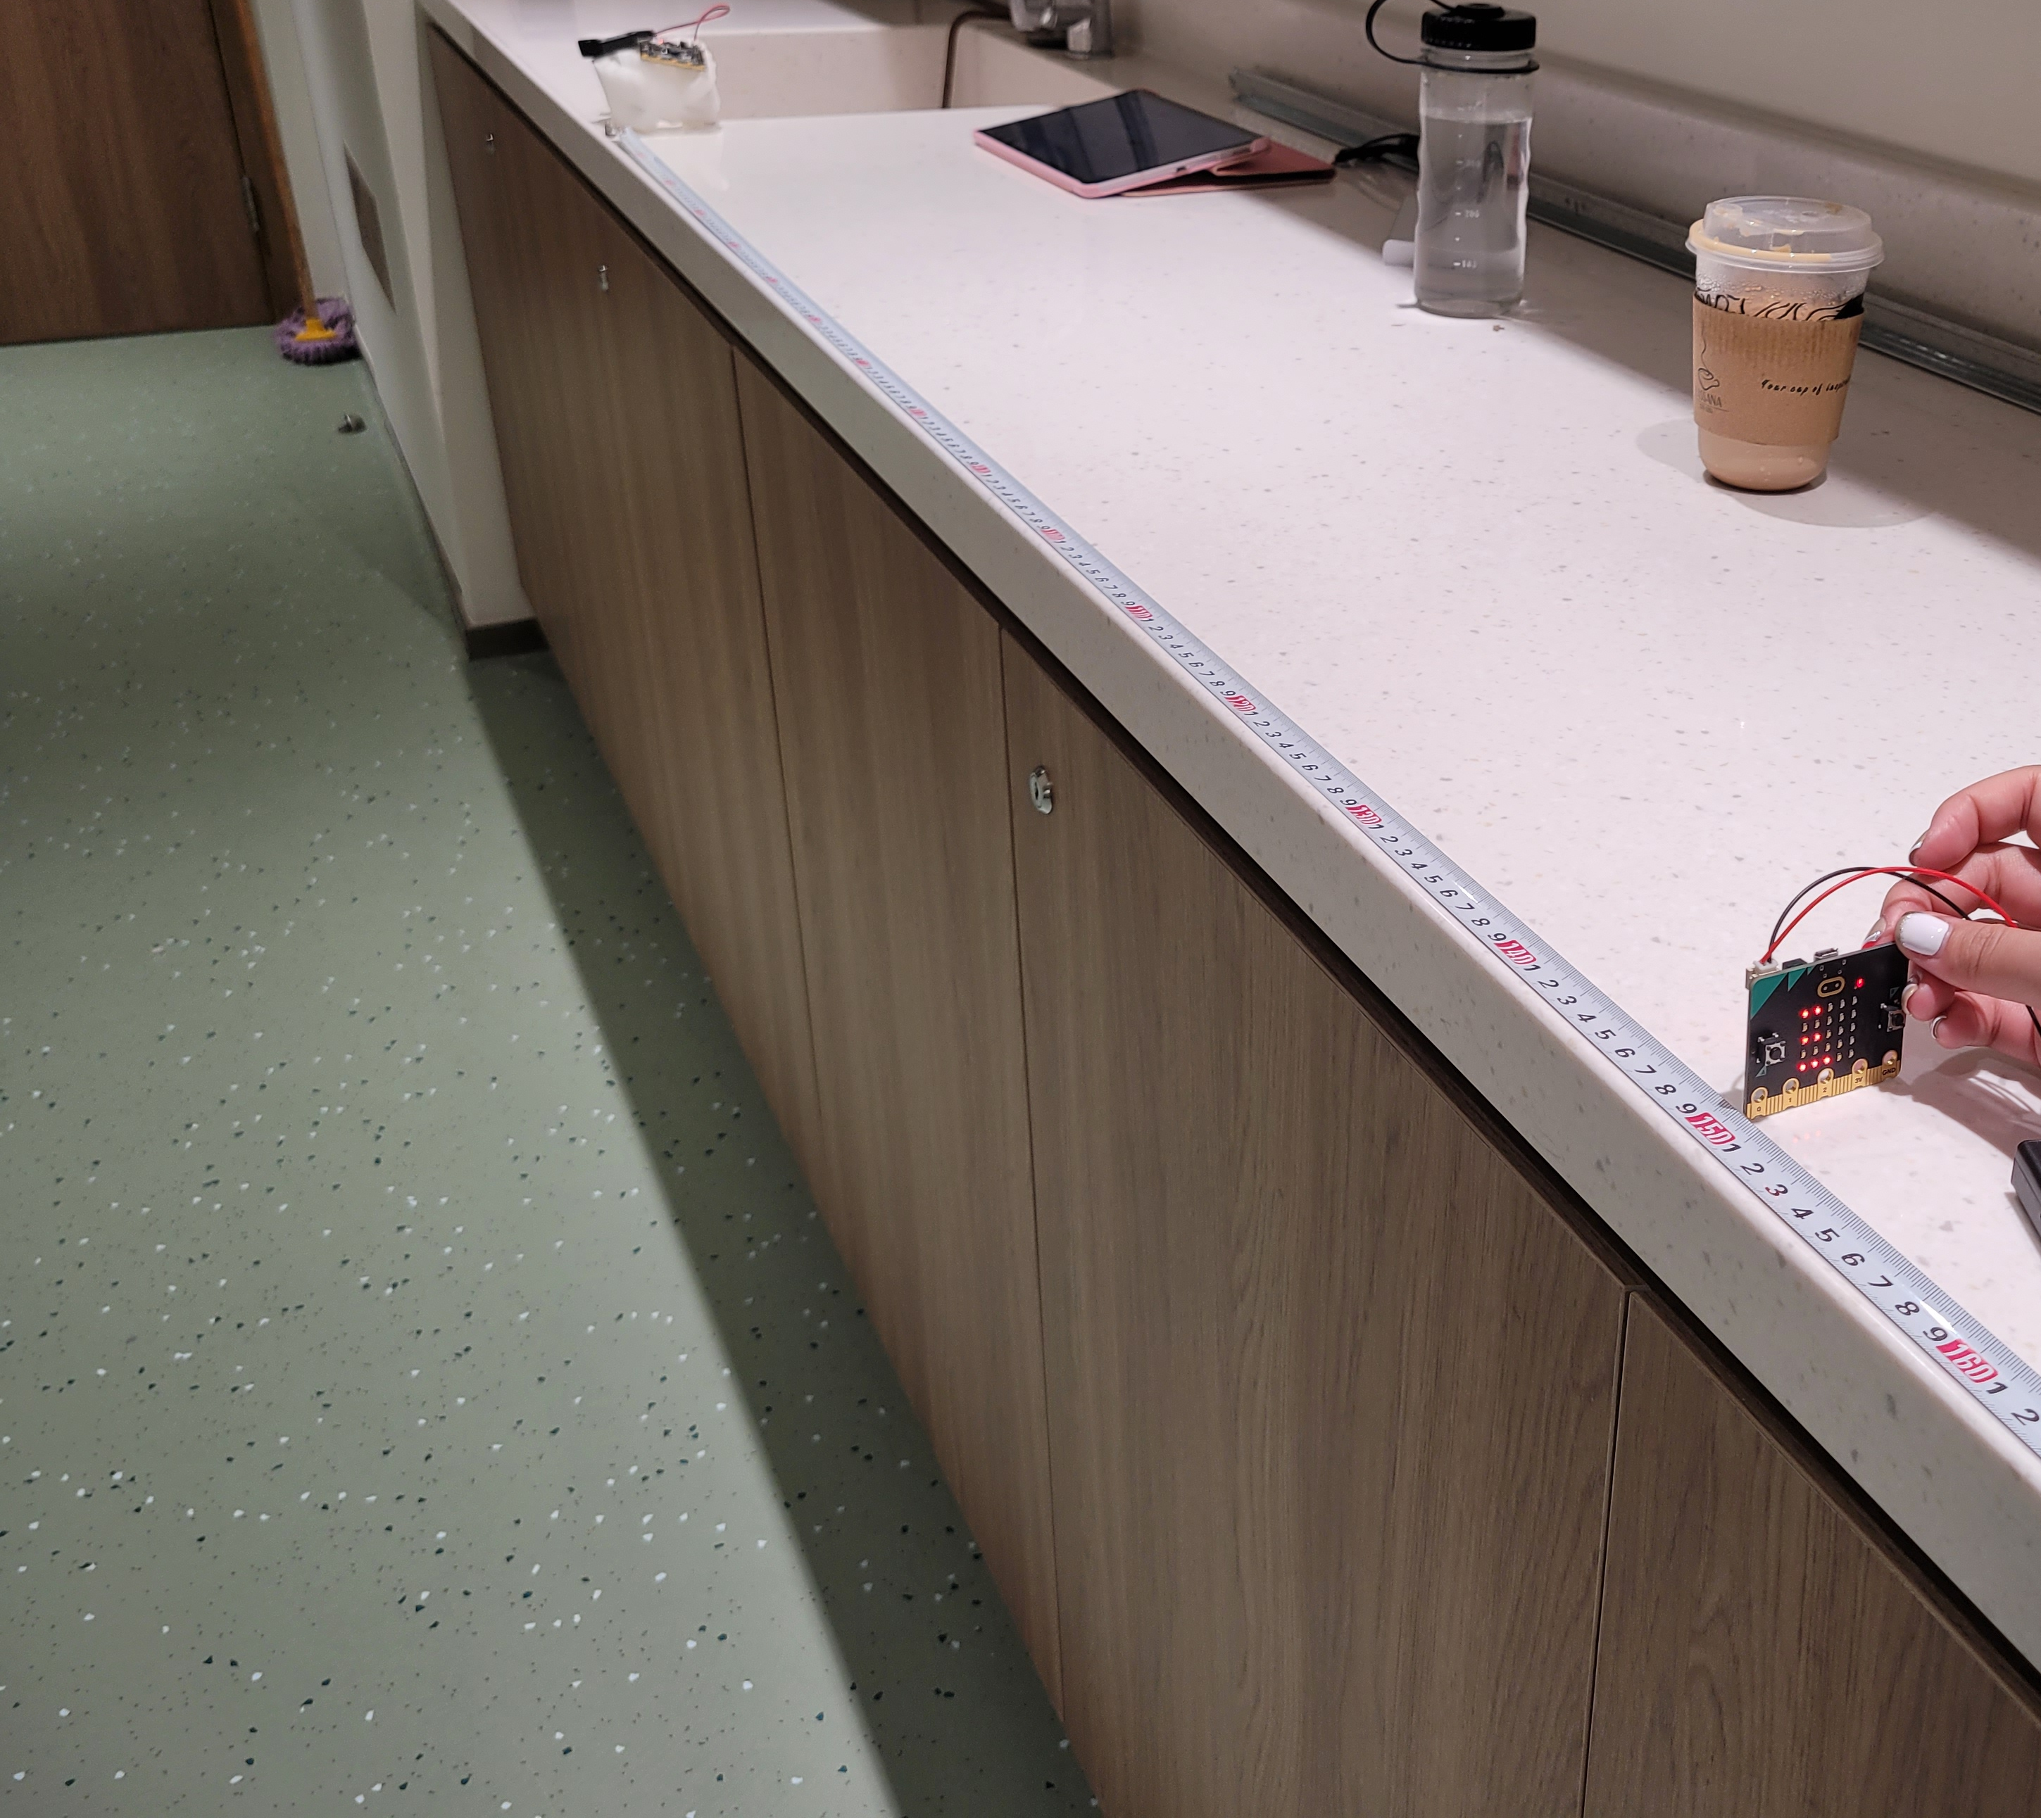
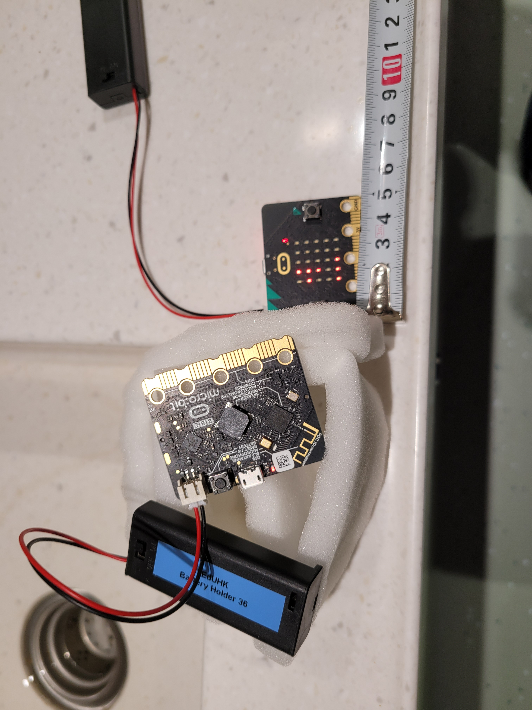
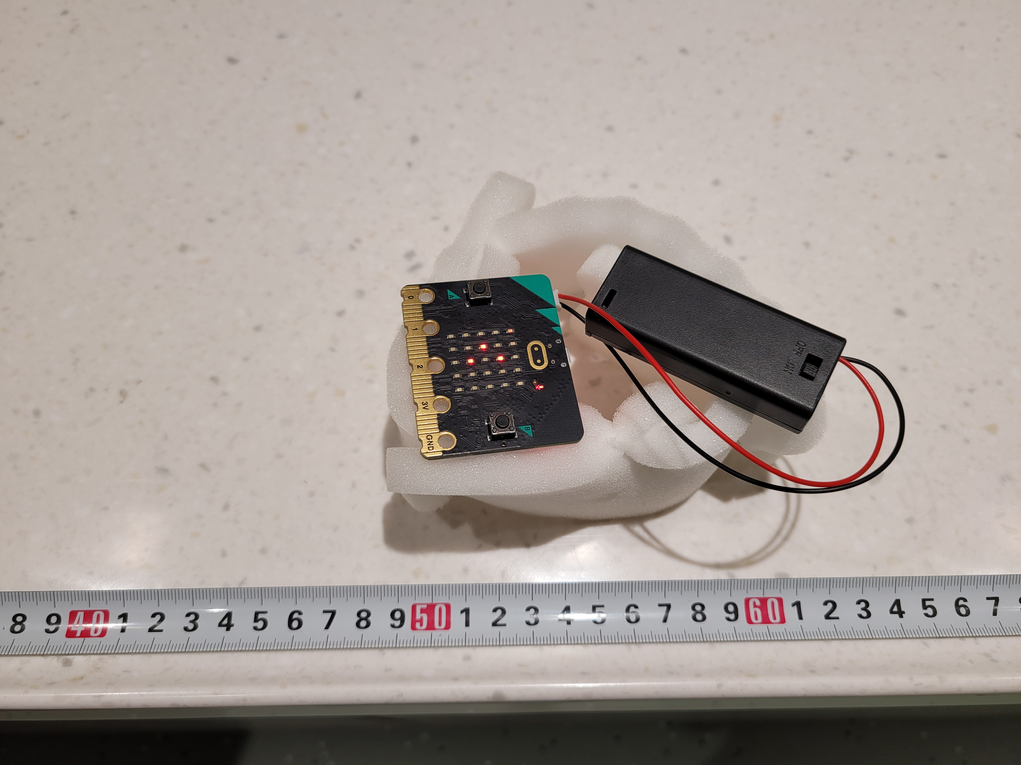
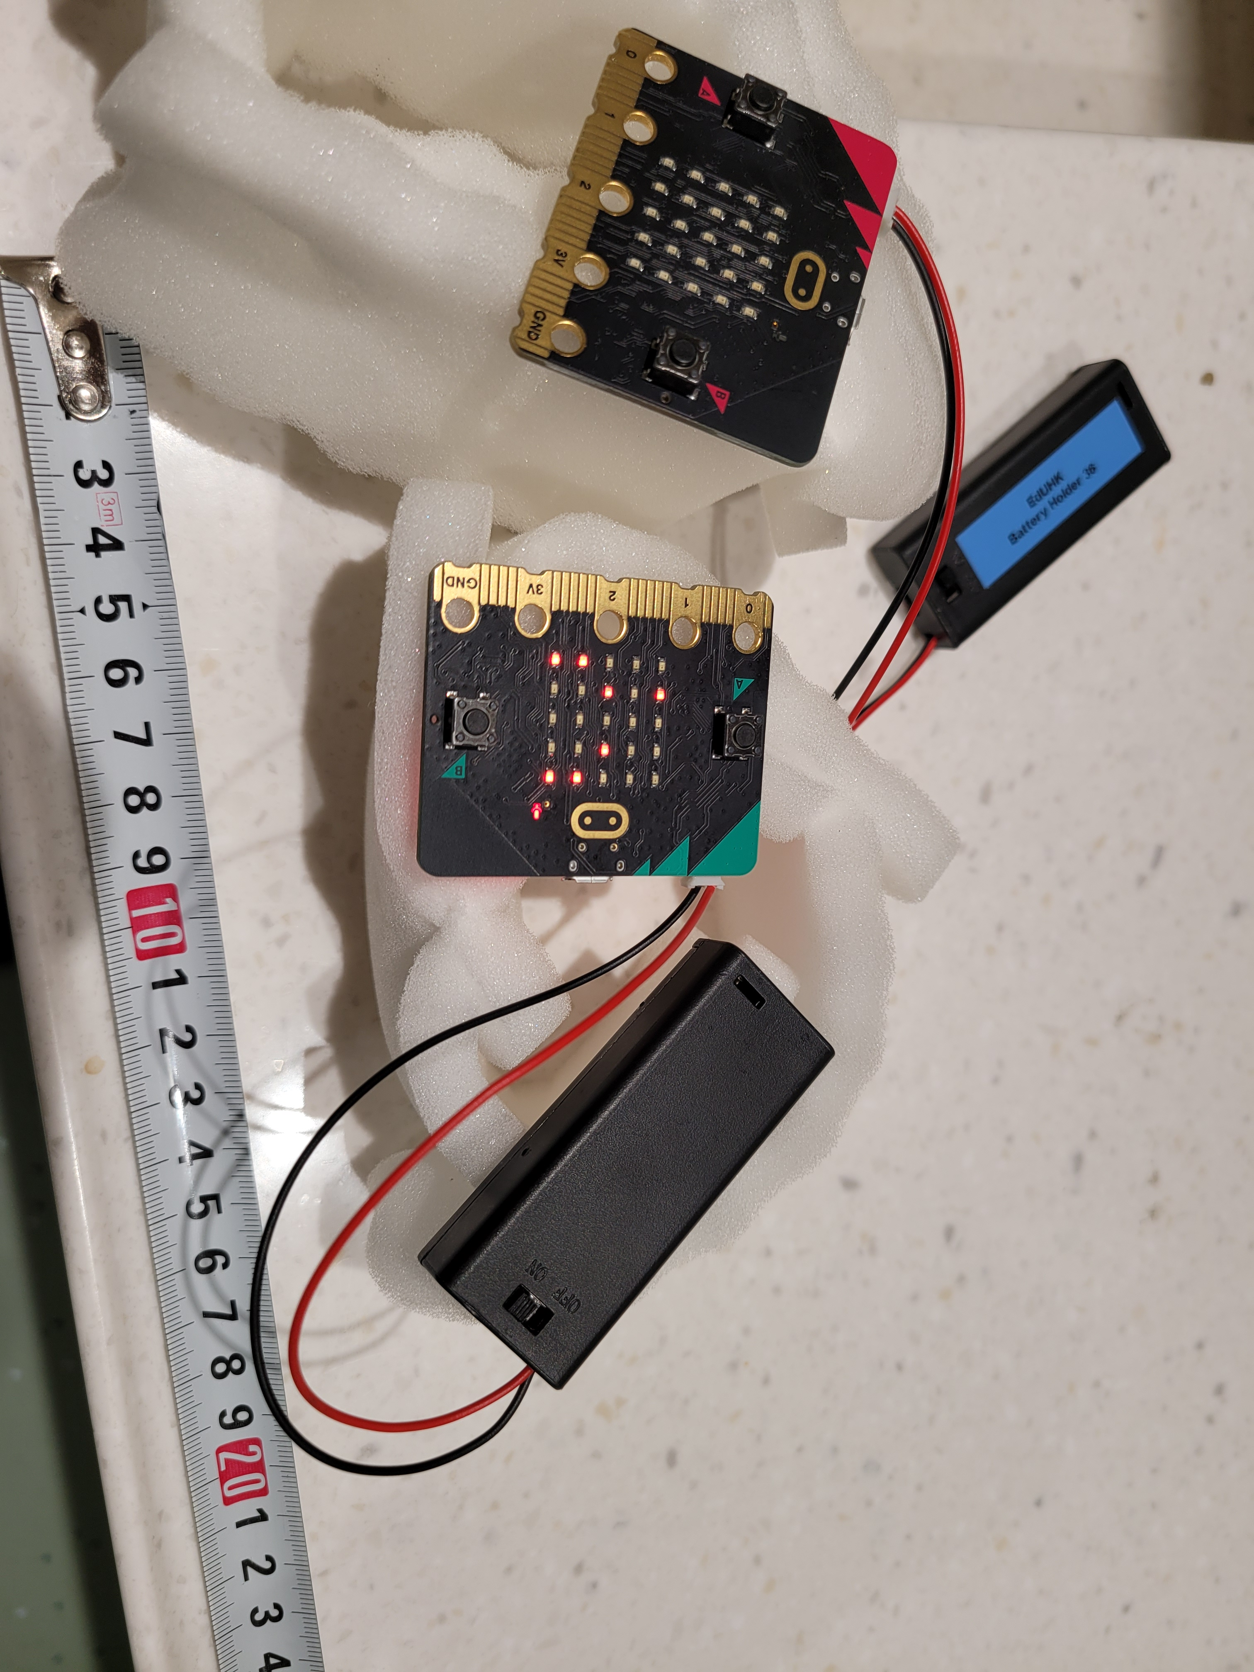

Slide 21
Objectives of experiment 5
Using Microbit as a sound logger to detect the maximum sound level of different sound source in the same distance(0m)

Slide 22
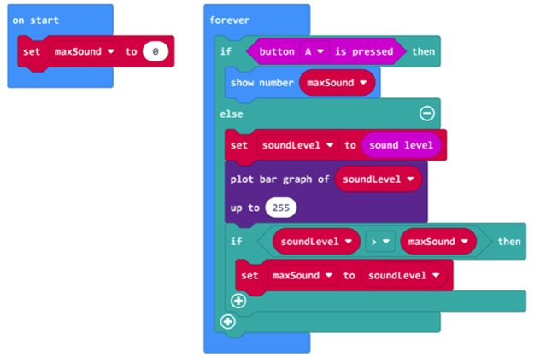
Coding of sound logger in experiment

Slide 23
experiment 5
sound source | Max sound level
Clock | 131
2 clocks | 131
human screaming | 131
2 human screaming | 131
all | 131

Slide 24
Objectives of experiment 6
Compare the sound level differences of R8050 and Microbit by using Microbit as a sound source in the same distance(0m)

Slide 25
Coding of sound meter in experiment 6

Slide 26
experiment 6
distance | Microbit sound level | R8050 decibel
0 | 60 | 70.2
0.5 | 15 | 53.2
1 | 15 | 50
1.5 | 15 | 48.2
2 | 15 | 46.3

Slide 27
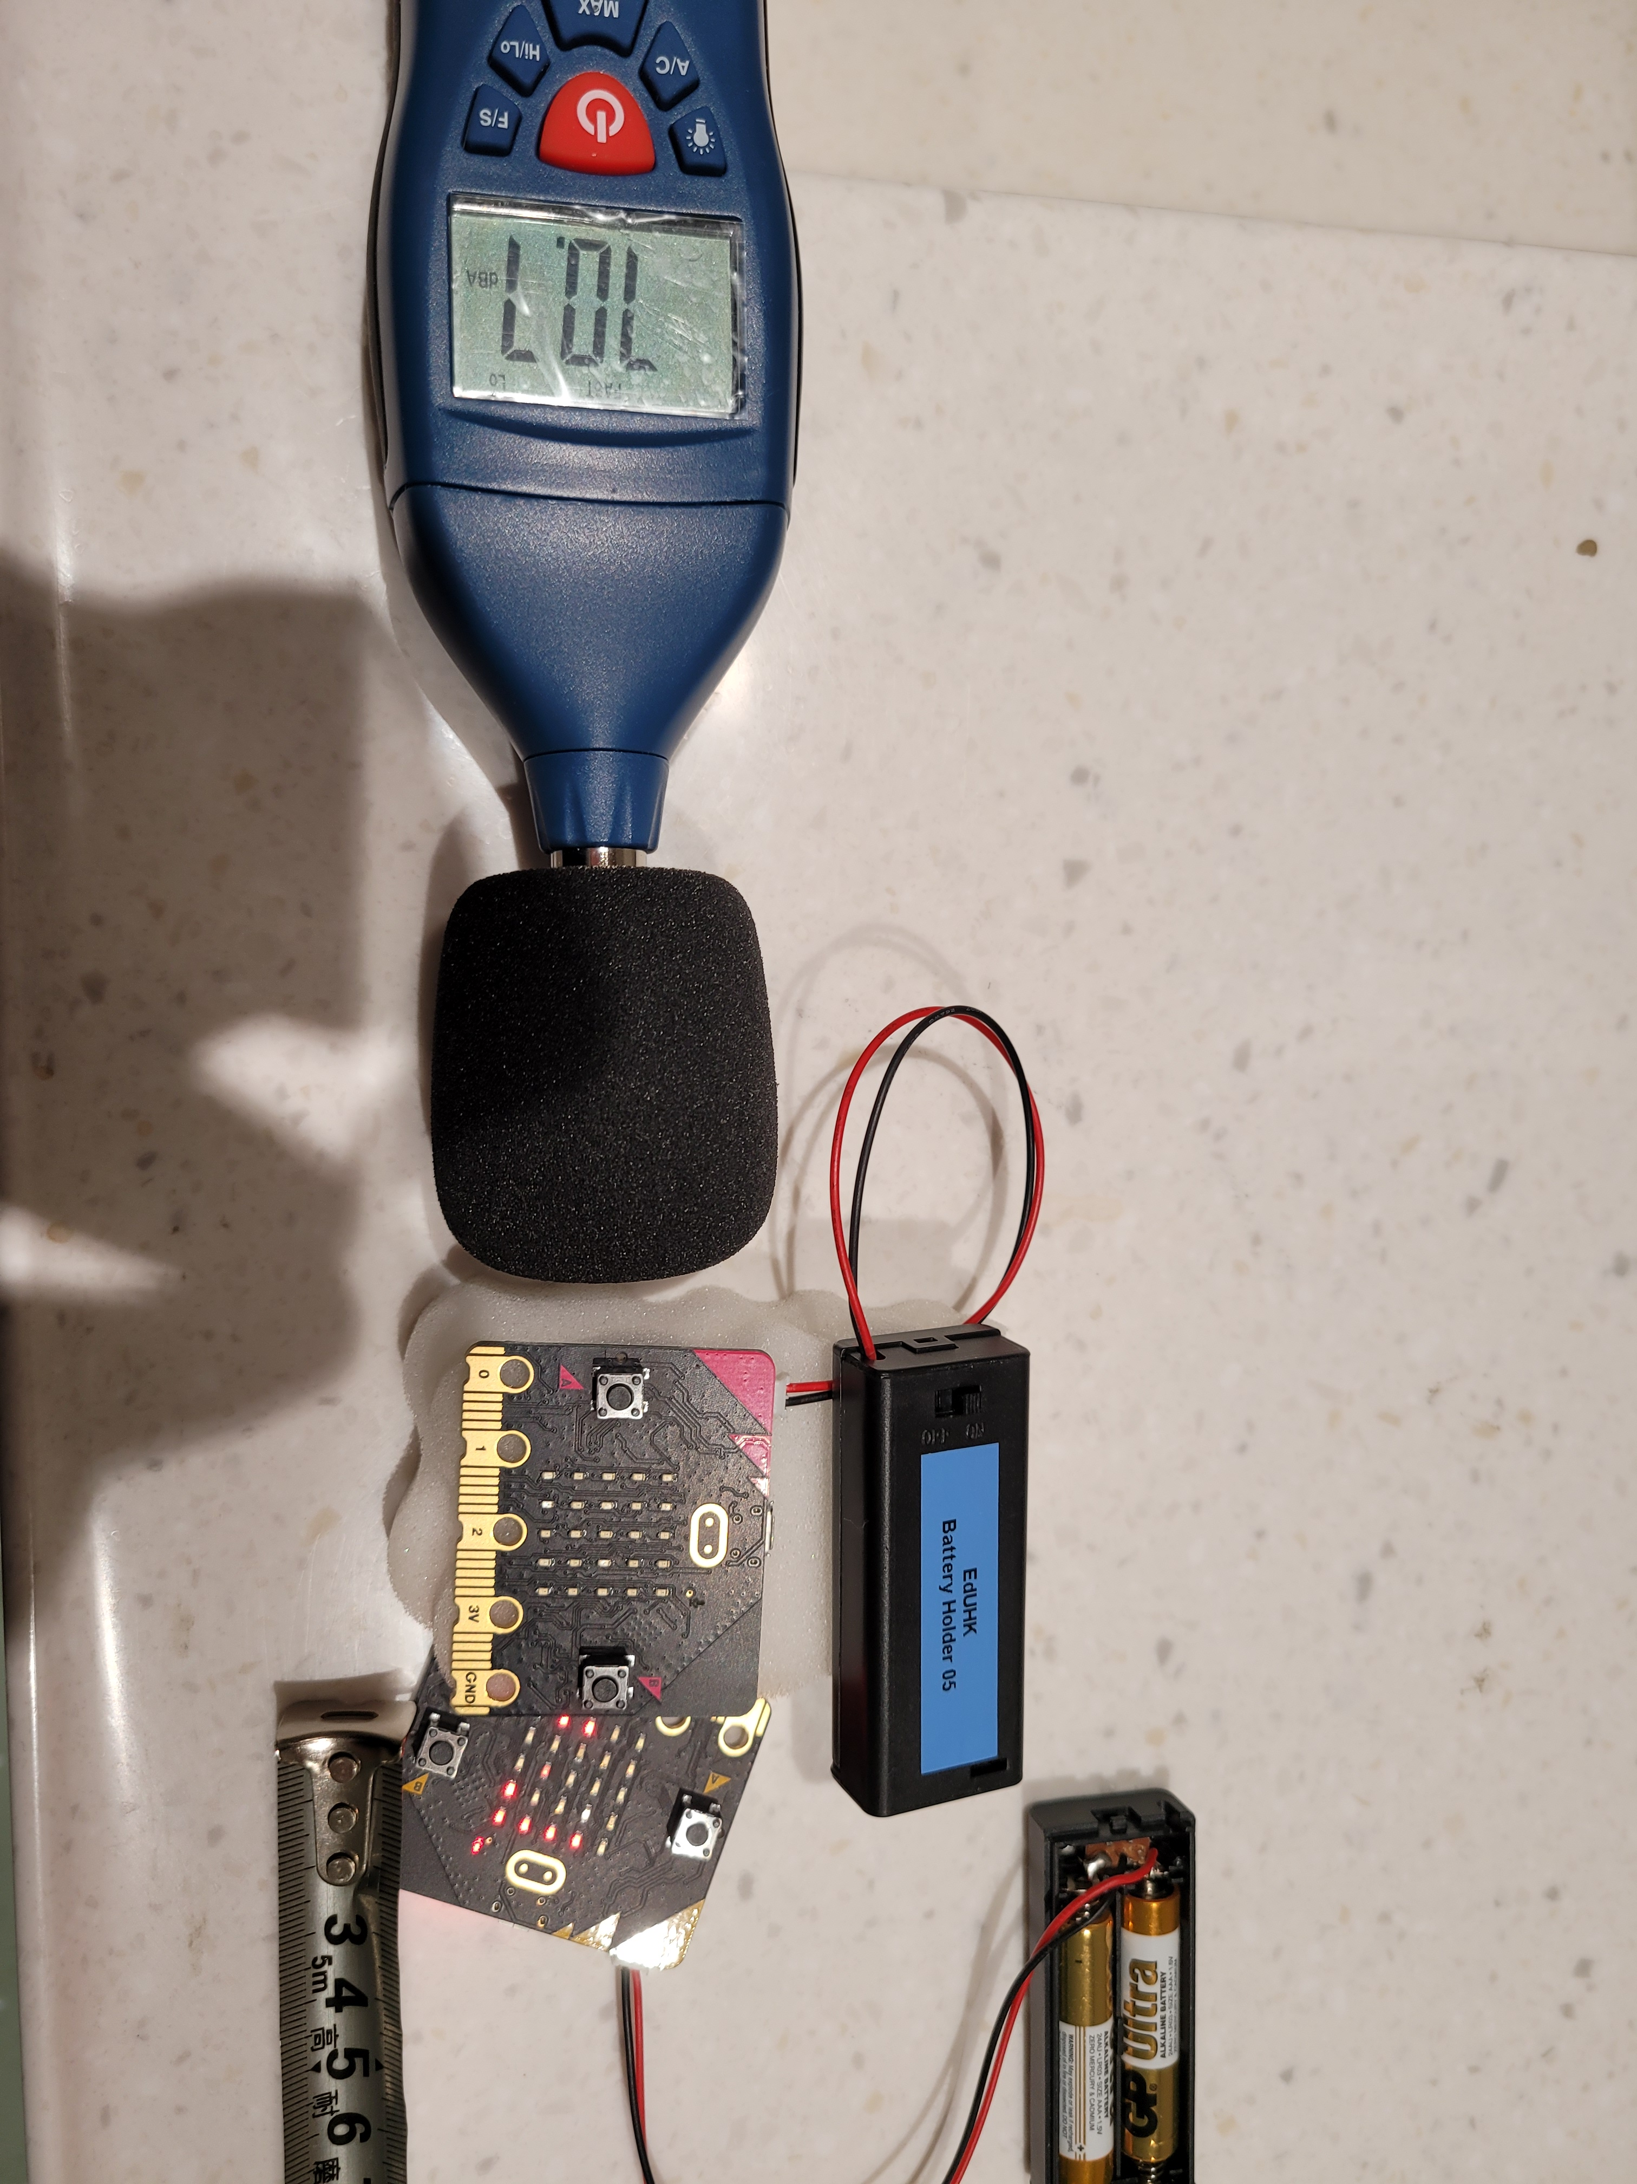
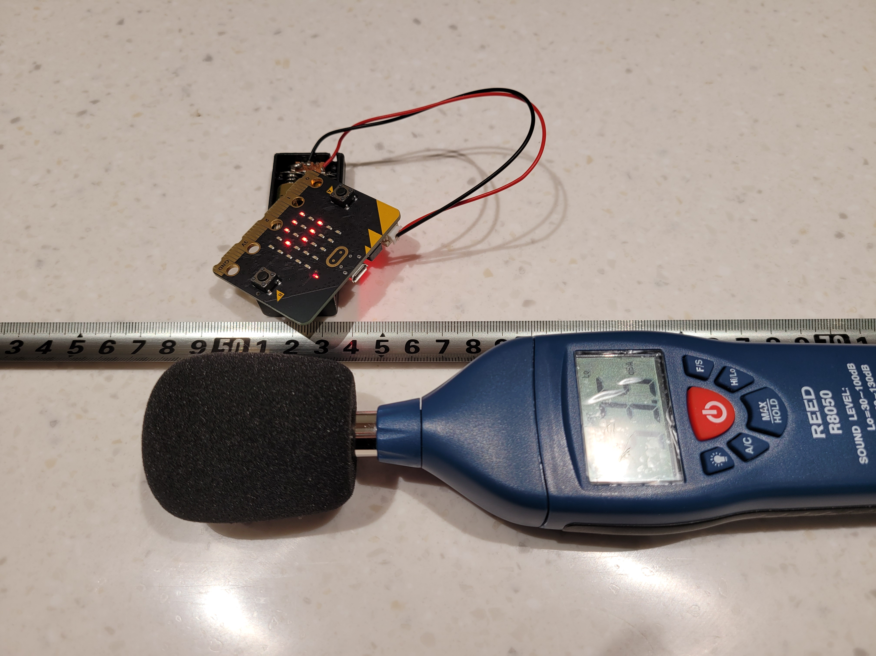
experiment 6

Slide 28
Objectives of experiment 7
Compare the sound level differences of R8050 and Microbit by using Microbit as a sound source in the same distance(0m) with different Sound insulation material

Slide 29
Coding of sound meter in experiment 7

Slide 30
experiment 7
Sound insulation material | Micro:bit sound level | R8050 decibel
N/A | 45 | 74
inside a paper cup with sponge | 30 | 64
inside a box with sponge (open) | 15 | 60
inside a box with sponge (close) | 7 | 46

Slide 31
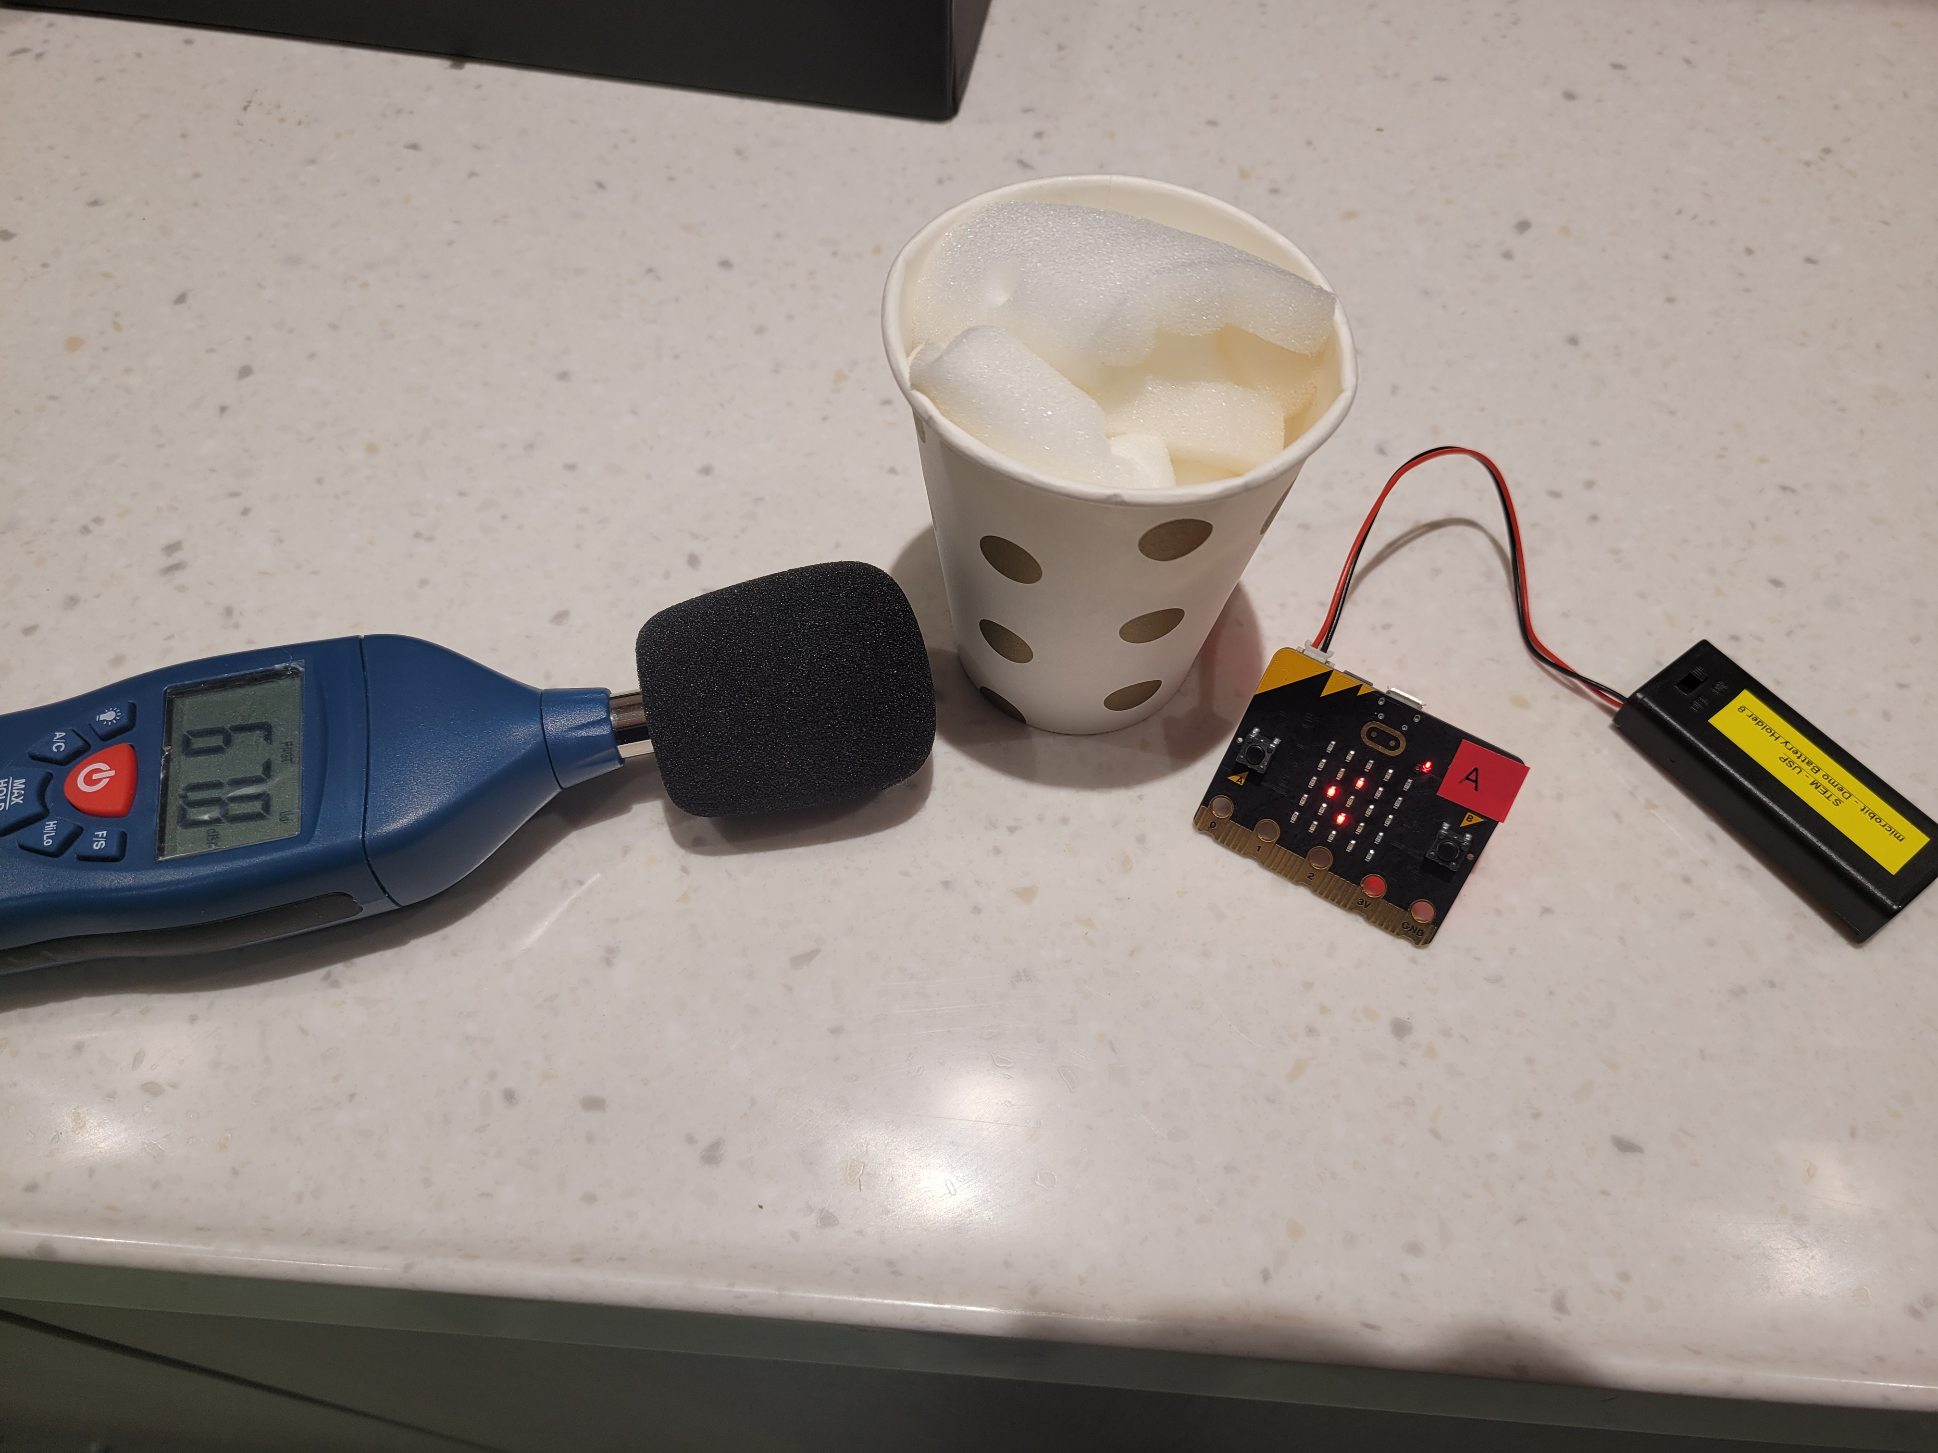
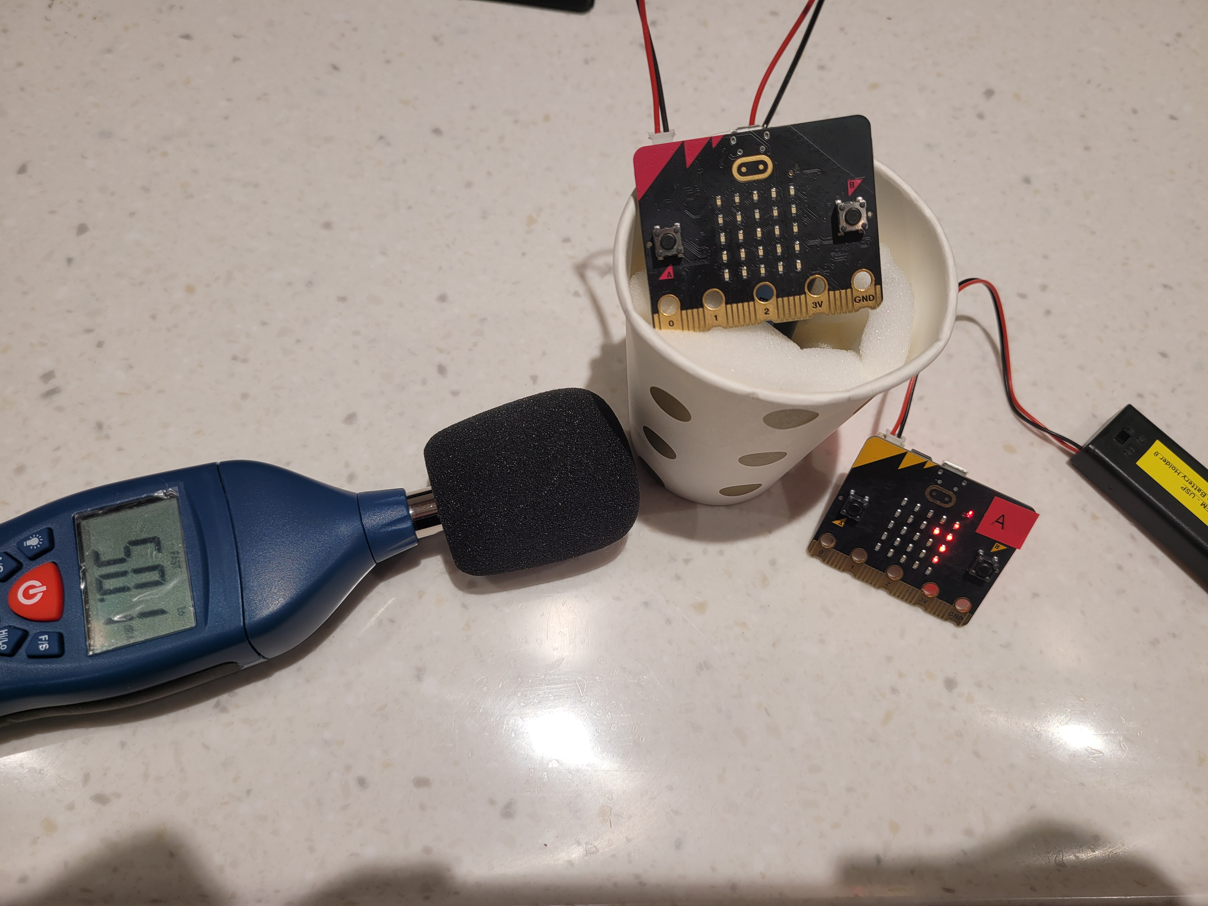
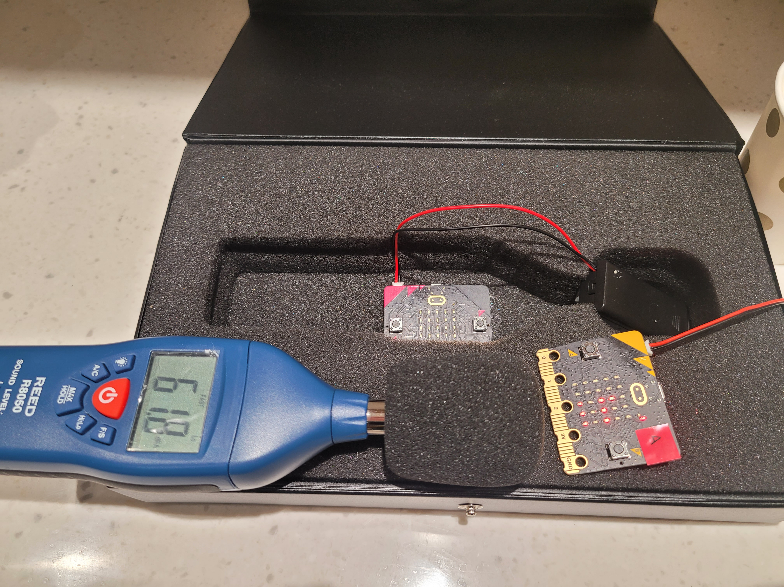
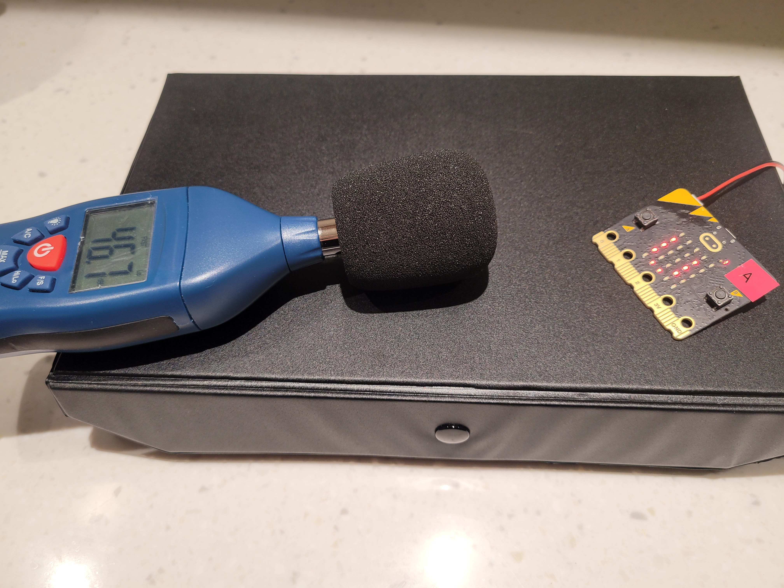
experiment 7

Slide 32
Objectives of experiment 8
Use Microbit A as sound meter and sender and Microbit B as receiver that receive data from Microbit A, and use 165Hz from Iphone as sound source, to detect the sound level by using different materials for sound insulation in 1m.
A# Sound source in box
B# Sound meter in box
Sound source: https://www.youtube.com/watch?v=bZyCHCop2WQ

Slide 33
experiment 8
Experiment 8a | Sound level
N/A | 56
on the box with sponge | 37
inside the box with sponge | 30
Experiment 8b | Sound level
N/A | 56
on the box with sponge | 37
inside the box with sponge | 30

Slide 34
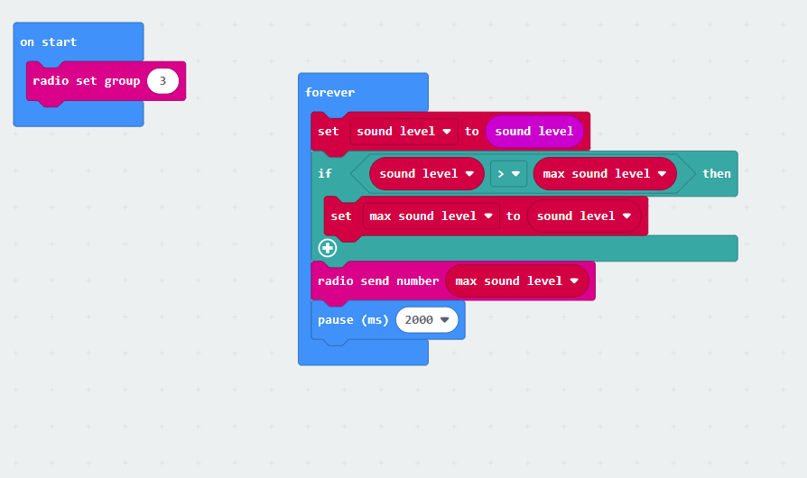
Coding of sender

Slide 35
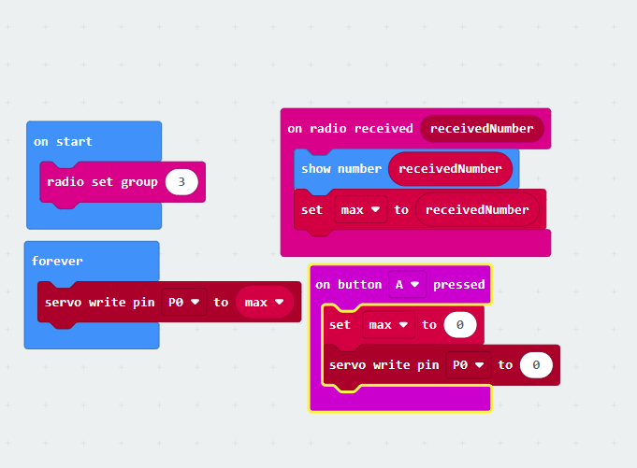
Coding of receiver

Slide 36
experiment 8a
Sound source in box
* with video

Slide 37
experiment 8b
Sound meter in box
* with video

Slide 38
Objectives of experiment 9
Calibration to find out the

Slide 39
Objectives of experiment 2
To compare different sound source by using R8050 and Microbit

Slide 40
Objectives of experiment 2
To compare different sound source by using R8050 and Microbit

Slide 41
Objectives of experiment 2
To compare different sound source by using R8050 and Microbit

Slide 42
Objectives of experiment 2
To compare different sound source by using R8050 and Microbit

Slide 43
Objectives of experiment 2
To compare different sound source by using R8050 and Microbit

Slide 44
Objectives of experiment 2
To compare different sound source by using R8050 and Microbit

Slide 45
Objectives of experiment 2
To compare different sound source by using R8050 and Microbit

Slide 46
Objectives of experiment 2
To compare different sound source by using R8050 and Microbit

Slide 47
Objectives of experiment 2
To compare different sound source by using R8050 and Microbit

Slide 48
Objectives of experiment 2
To compare different sound source by using R8050 and Microbit

Slide 49
Objectives of experiment 2
To compare different sound source by using R8050 and Microbit

Slide 50
Objectives of experiment 2
To compare different sound source by using R8050 and Microbit

Slide 51
Objectives of experiment 2
To compare different sound source by using R8050 and Microbit

Slide 52
Objectives of experiment 2
To compare different sound source by using R8050 and Microbit

Slide 53
Objectives of experiment 2
To compare different sound source by using R8050 and Microbit

Slide 54
Objectives of experiment 2
To compare different sound source by using R8050 and Microbit

Slide 55
Objectives of experiment 2
To compare different sound source by using R8050 and Microbit

