Slide 1
The Education University of Hong Kong
2022-2023 Quality Education Fund Thematic Network - Tertiary Institutes
STEM Project Team
SCHOOL: SAHK B M Kotewall Memorial School
TOPIC: Wheelchairs Astern Sensor

Slide 2
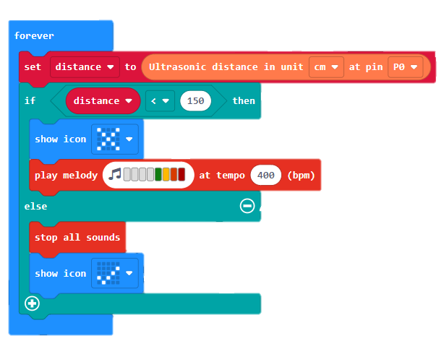
Topic-1
Sonar:bit Sensor:
Combined Sonar:bit and iot:bit to coordinate detect the distance while student is getting closed to the wheelchairs.
Errors:
Time delay;
Distance error

Slide 3
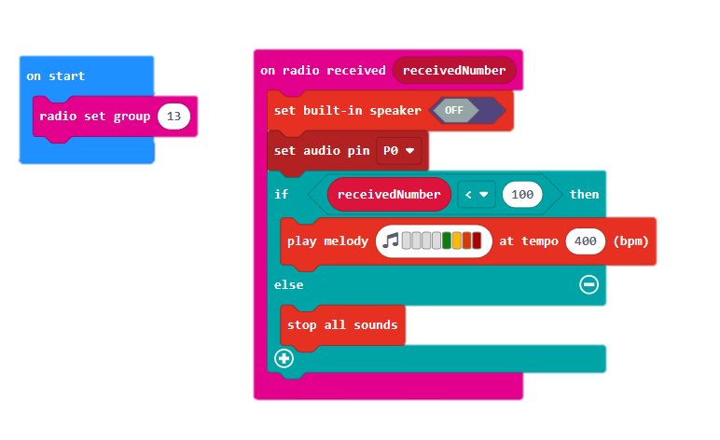
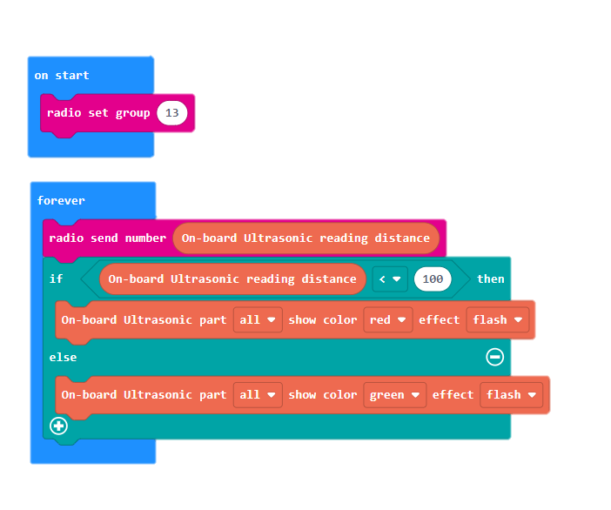
Topic-2
Send: with RUS-04 Sensor to detect distance and send the data to the received micro:bit.
Error:
Radio transmission delay for the received number;
Setting to be more complicated for student.
Receive: receiving the data from the detect setting and give three types of light for different alarms.

Slide 4
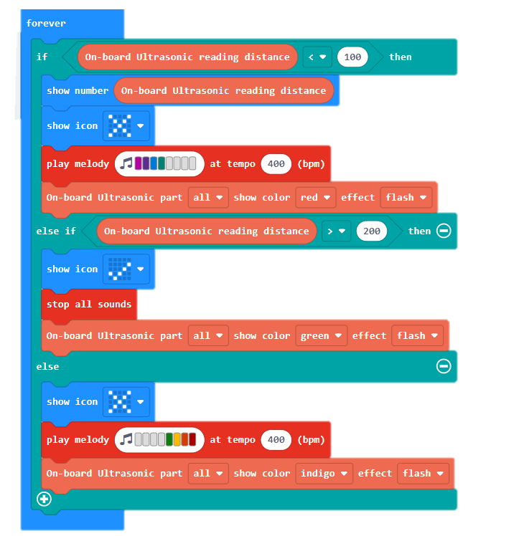
Topic-3
RUS-04 Sensor
Very closed distance alarm
Light and sound alarm for three distances with the cross symbol or tick symbol.
Safe distance alarm
Closed distance alarm

Slide 5
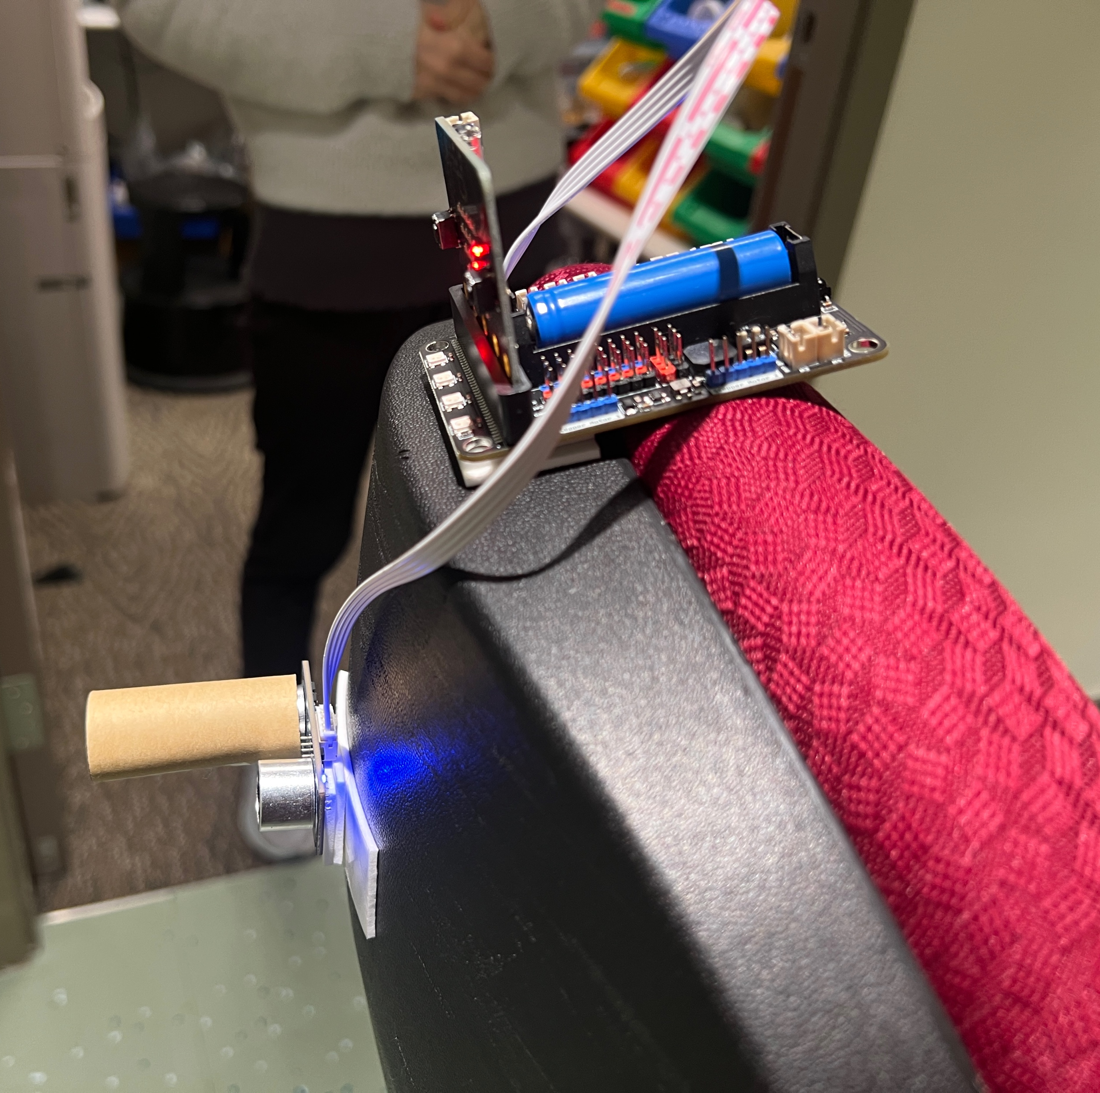
Photo of Topic-3

