Slide 1
The Education University of Hong Kong
2022-2023 Quality Education Fund Thematic Network - Tertiary Institutes
STEM Project Team
SCHOOL:中西區聖安多尼學校Central And Western District St. Anthony's School
TOPIC: Insulation

Slide 2
Topic
Homemade insulation device

Slide 3
Experiment material
Insulation material:
Towels, sponges, cotton, newspapers, cardboard, tinfoil

Slide 4
Objectives of Experiment
Explore the insulation capabilities of different materials, and find out which is the best Insulation material for keeping cold

Slide 5
Result
1st experiment | weight (g) | 30 mins | change | % loss | 1h | change | % loss | total change | total% loss | Best*
N/A | 9.2 | 5.5 | 3.7 | 40.2 | 1.9 | 3.6 | 69.2 | 7.3 | 79.3 | /
tin foil | 8.8 | 5.8 | 3 | 34 | 1.8 | 4 | 69 | 7 | 79.5 | 6
sponge | 9.9 | 6.7 | 3.2 | 32.3 | 3.6 | 3.1 | 46.2 | 6.3 | 63.6 | 4
towel | 10.7 | 8.2 | 2.5 | 23.3 | 5 | 3.2 | 39 | 5.7 | 53.2 | 1
cotton | 8.5 | 6.4 | 2.1 | 24.7 | 3.8 | 2.6 | 40.6 | 4.7 | 55.2 | 2
newspaper | 8 | 5.7 | 2.3 | 28.8 | 3.1 | 2.6 | 45.6 | 4.9 | 61.2 | 3
cardboard | 10 | 6.7 | 3.3 | 33 | 3.6 | 3.1 | 46.2 | 6.4 | 64 | 5

Slide 6
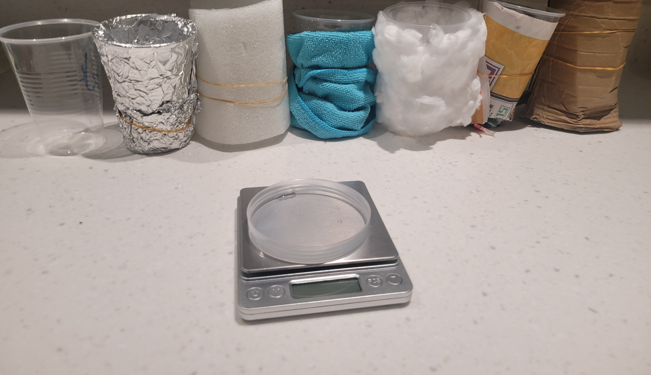
Photo

