Slide 1







The Education University of Hong Kong
2022-2023 Quality Education Fund Thematic Network - Tertiary Institutes
STEM Project Team
SCHOOL: LCPS 荔枝角天主教小學
TOPIC: Motion Sensor

Slide 2

Objective
To detect motion using motion sensor with Micro:bit.

Slide 3
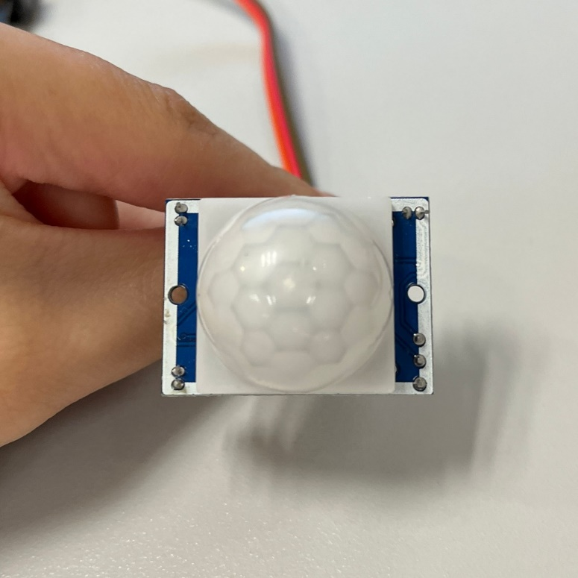
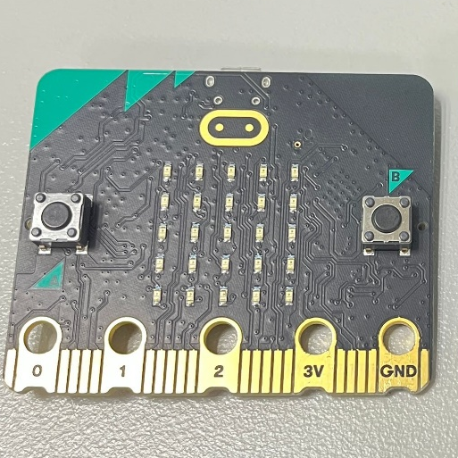
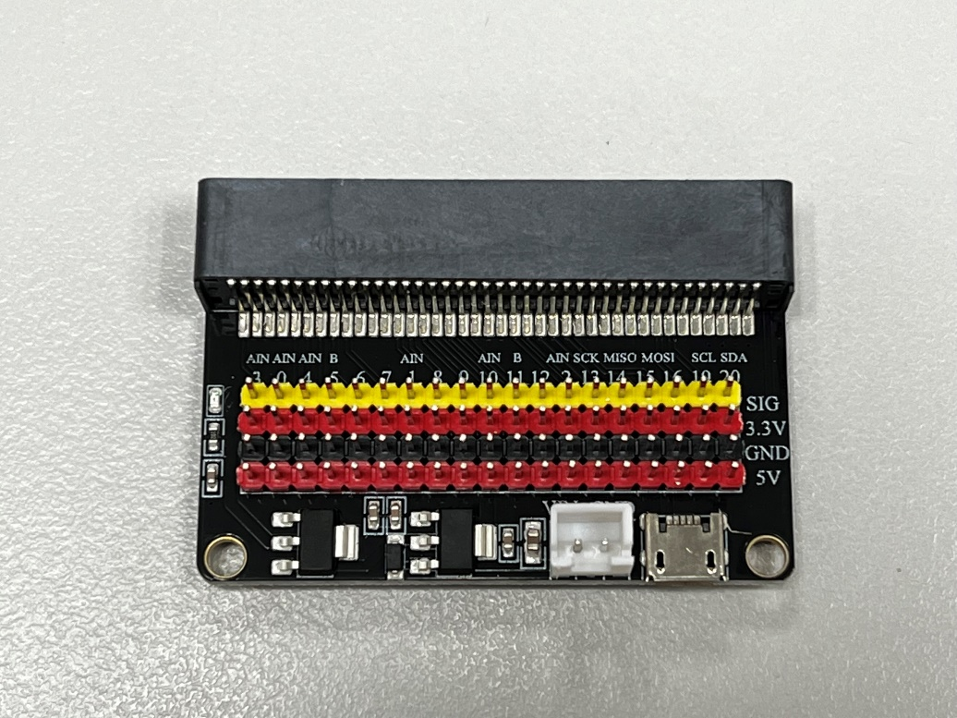
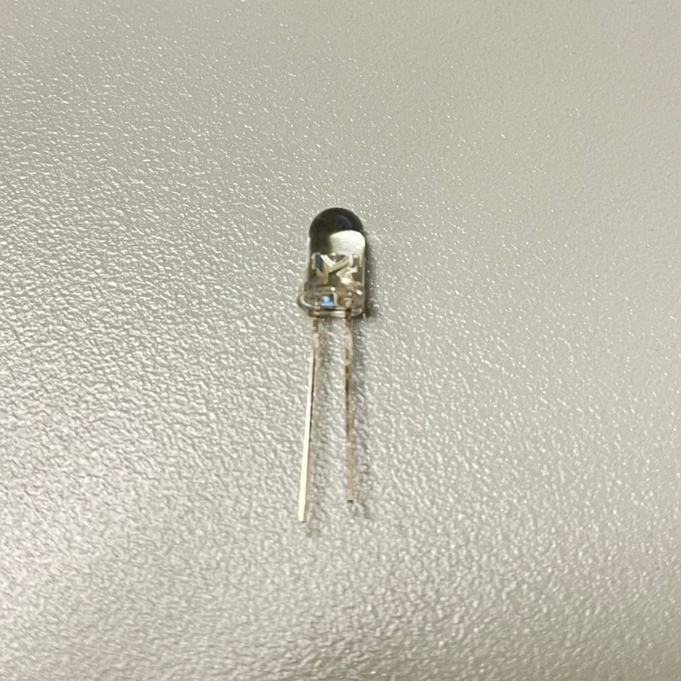
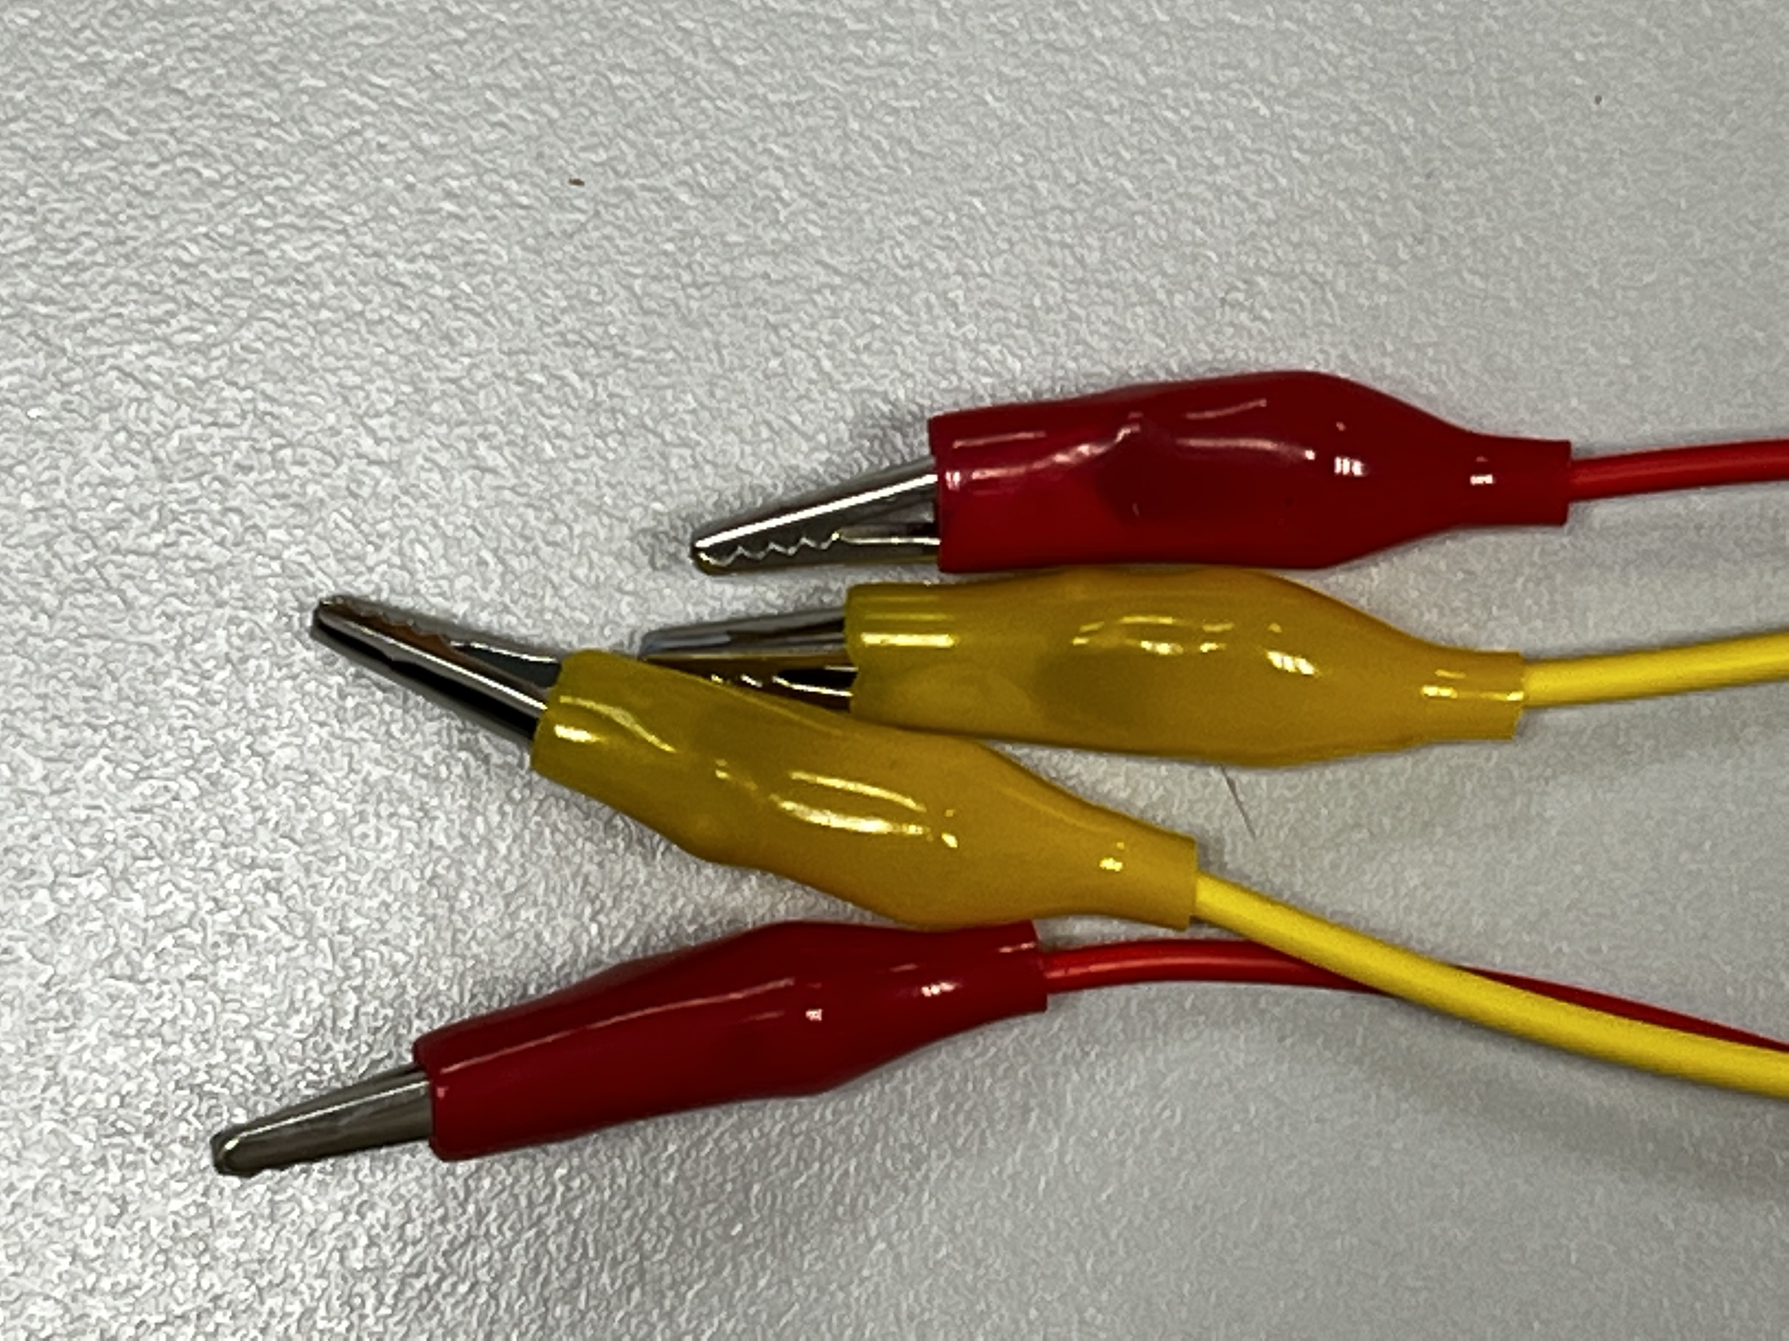
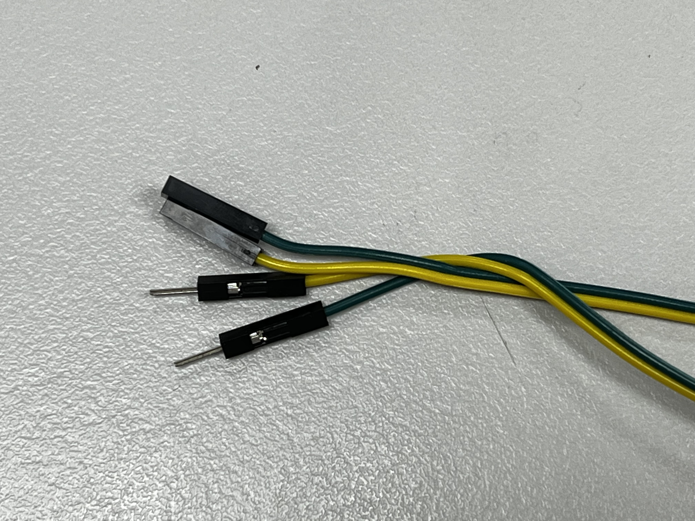
Materials
Motion sensor
Micro:bit
Expansion board
LED light
Alligator clips
Dupont Jumper Cables

Slide 4
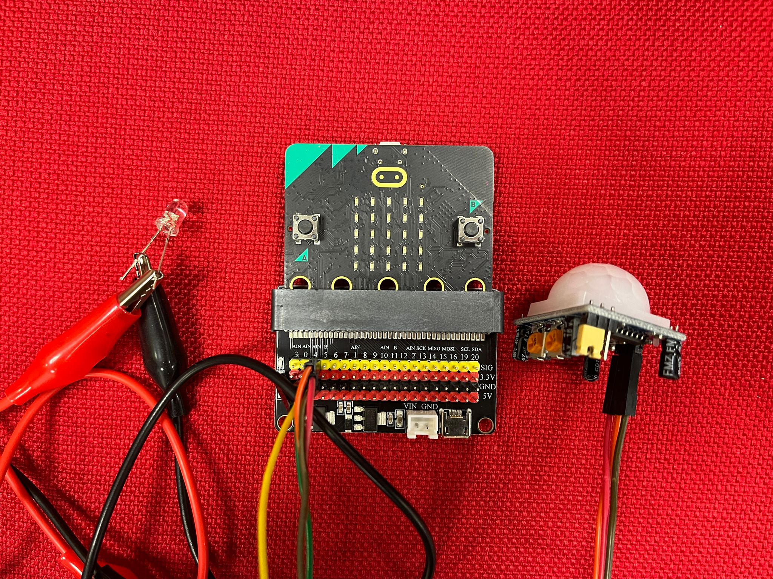
Set-up

Slide 5
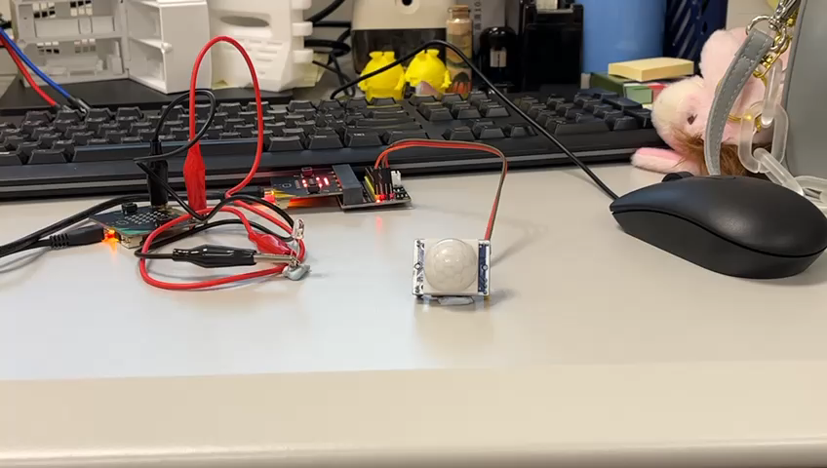
Video

Slide 6
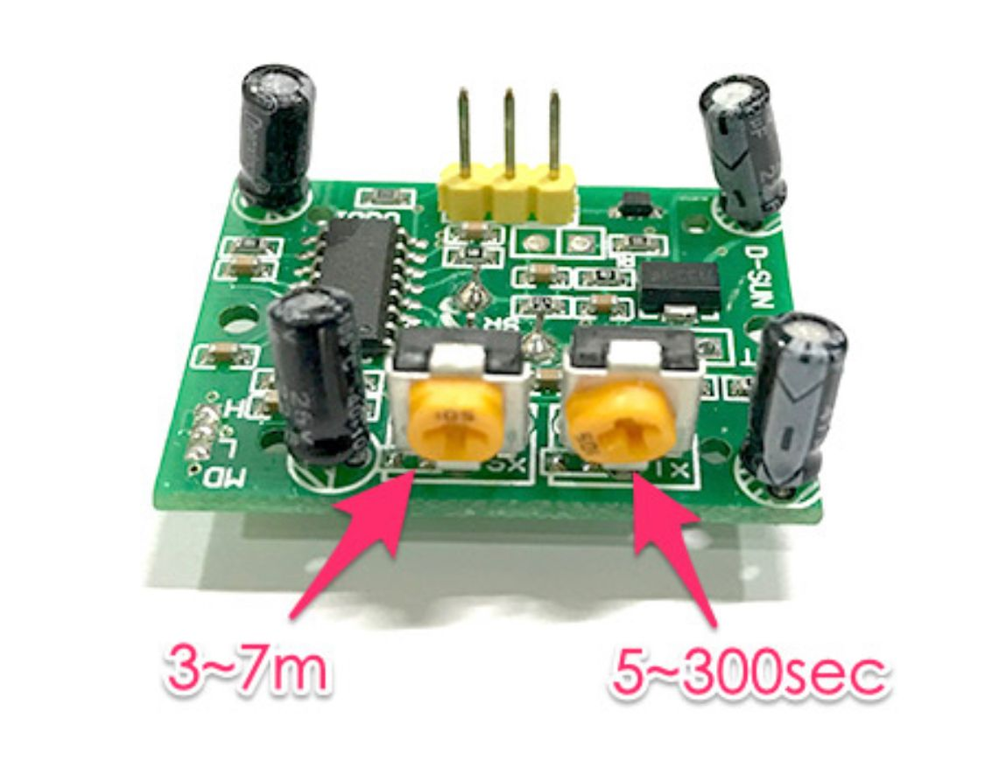
Motion Sensor
標示 SX ( Sensitivity ) 的旋鈕是偵測的靈敏度，靈敏度以偵測距離 ( high ) 計算，範圍 3~7 公尺，順時針旋轉靈敏度越高
標示 TX ( Time Delay ) 的旋鈕是偵測到訊號之後，下一次再繼續偵測的延遲時間，時間範圍是 5~300 秒，順時針旋轉延遲時間越長。
https://tutorials.webduino.io/zh-tw/docs/socket/sensor/pir.html
https://www.epitran.it/ebayDrive/datasheet/44.pdf

Slide 7
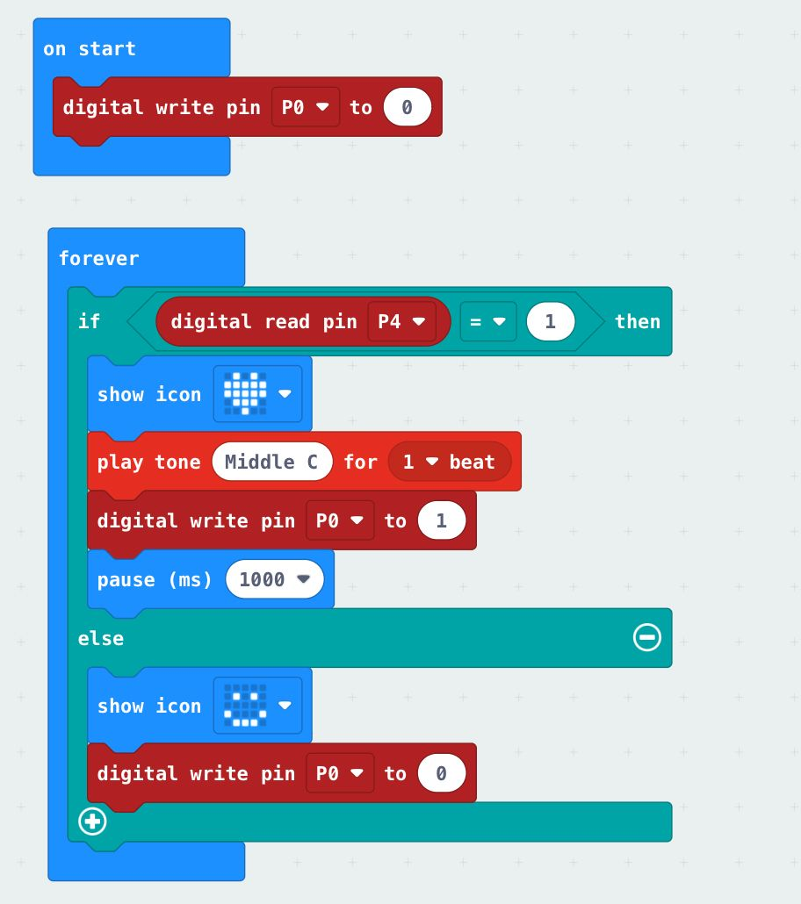
Micro:bit Code
Motion sensor with light bulb
https://makecode.microbit.org/_fa0907eAcRiK

