Slide 1
The Education University of Hong Kong
2022-2023 Quality Education Fund Thematic Network - Tertiary Institutes
STEM Project Team
SCHOOL: LCPS 荔枝角天主教小學
TOPIC: Water Temperature Sensor

Slide 2
Objectives
To measure the water temperature with Micro:bit.
To prevent the elderly from drinking water that is too hot.

Slide 3
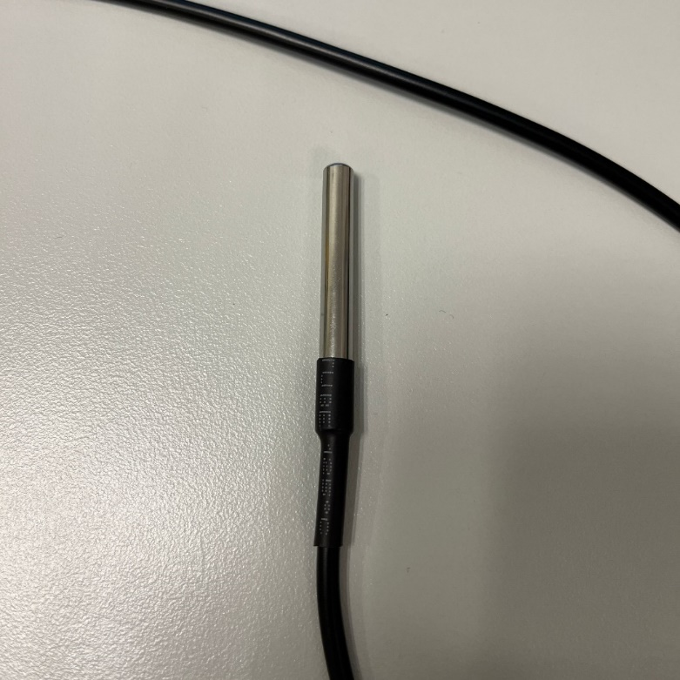
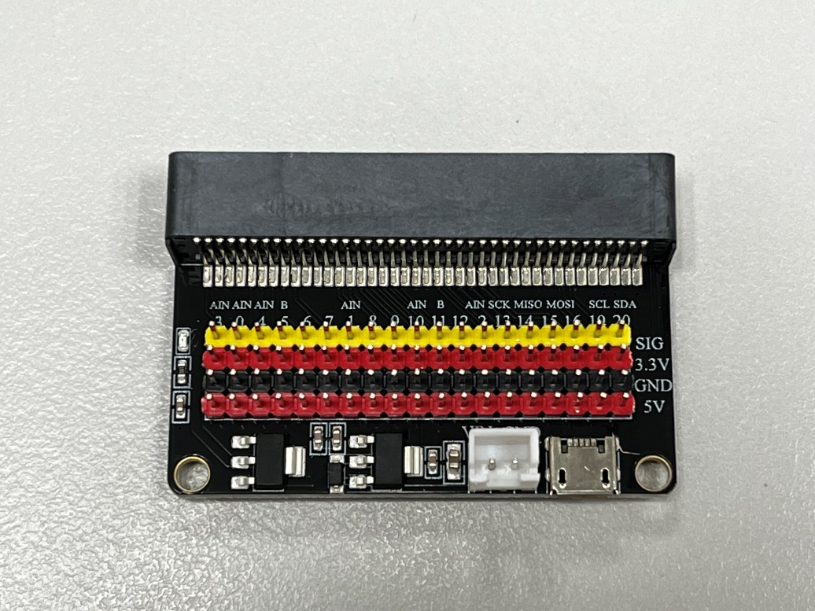
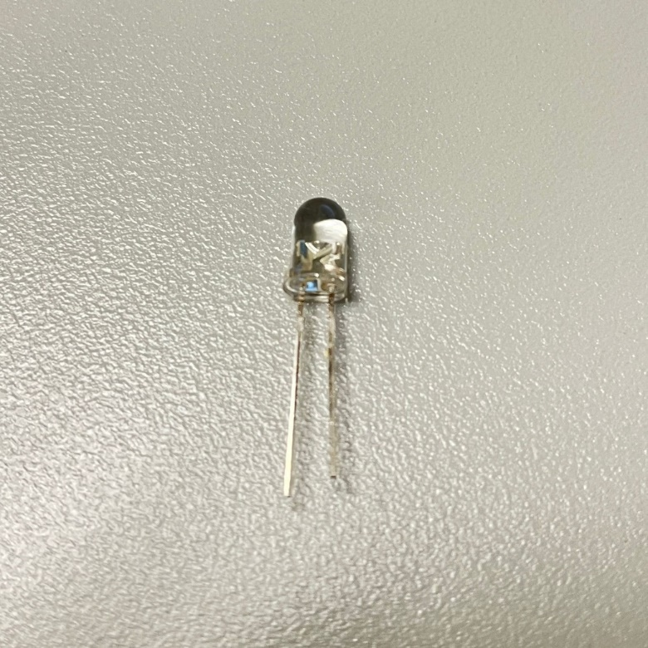
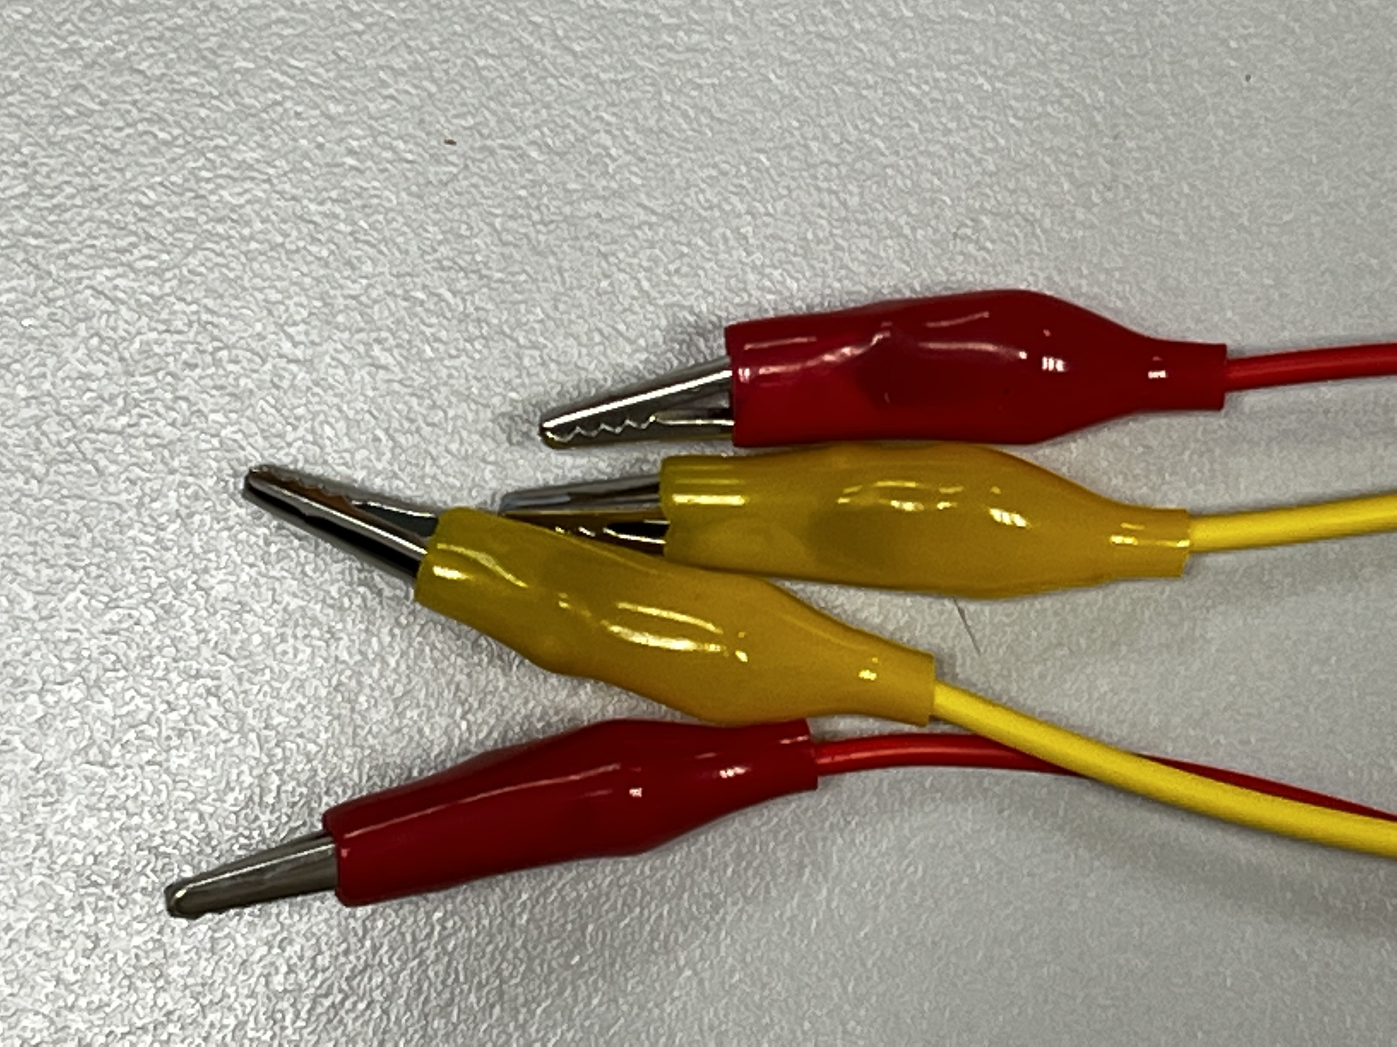
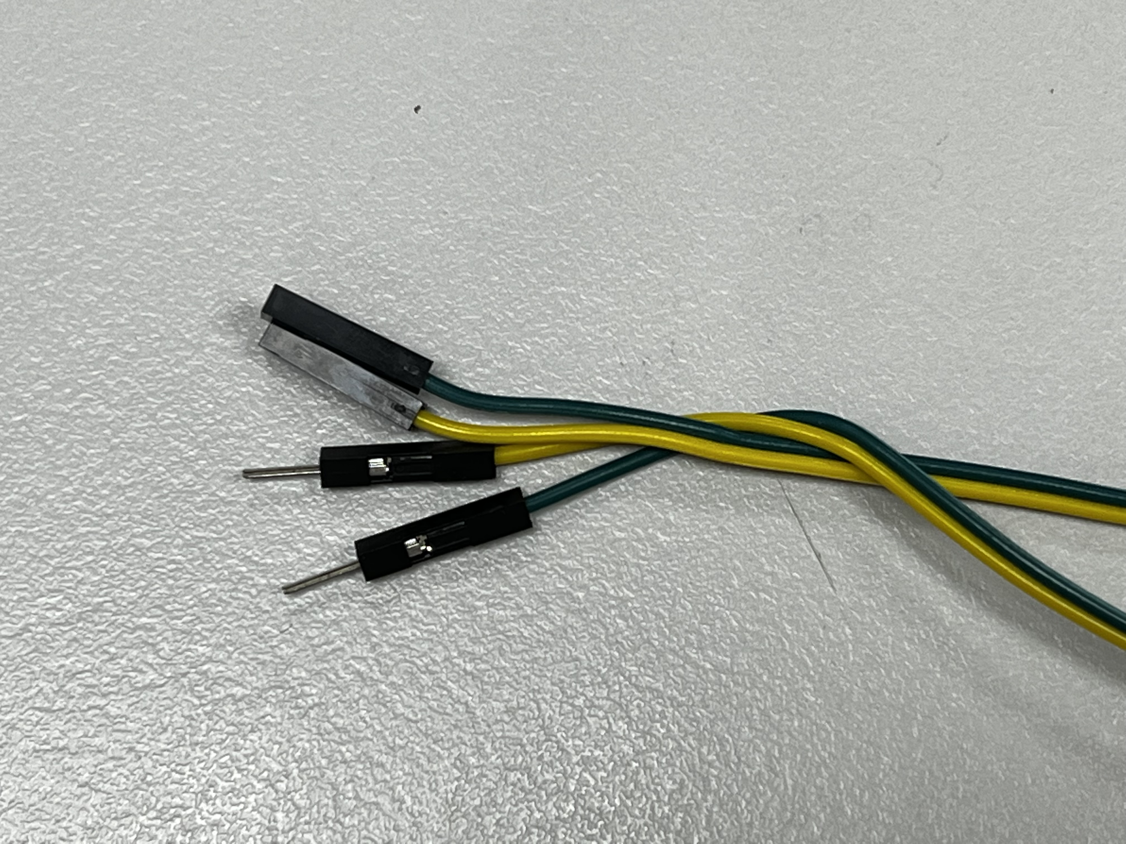
Materials
Water-proof Temperature Sensor
Micro:bit
Expansion board
LED light
Alligator clips
Dupont Jumper Cables

Slide 4
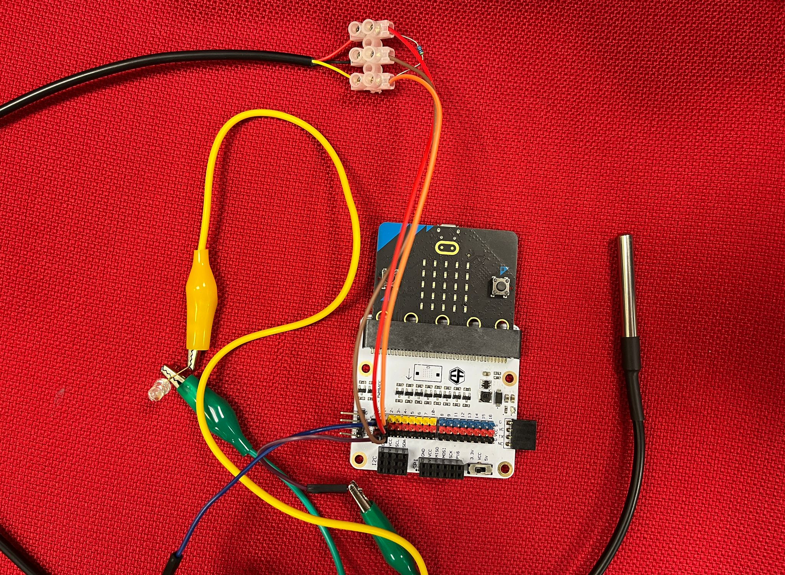
Set-up

Slide 5
Video

Slide 6
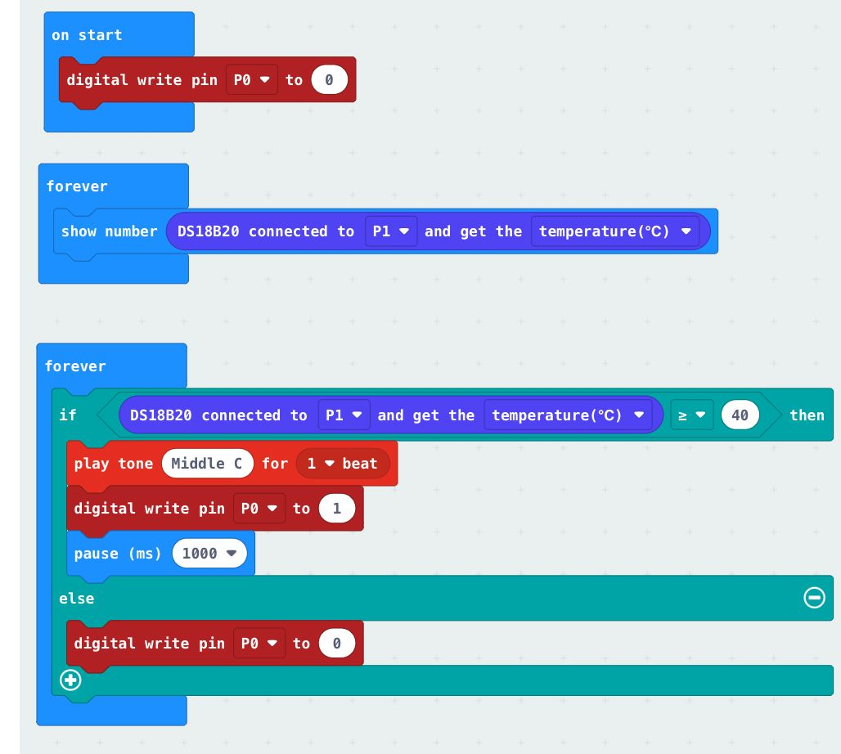
Micro:bit Code
https://makecode.microbit.org/_VXPRtrCCV8pf
Water-proof Temperature Sensor with light bulb

