Slide 1
The Education University of Hong Kong
2022-2023 Quality Education Fund Thematic Network - Tertiary Institutes
STEM Project Team
SCHOOL: Sha Tin Methodist Primary School (P.3)
TOPIC: Cold Insulation Test

Slide 2
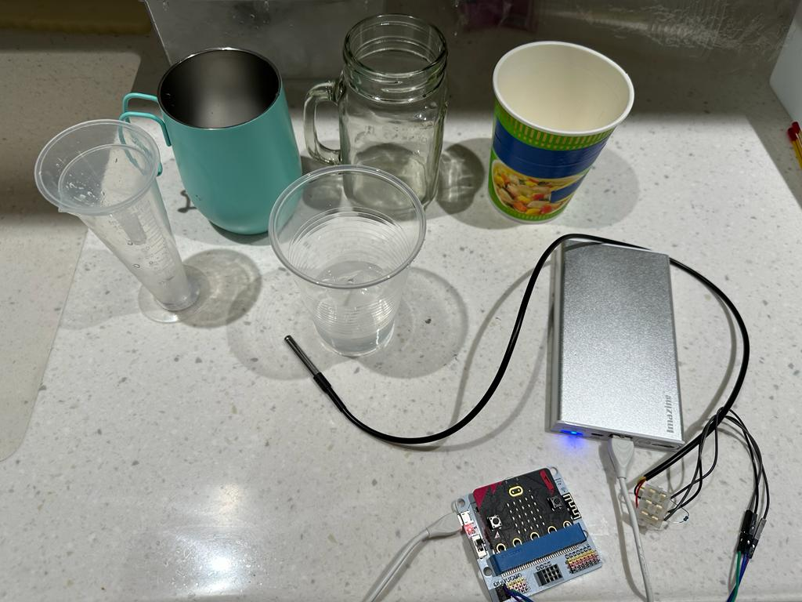
Experiment 1-Temperature test

Slide 3
Objective of Experiment
Use Micro:bit and DS18B20 temperature sensor to test which material is most suitable for cold insulation.
Notes:
Cold Insulation

Slide 4
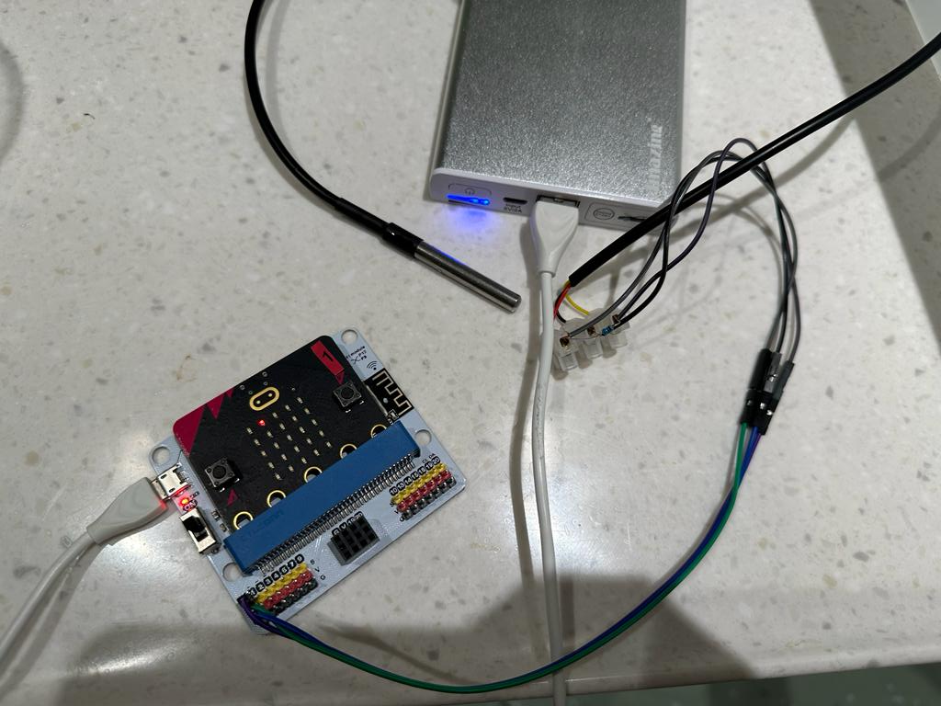
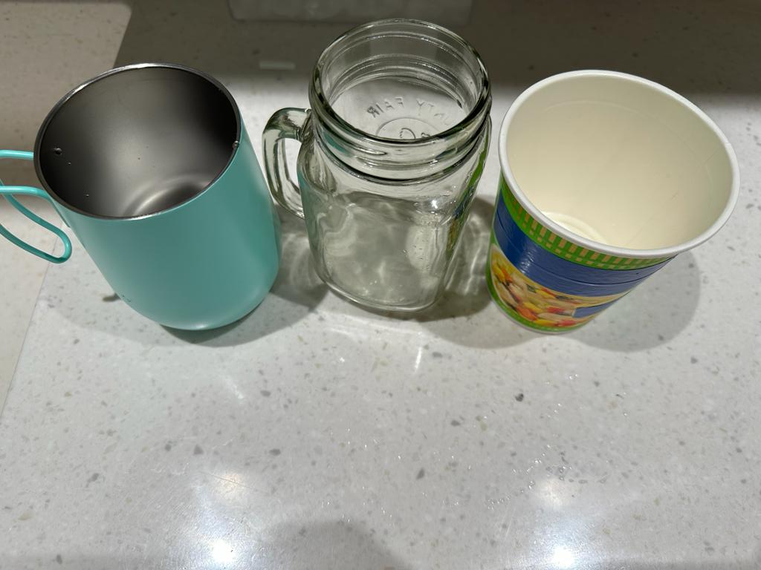
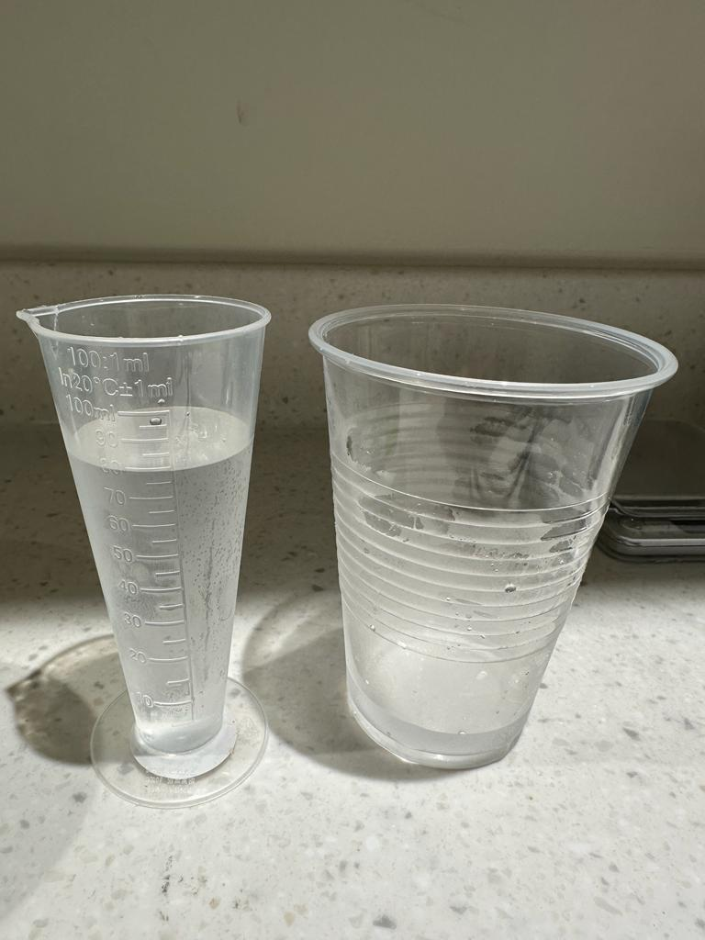
Experiment material
Micro:bit, IoT board and DS18B20 temperature sensor
Stainless Steel Cup, Glass Cup and Styrofoam Cup
Measuring cup and Cold water
Notes:
turbidimeter

Slide 5
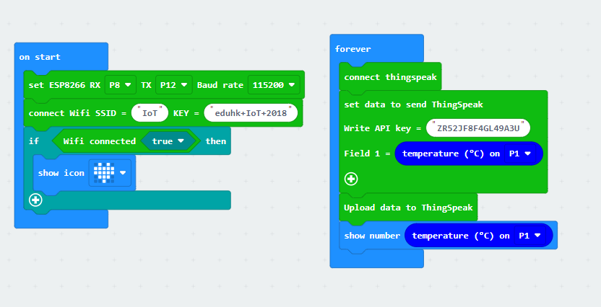
Coding

Slide 6
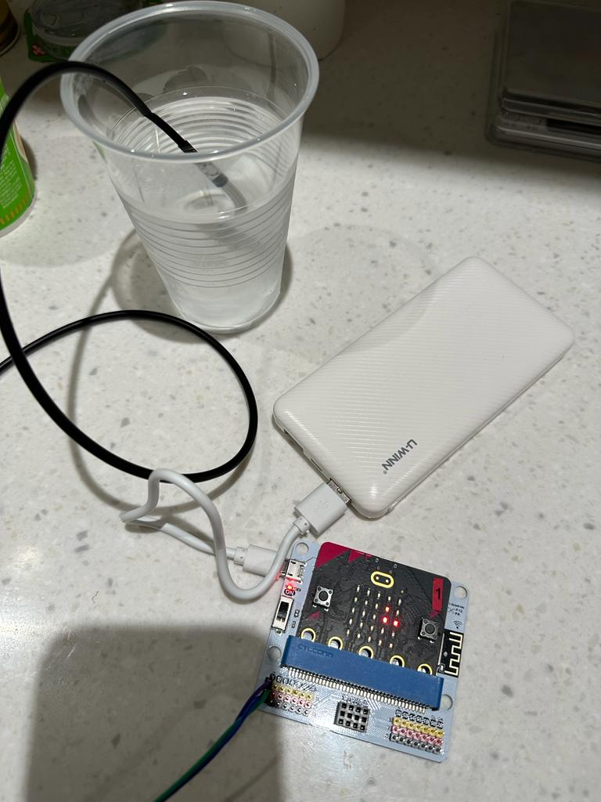
Experiment
Temperature of the cold water: 5°C
Pour one glass of 5°C water into three different materials of cups equally. After ten minutes, pour the water out and measure the temperature change.

Slide 7
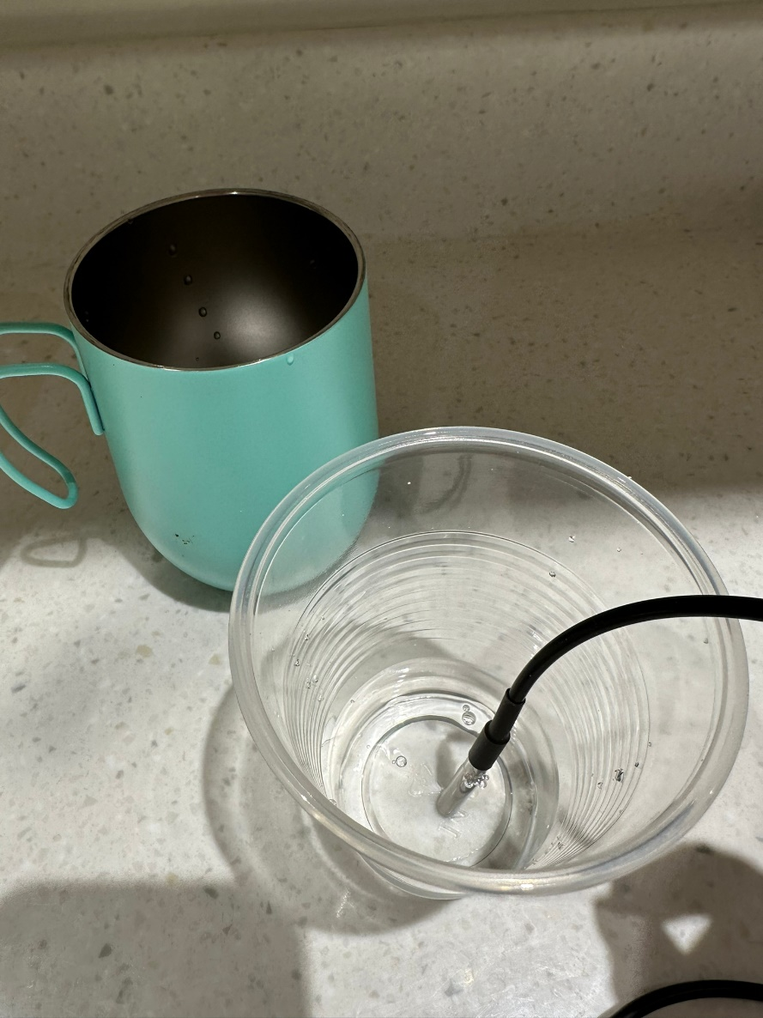
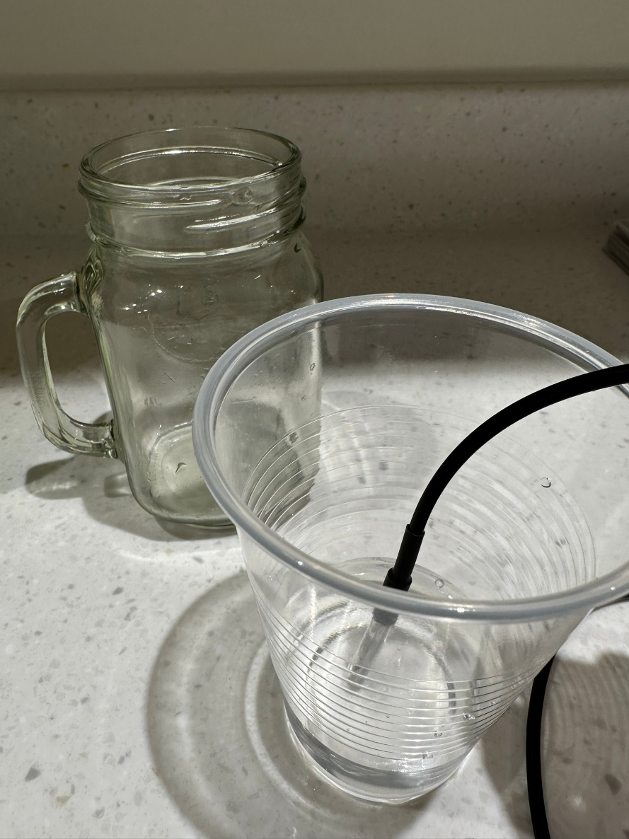
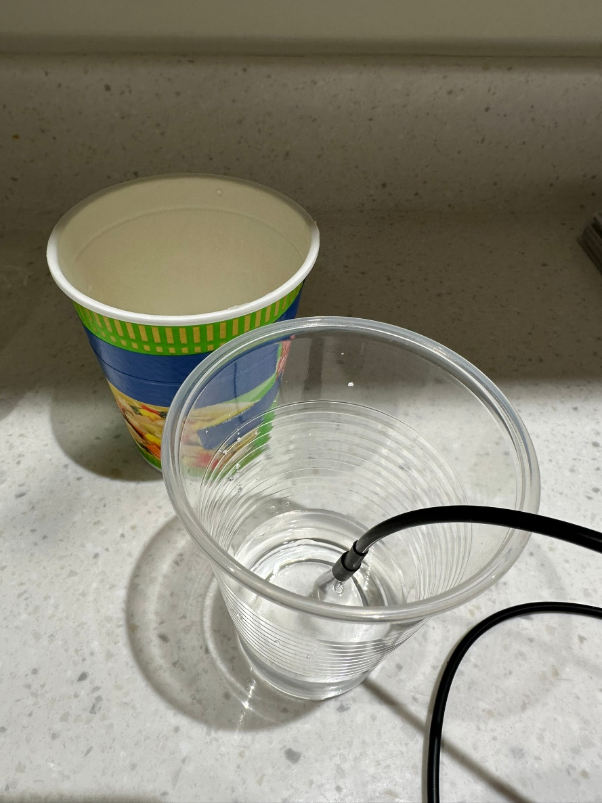
Experiment
10 minutes later……
Water insulated with:
Stainless Steel Cup: 9.38°C
Glass Cup: 13.31°C
Styrofoam Cup: 11.25°C

Slide 8
Result
Temperature of the original cold water: 5°C
Water insulated with: | Temperature changed after 10 minutes:
Styrofoam Cup | 9.38°C
Stainless Steel Cup | 11.25°C
Glass Cup | 13.31°C

Slide 9
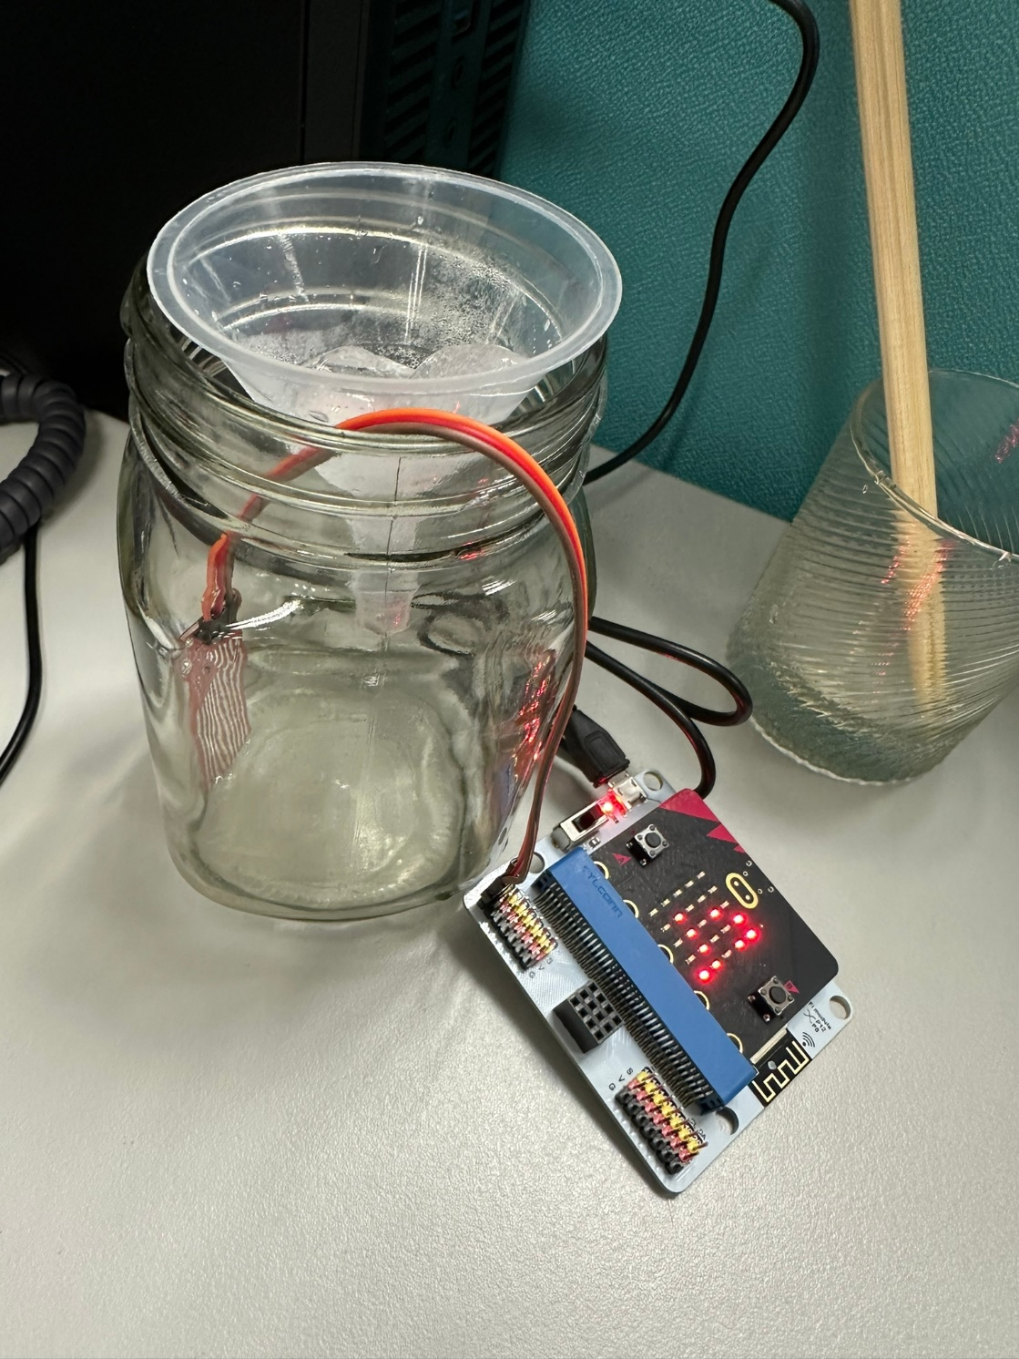
Experiment 2-Water Level Test
- with water sensor
Put the ice in the room about 10 minutes and measure the water level of melted ice.

Slide 10
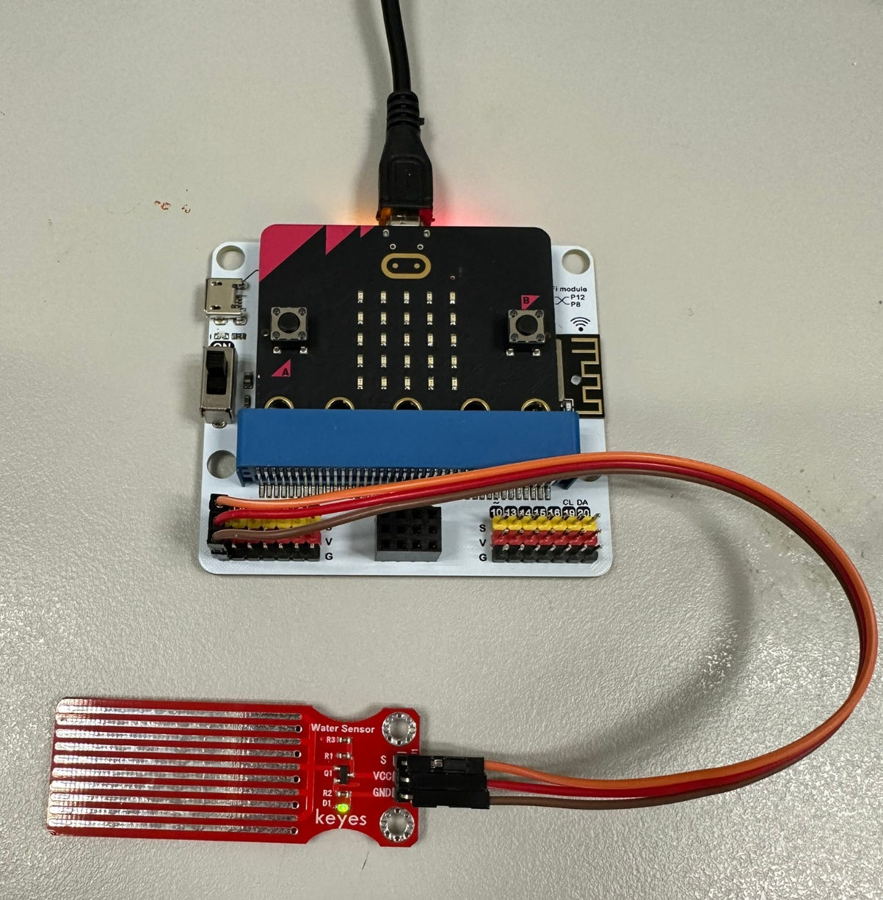
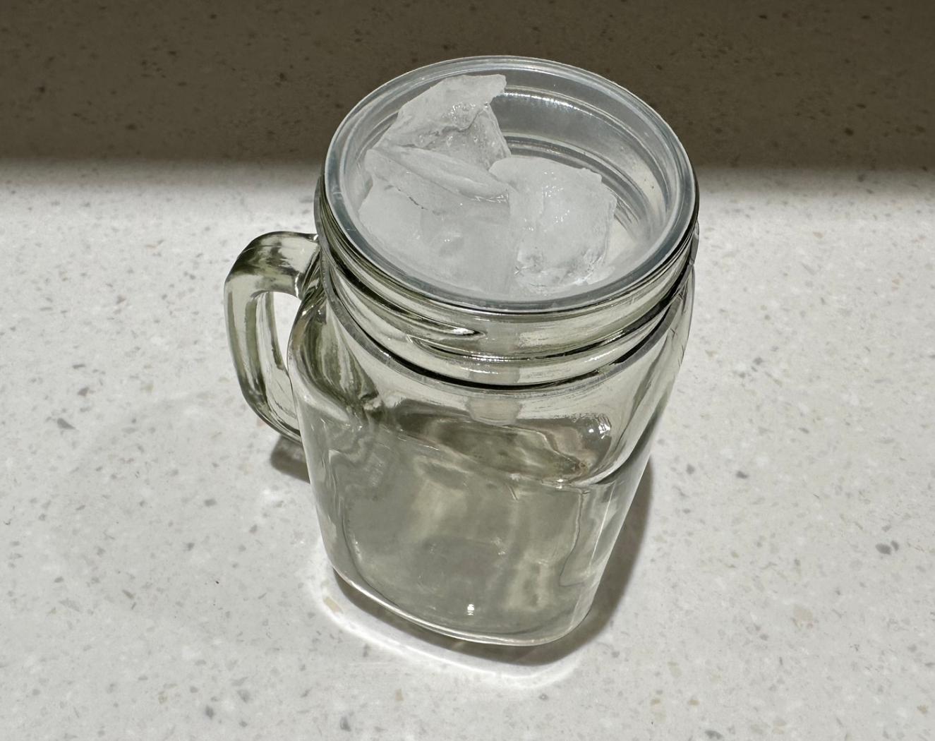
Experiment material
Micro:bit, IoT board and water sensor
Ice, funnel and cup

Slide 11
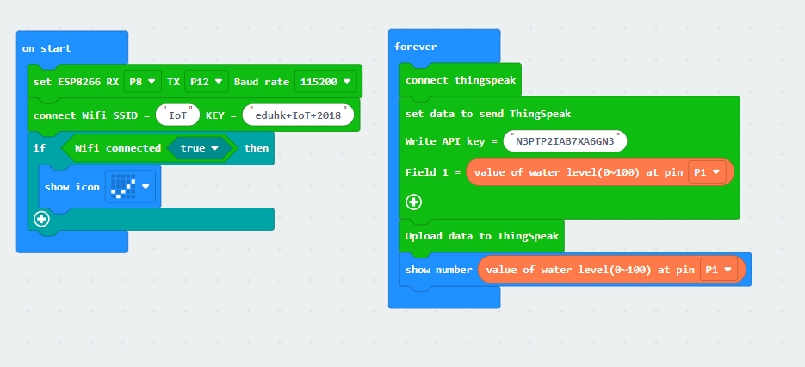
Coding
-Water Level Sensor with IoT

Slide 12
Limitation
The measuring range of the sensor is not wide enough for this experiment because each sample of ice is too small.
The data would be distracted, such as some water drop on the top of the sensor.
The angle of the sensor need to be 90°.
The cup body needs to be the same width.

Slide 13
Test for the Water Sensor
Water Level | Reading
10ml | 36
20ml | 49 (+13)
30ml | 52 (+3)
40ml | 54 (+2)
50ml | 75 (+21)
70ml | 74 (-1)
90ml | 76 (+2)
110ml | 77 (+1)
130ml | 78 (+1)
150ml (full) | 78 (+0)
Notes:
*not that accurate

Slide 14
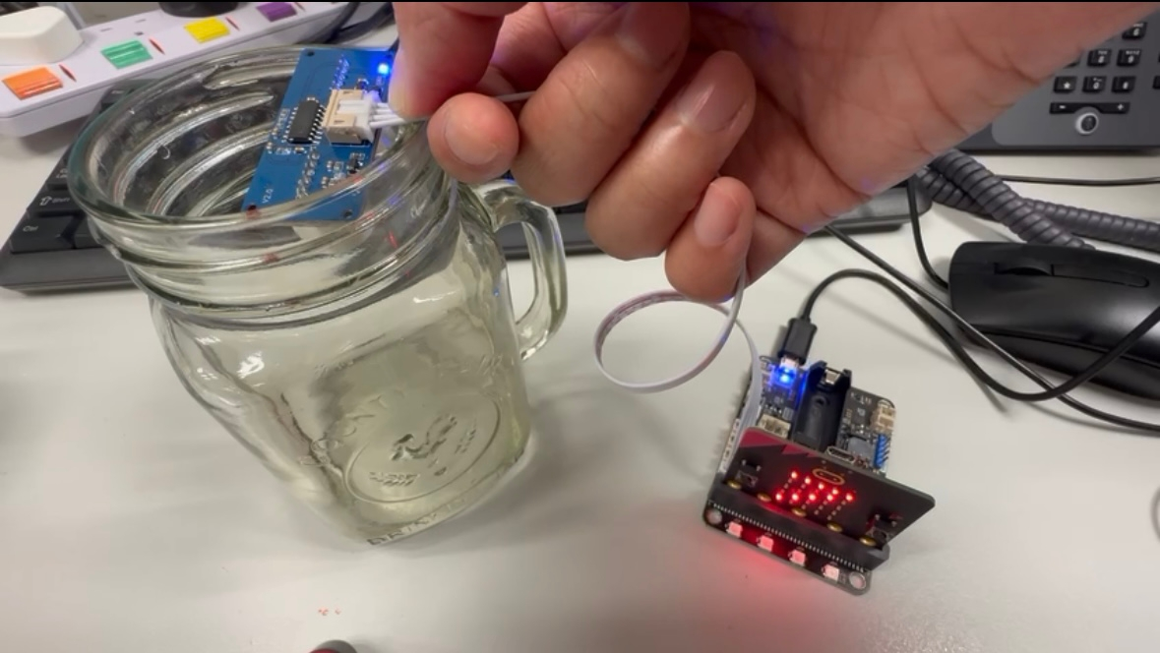
Experiment 3-Water Level Test
- with ultrasonic sensor

Slide 15
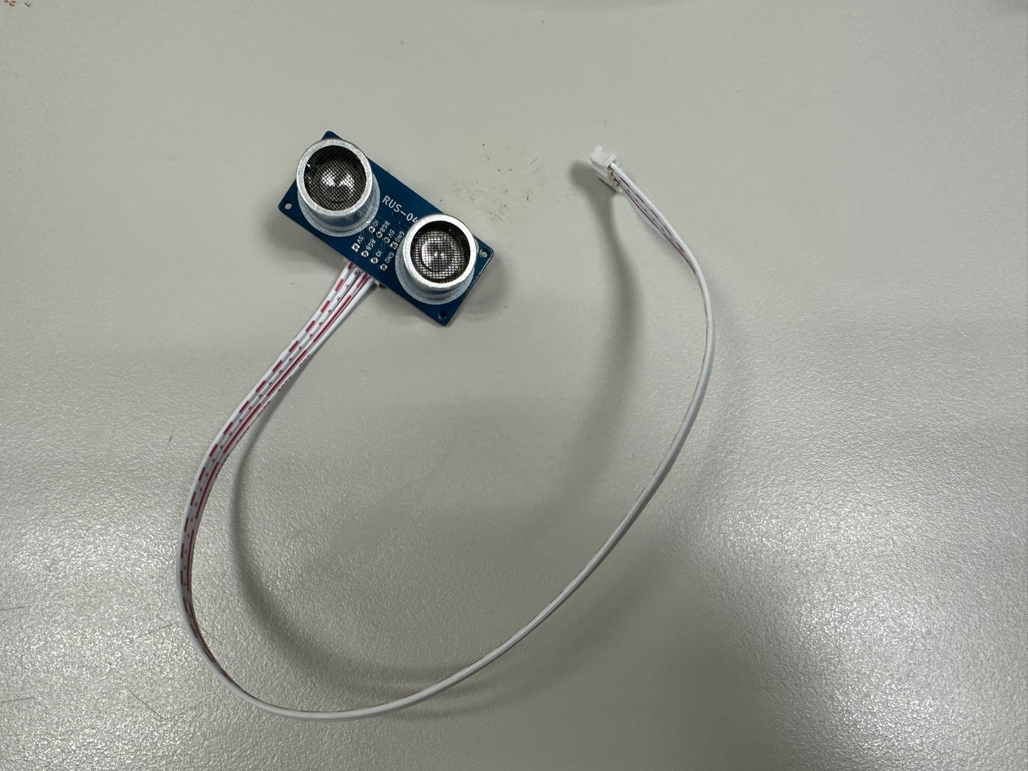
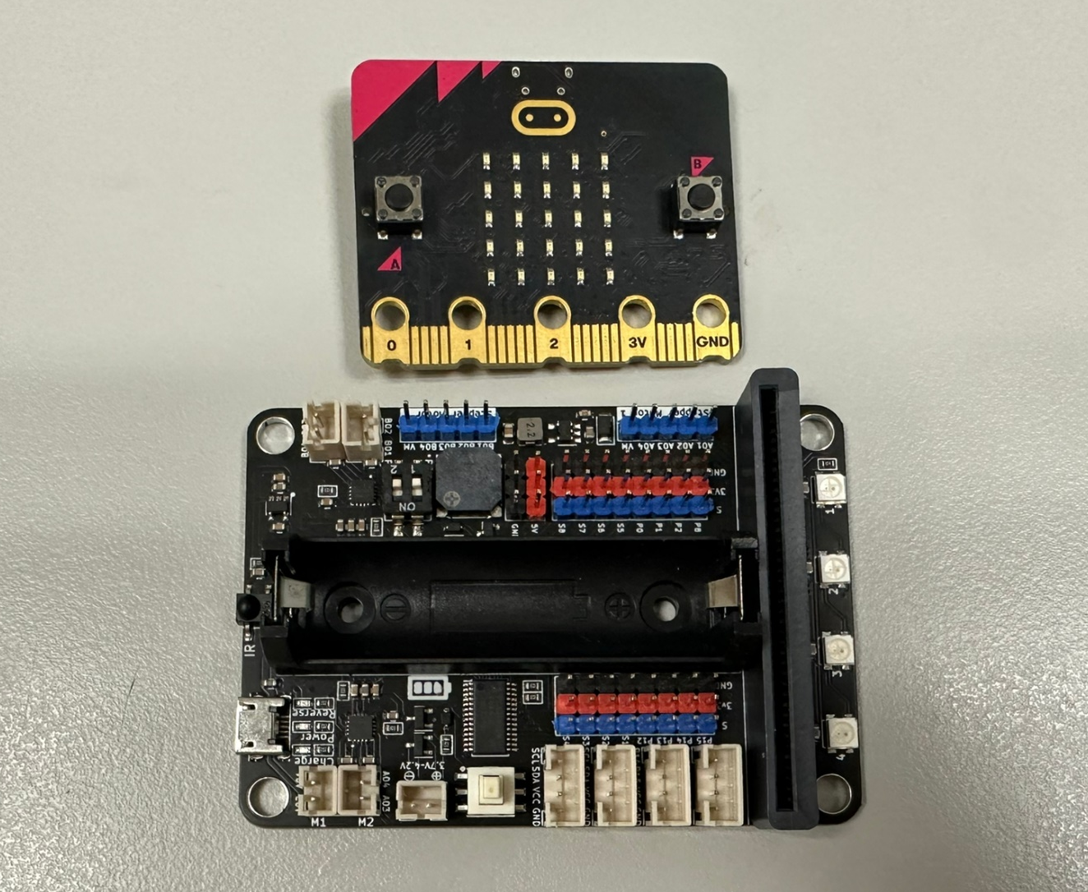
Experiment material
Micro:bit and motor:bit
Ultrasonic Sensor

Slide 16
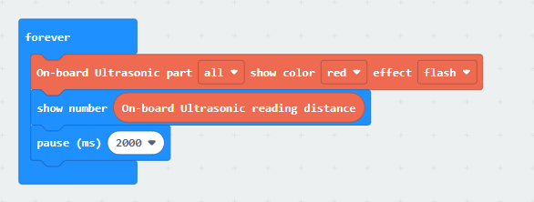
Coding
-Ultrasonic Sensor

Slide 17
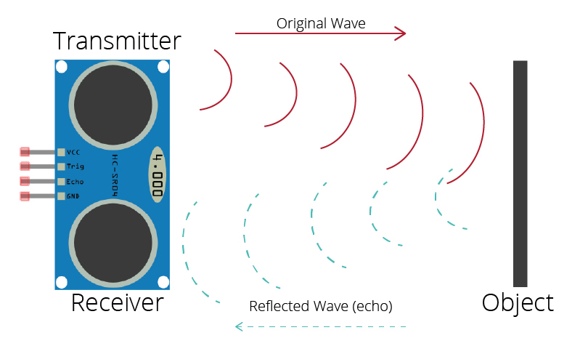
Limitation
The sensor may affected by the other objects, it is not only reflect the distance between the sensor and water level, so the data is not accurate.
Reference: Random Nerd Tutorials
Notes:
https://randomnerdtutorials.com/complete-guide-for-ultrasonic-sensor-hc-sr04/

Slide 18
Test for the Ultrasonic Sensor
Water Level | Reading
10ml | 16
20ml | 17
30ml | 17
40ml | 15
50ml | 17

