Slide 1
The Education University of Hong Kong
2022-2023 Quality Education Fund Thematic Network - Tertiary Institutes
STEM Project Team
SCHOOL: S.K.H. Leung Kwai Yee Secondary School
TOPIC: Mosquito Trap

Slide 2
Topic - 1
Utilizing the living nature of mosquito to attract them to come into the trap which will be settled in three places with different containers, like sugar water, acid-base solution and soap-suds.
The amounts of mosquito will largely different where in biological garden and playground or the back of the canteen, which shows environment effects.

Slide 3
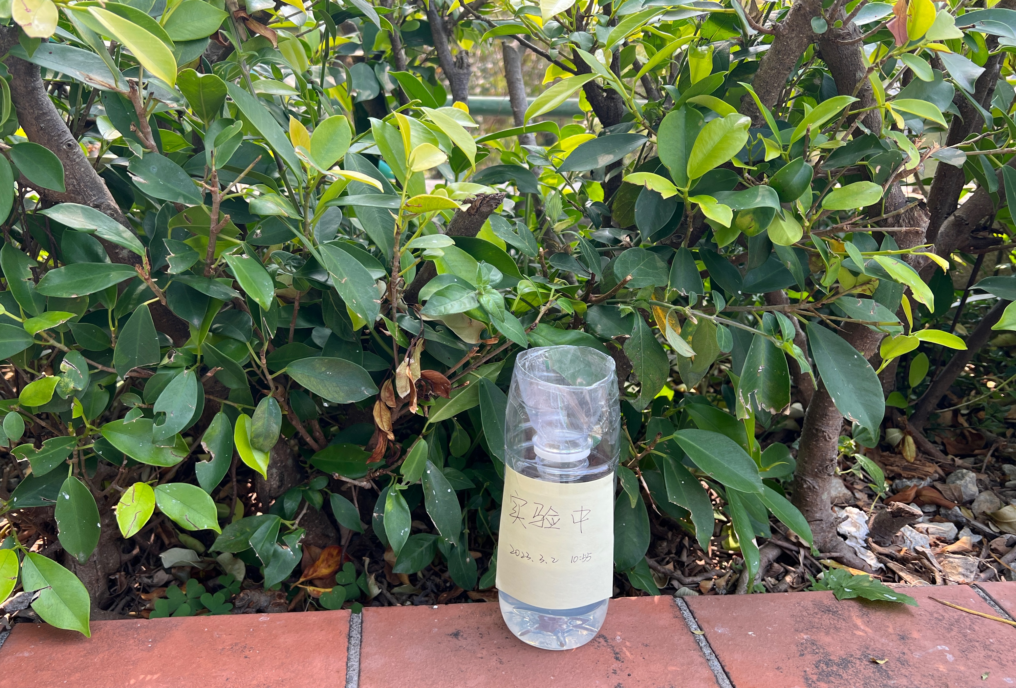
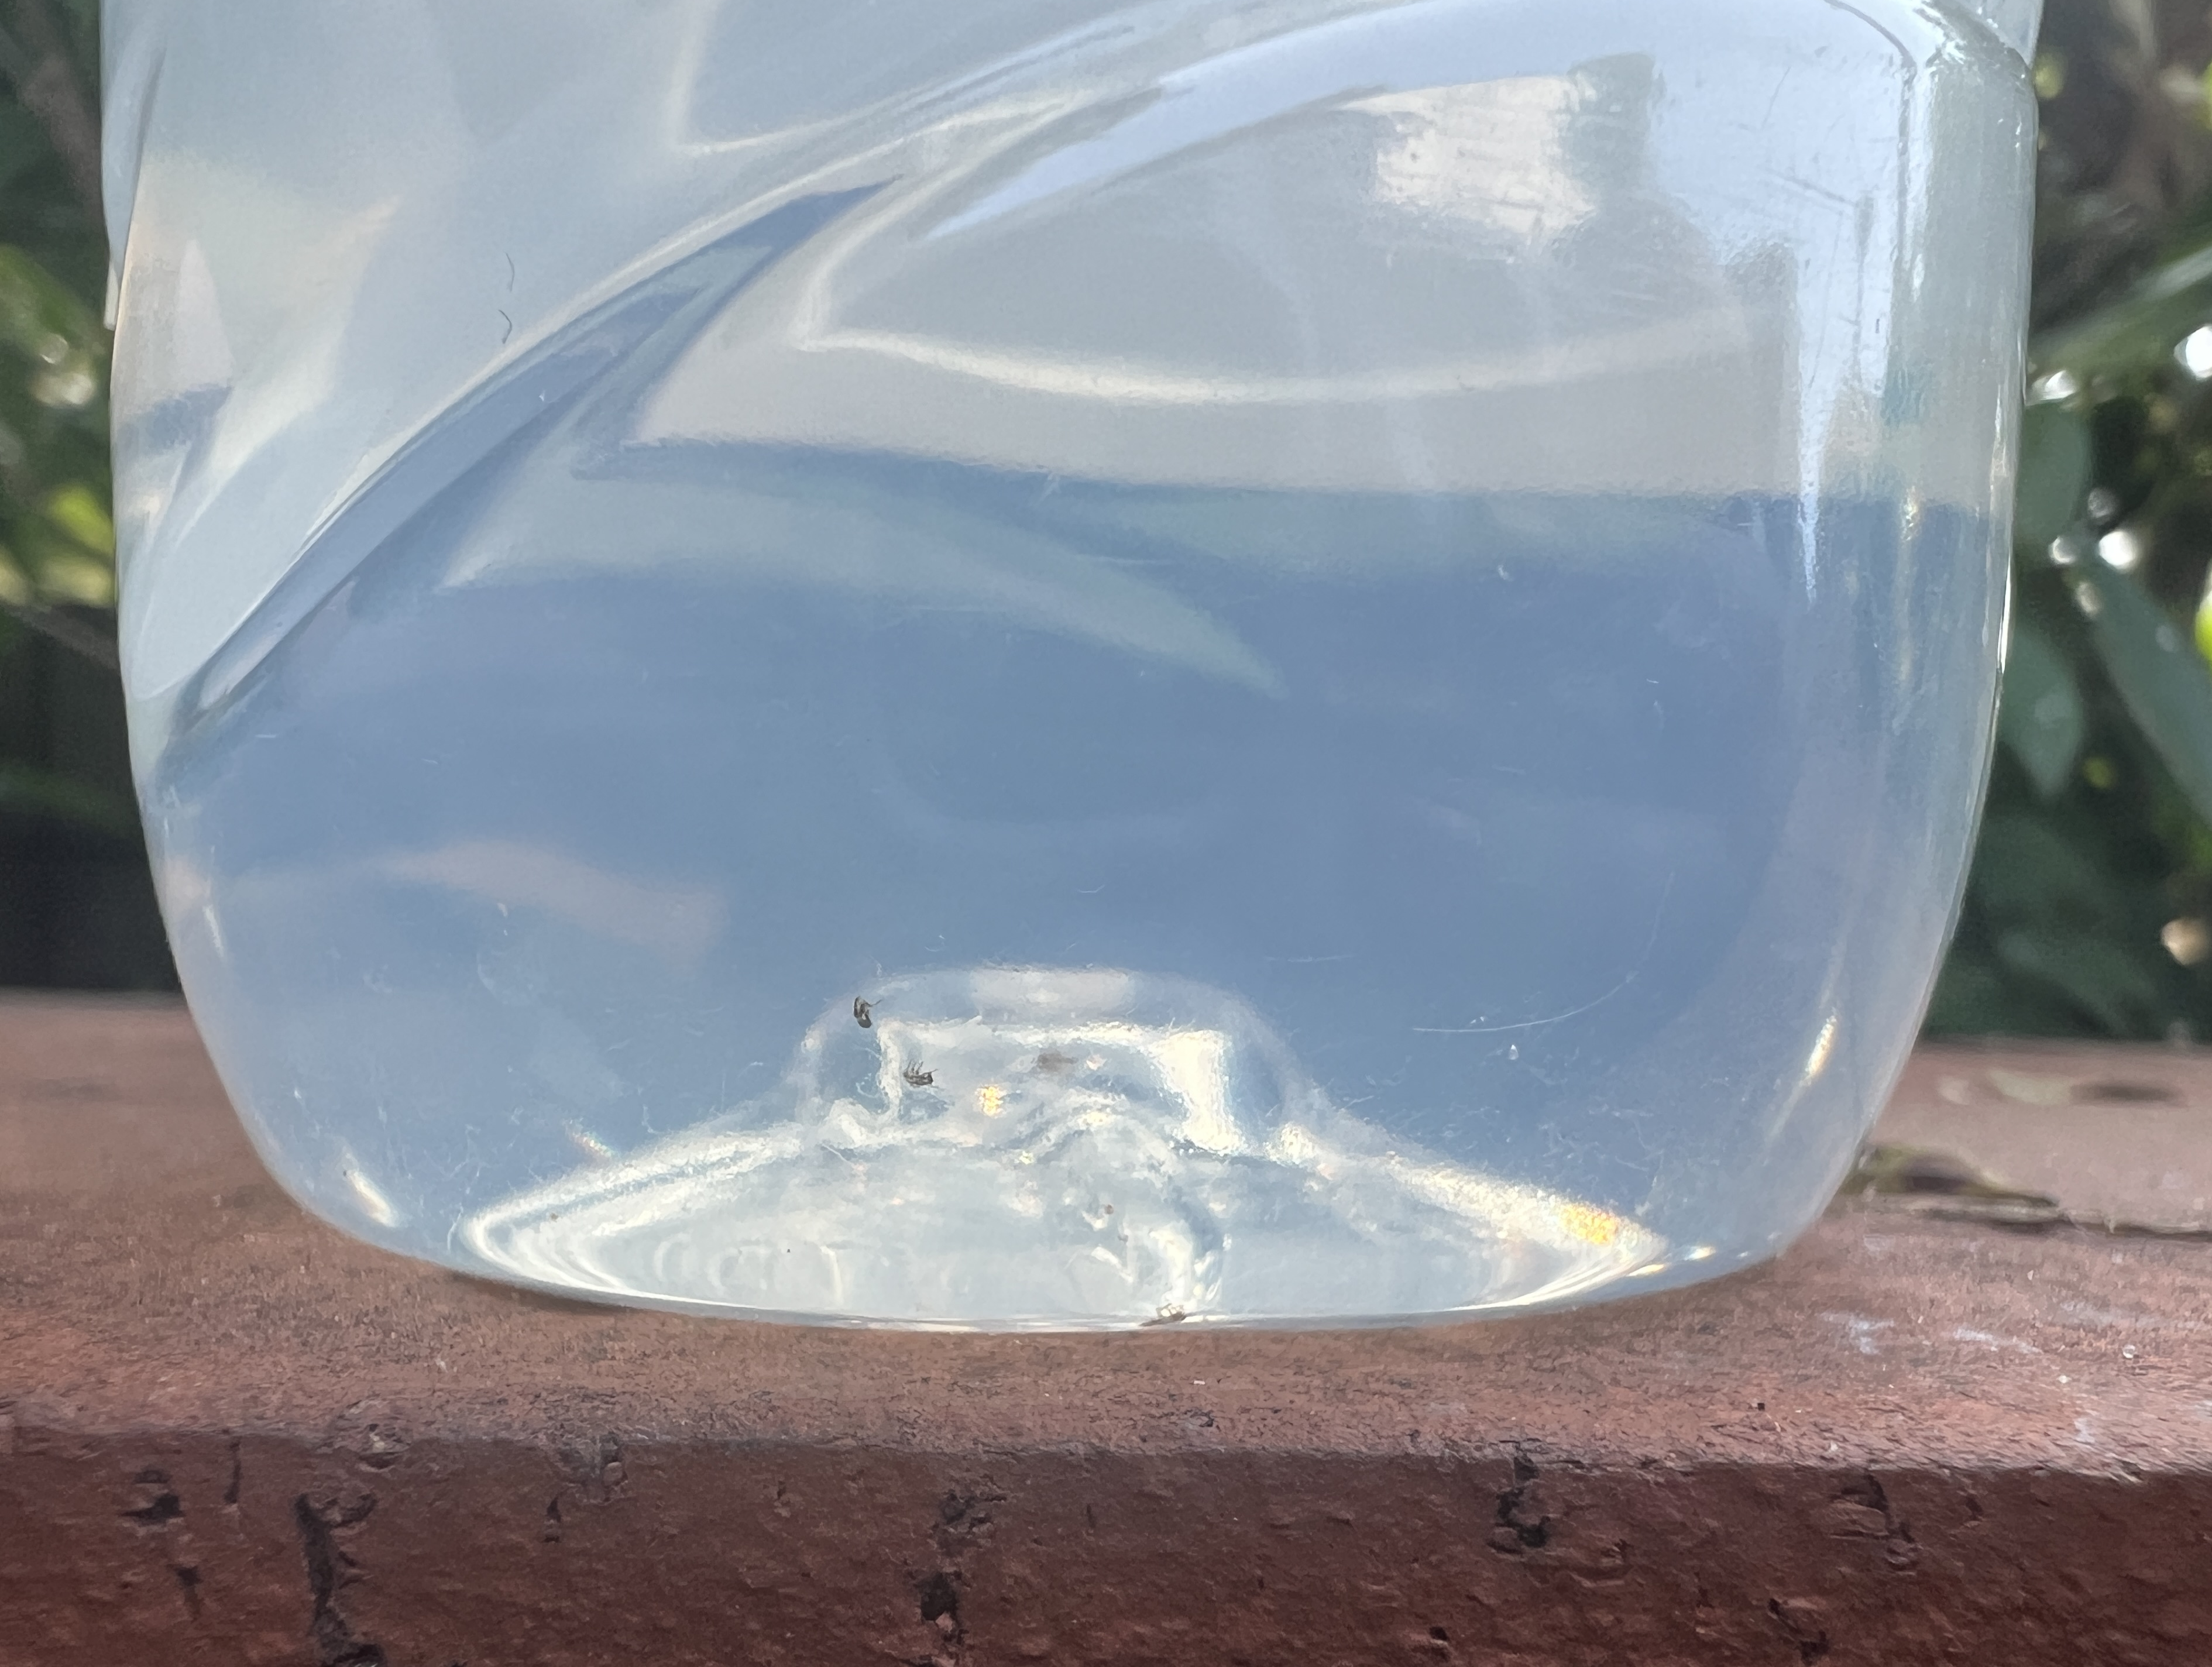
Experiment - 1

Slide 4
Result - 1
10 different kinds of larva, but only one mosquito larva.
The trap still put in the same place for one more week, and there is no better result in this condition.

Slide 5
Topic - 2
Based on the experiment 1, added one fan as another factor to attract mosquito.
Settled in biological garden where has a mass of mosquito.

Slide 6
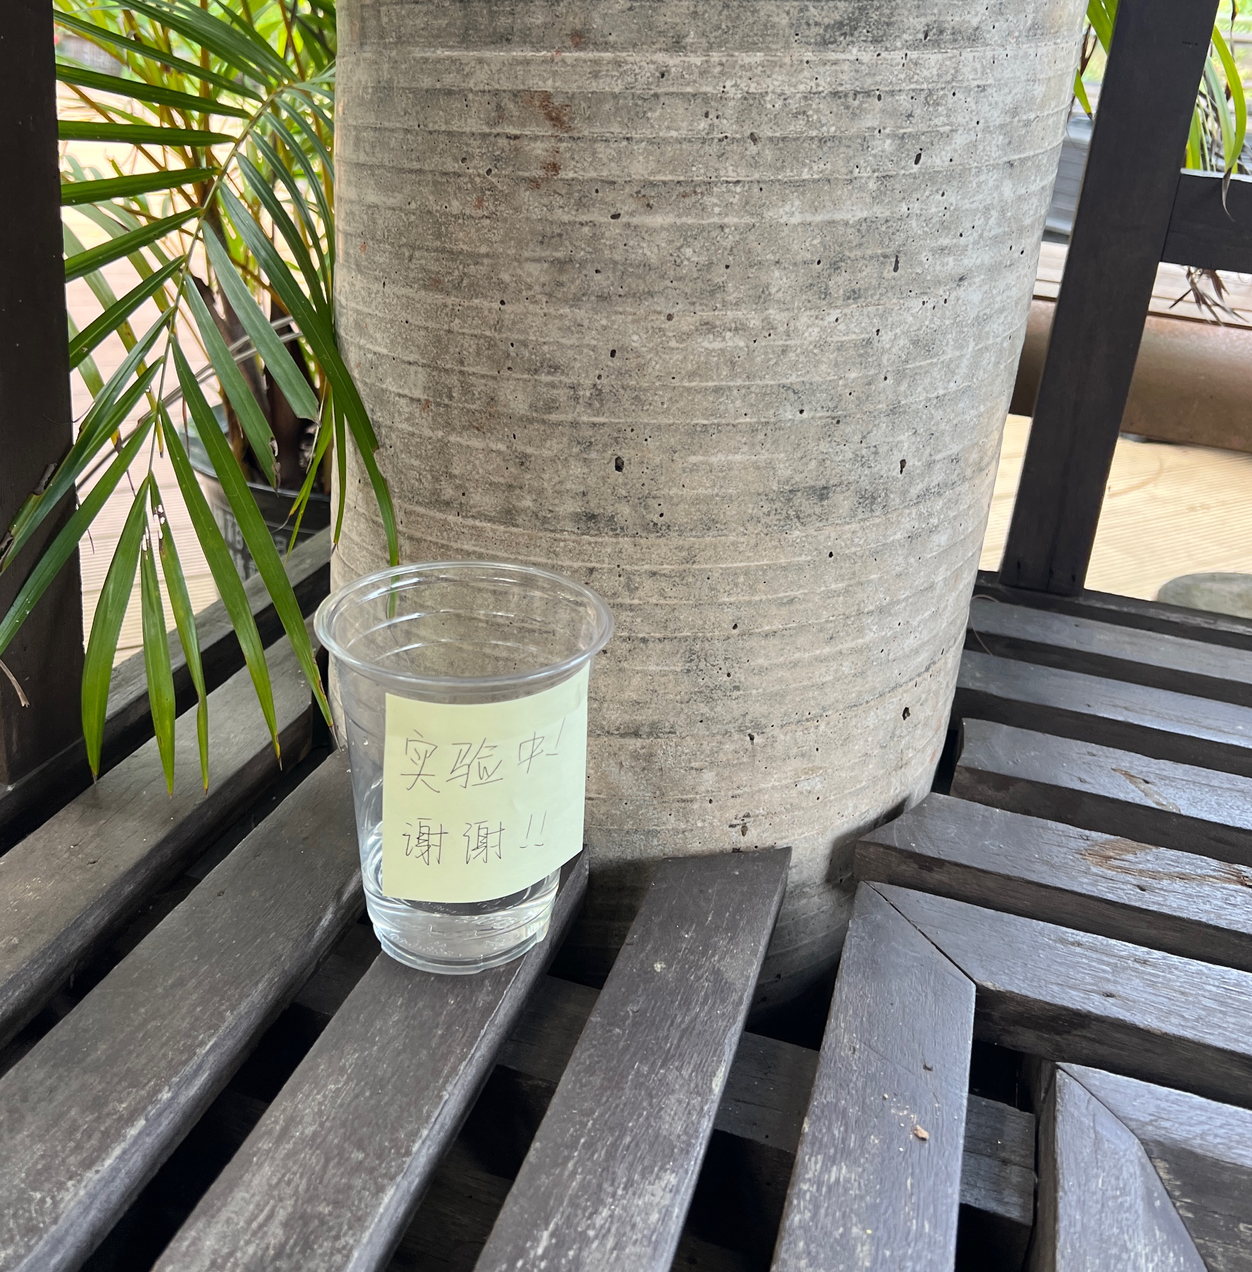
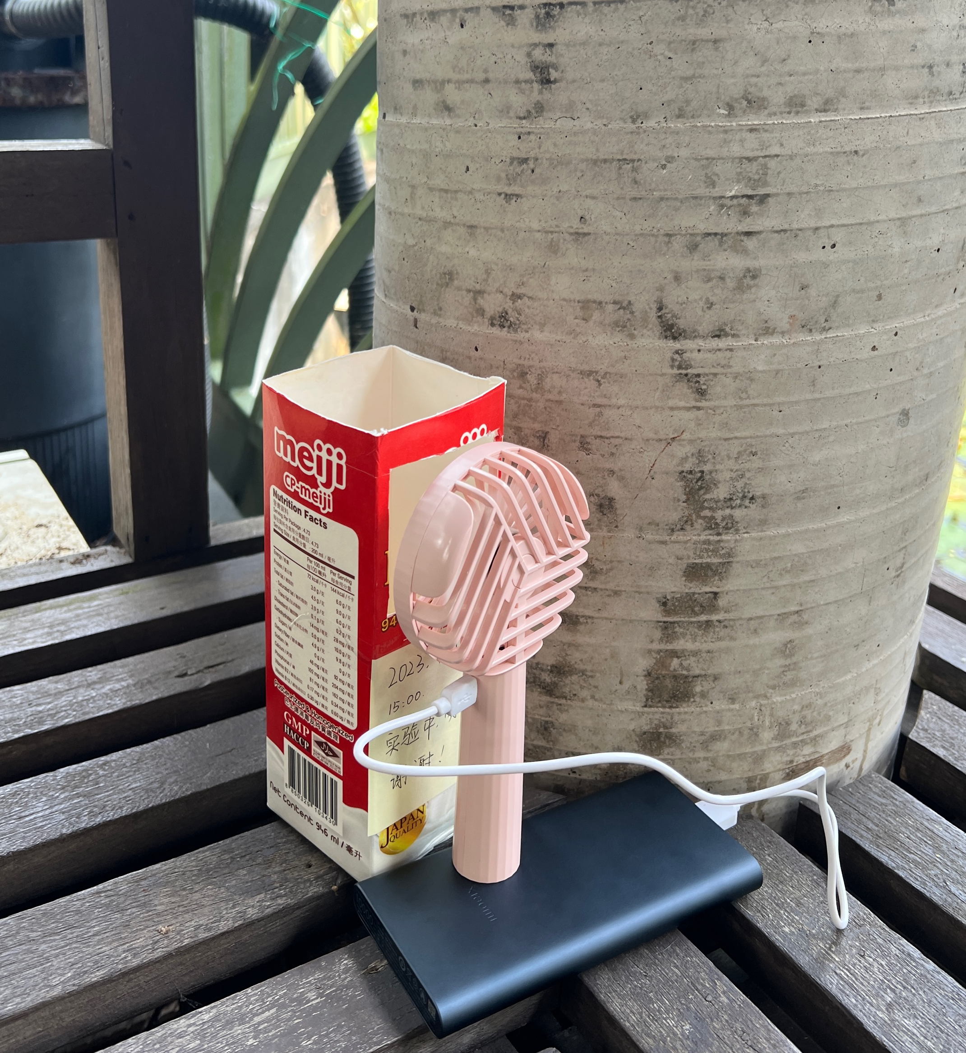
Experiment - 2

Slide 7
Experiment - 2

Slide 8
Result - 2
Pellucid Cup | Milk Cup | Fan
1 | 6-10 | 6
Conclusion:
The sugar water not so attractive for mosquito in this high concentration environment.
Power Bank | Time
10000mAh | around 15 hours
Power Bank:
The power bank continually work for around 15 hours until it out of battery.

Slide 9
Topic - 3
The service life of power bank with fan different in sizes and specified voltage
Power line connections with 2.54 wires
Using plastic strips to lose wire from breaking

Slide 10
Materials
USB Transportation
Voltage Regulator
升壓線
Plastic trips to lose and control

Slide 11
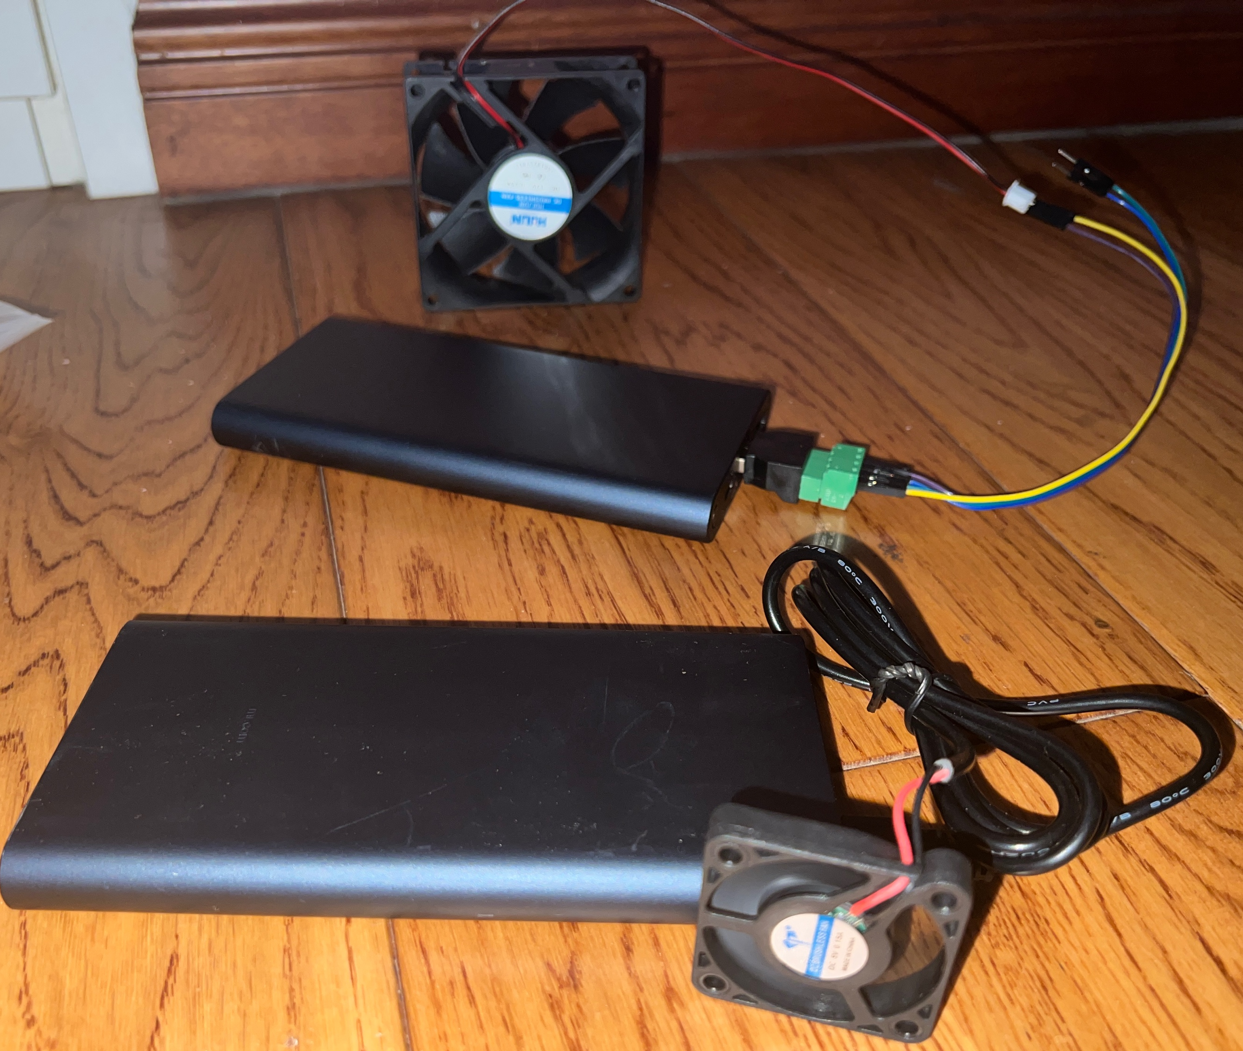
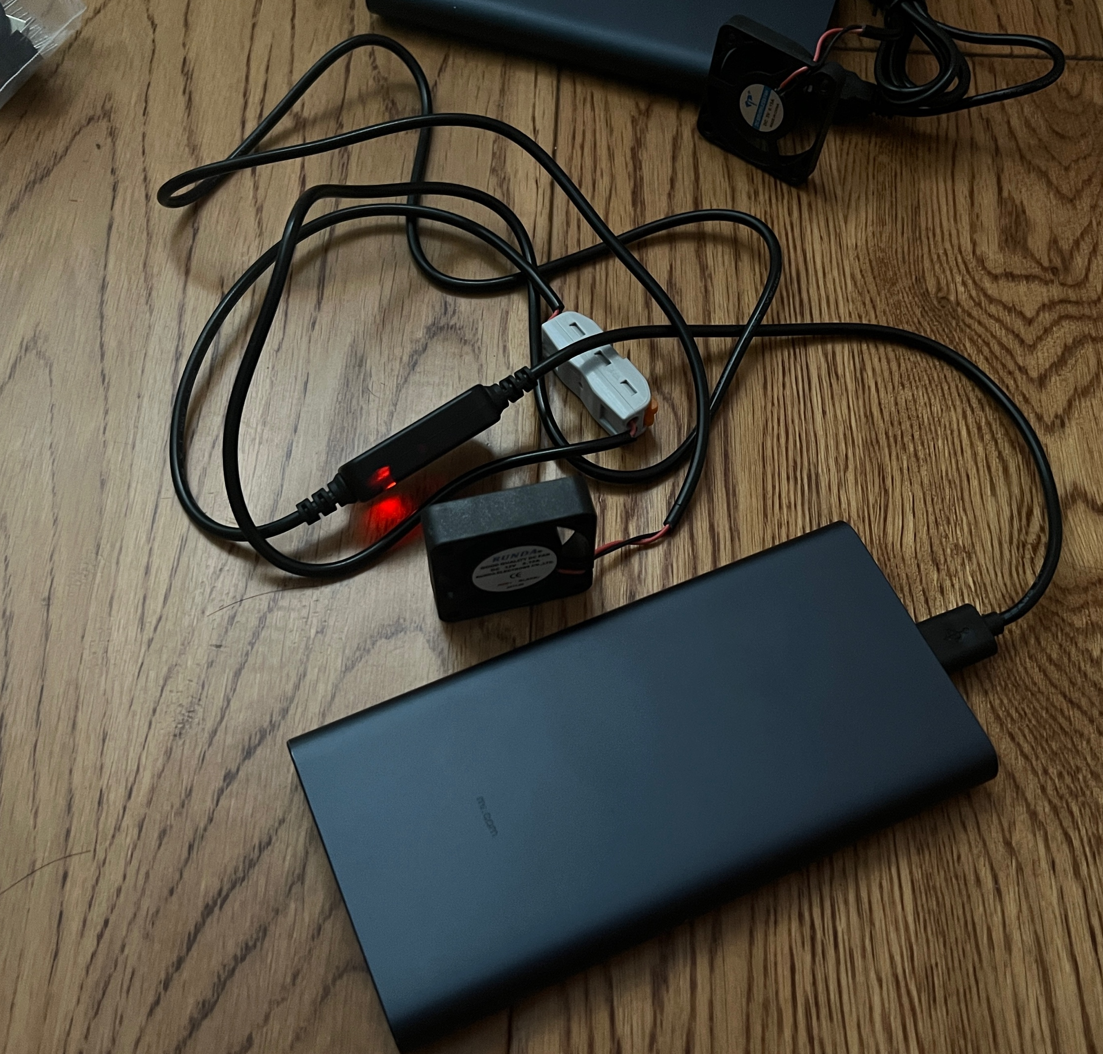
Experiment - 3
2.54 wires

Slide 12
Result - 2
Output Voltage | Fans Voltage | Sizes | Power life (10000mAh)
5v | 5v | 4cm*4cm | 10-15 seconds
5v | 12v | 4cm*4cm | 10-15 seconds / 90mins for one time
5v | 12v | 8cm*8cm | 10-15 seconds
12v | 12v | 4cm*4cm | 72 hours

